Slide 2
Skyjack proudly provides companies with quality-engineered, simple and reliable access and material handling equipment globally so they can maximize utilization and their return on investment.

Slide 3


Slide 4
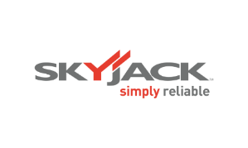
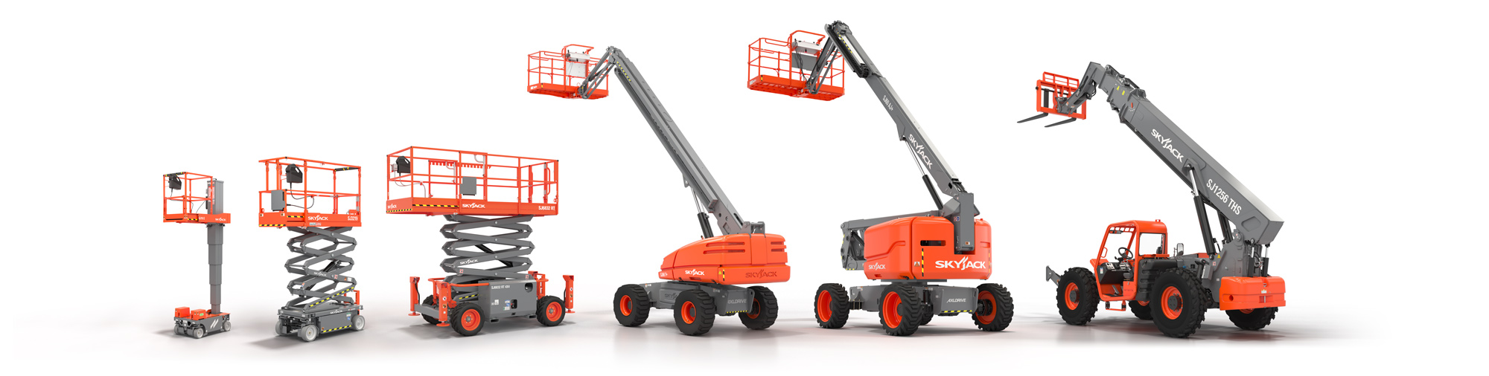
Simple, reliable products

Slide 5

Industry-leading ROI

Slide 6

  competitive initial cost

Slide 7

  minimal operating cost

Slide 8



Maximized residual value

Slide 9
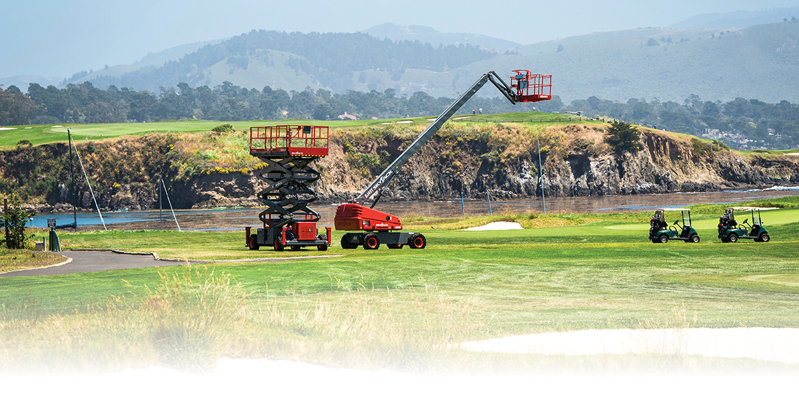
Easy to do business with

Slide 10
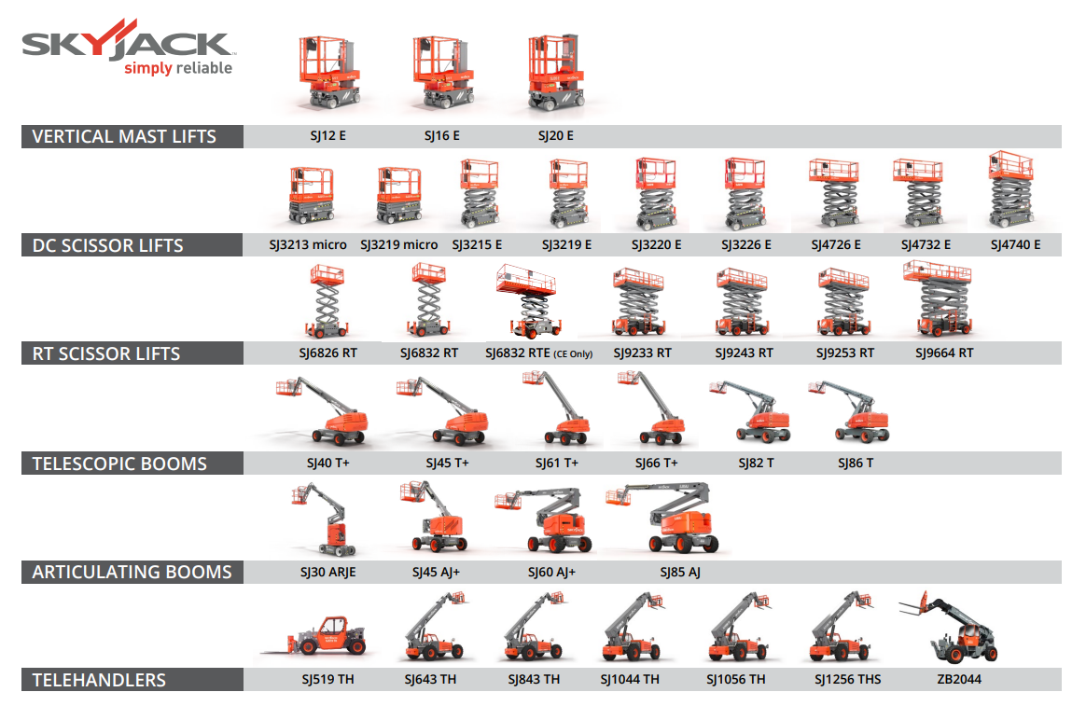

Slide 11
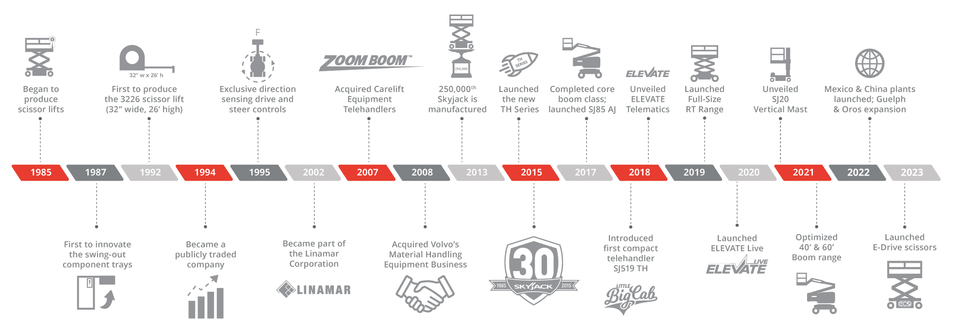
Milestones

Slide 12
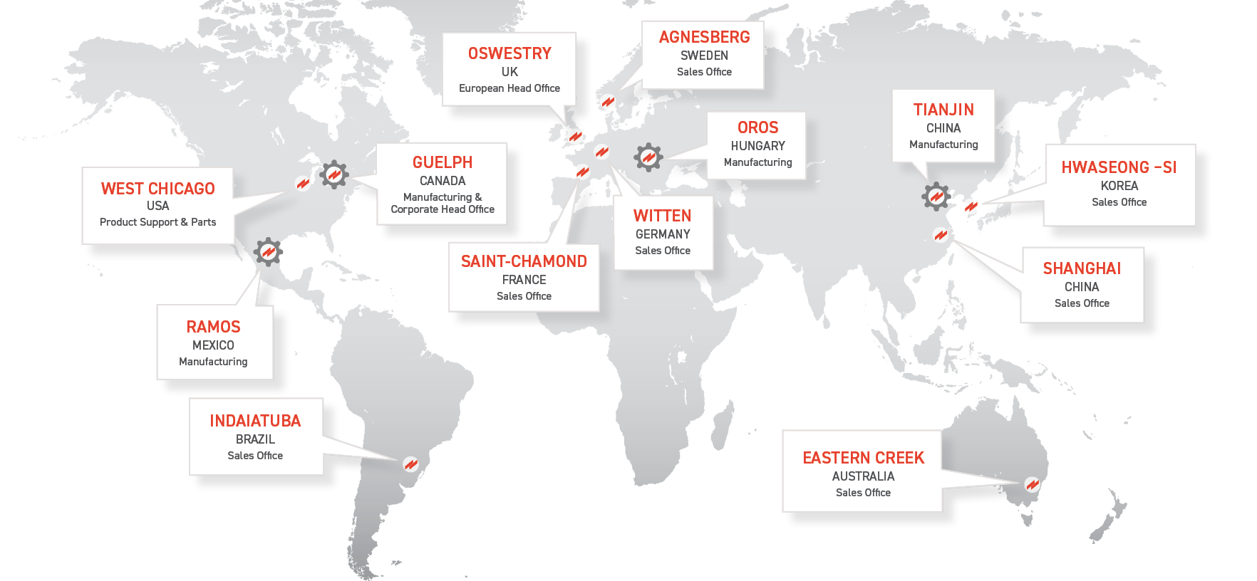
Global Locations

Slide 13
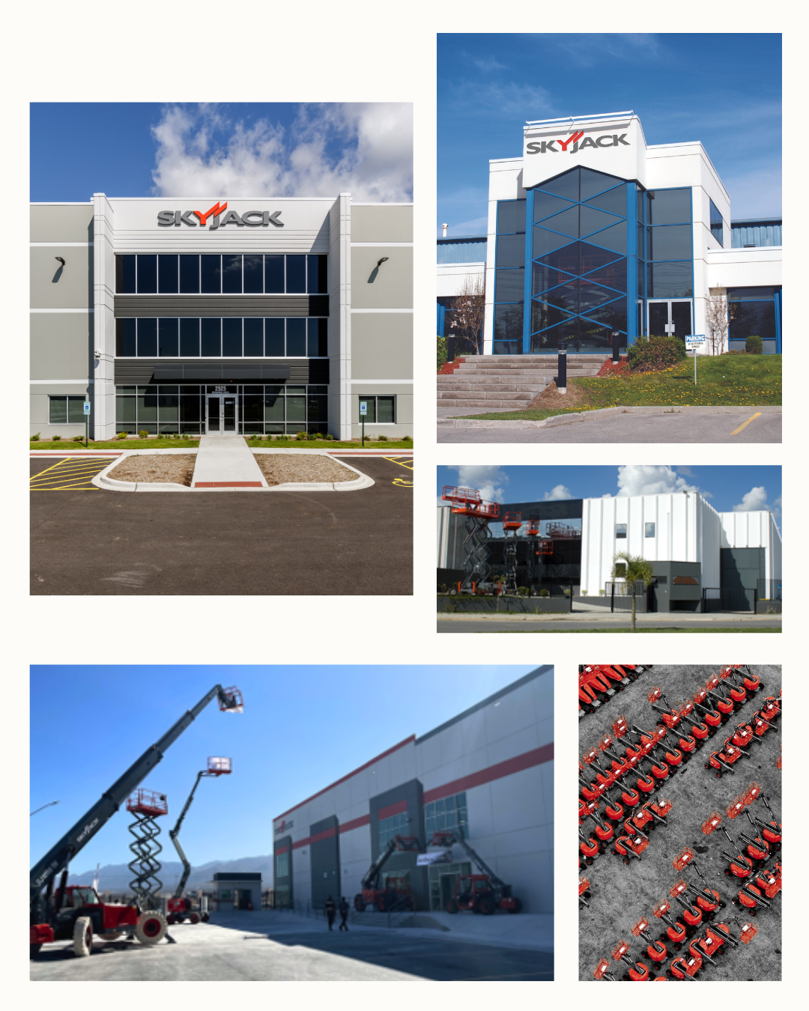
Global Capacity
Americas
Manufacturing
  Guelph, Canada
  Ramos, Mexico
Sales and Product Support
  Chicago, USA
  Indaiatuba, Brazil

Slide 14
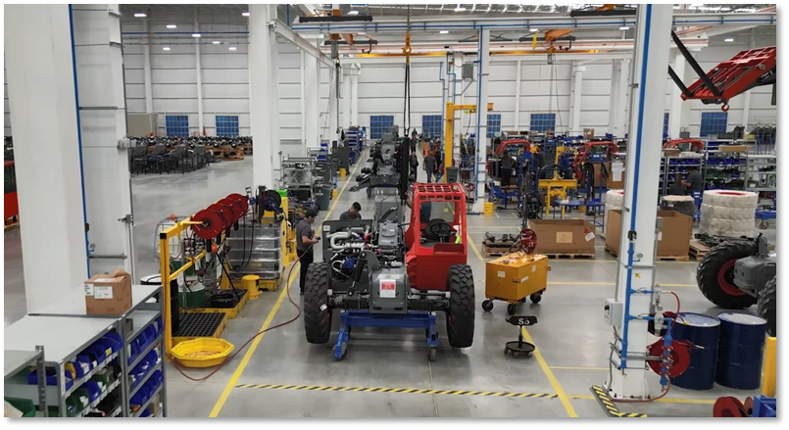

Slide 15
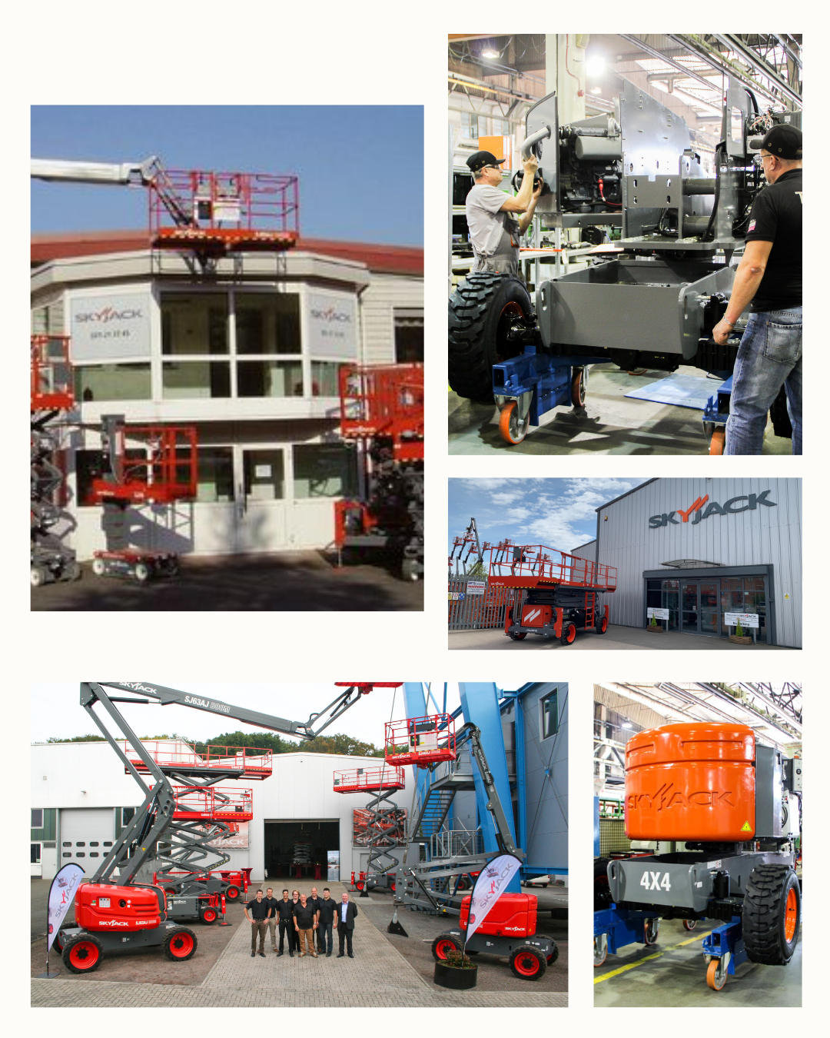
Global Capacity
Europe, Africa, Middle East (EAME)
Manufacturing
  Oros, Hungary
Sales and Product Support
  Oswestry, UK ( EAME HQ)
  Saint-Chamond, France
  Witten, Germany
  Agnesburg, Sweden

Slide 16
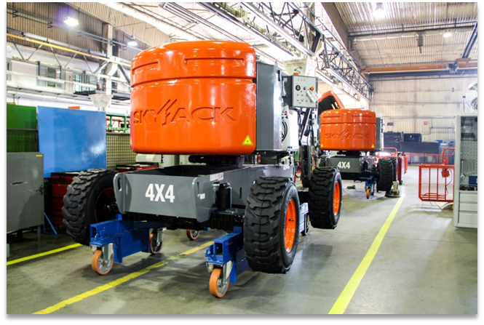

Slide 17
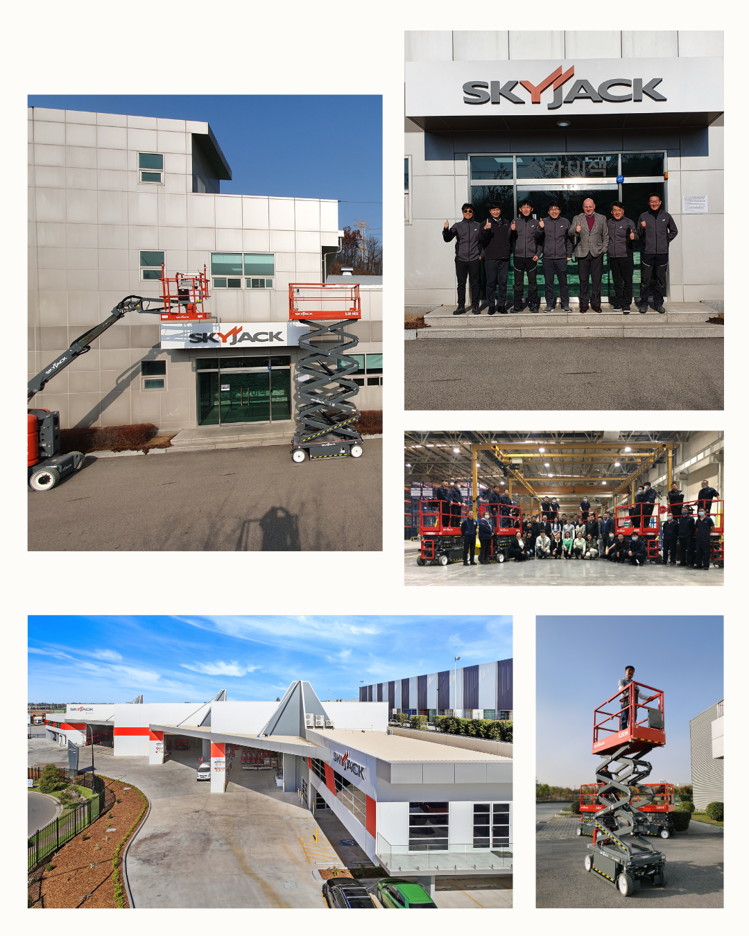
Global Capacity
Asia-Pacific
Manufacturing
  Tianjin, China
Sales and Product support
  Shanghai, China
  Hwaseong-Si, Korea
  Sydney, Australia

Slide 18
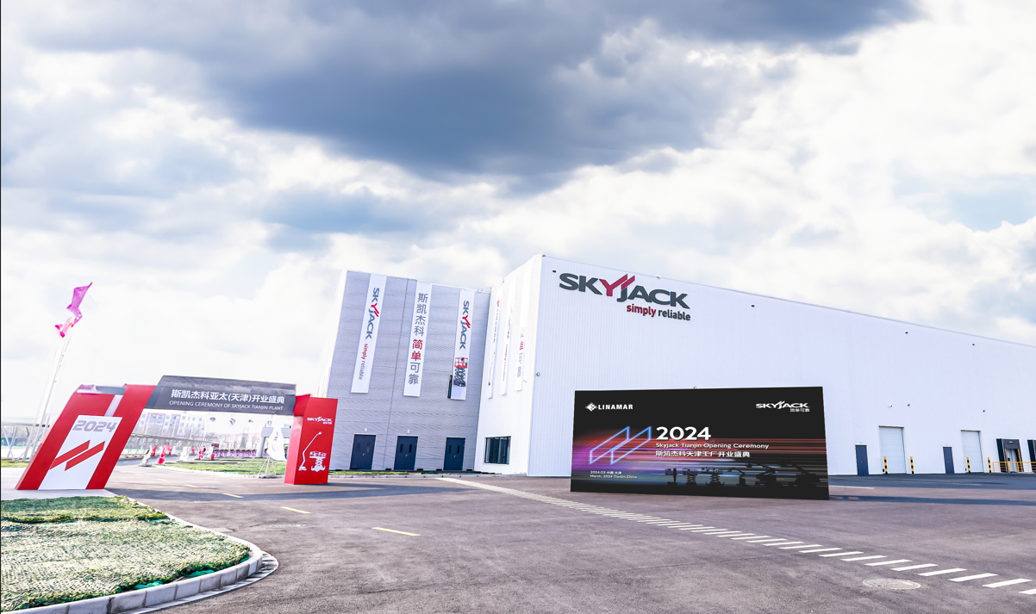

Slide 19
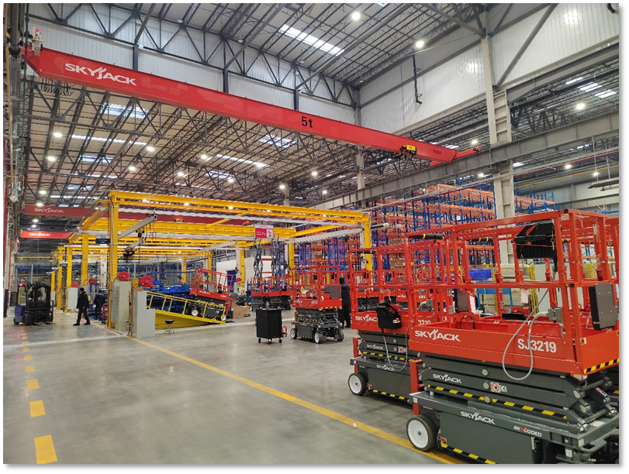

Slide 20
  Product Range

Slide 21
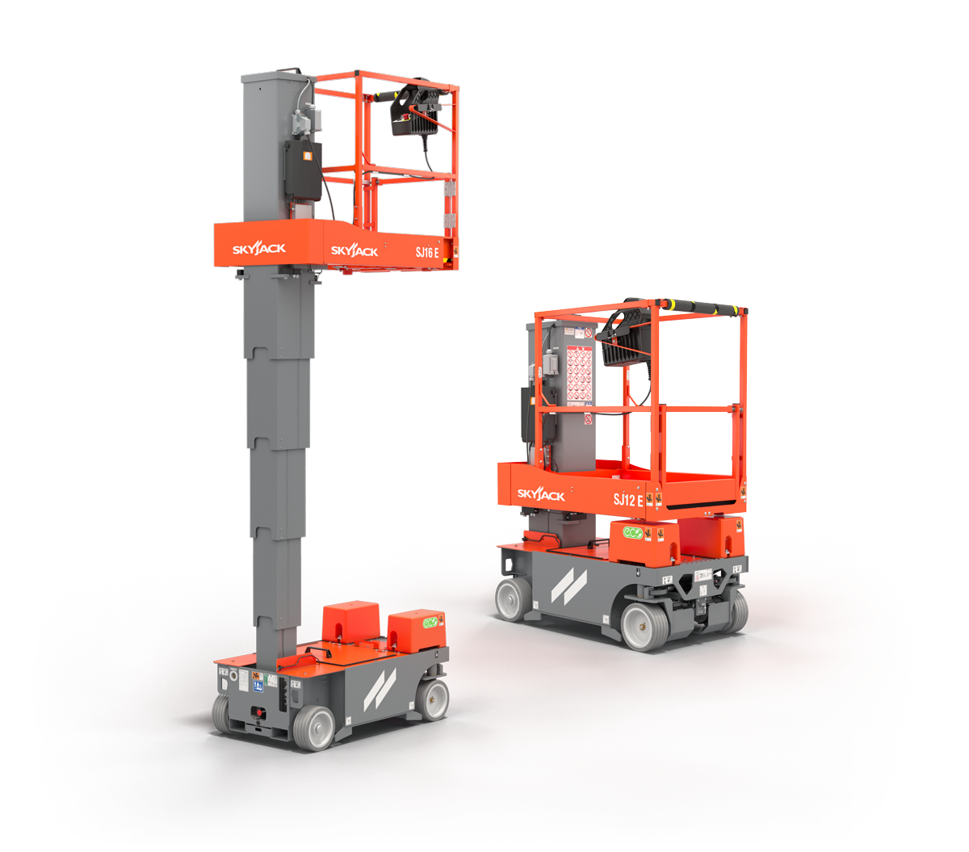
Vertical mast lifts with platform heights from 12’ (3.6 m) up to 19’ 6” (5.94 m)

Slide 22
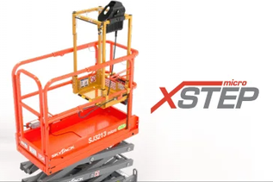
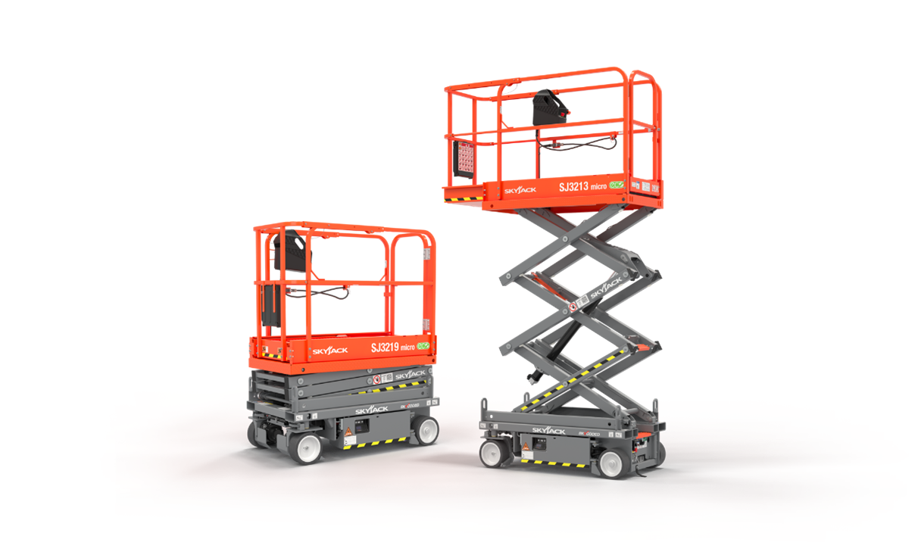
Micro scissor lifts with platform heights from 13’ (3.96 m) up to 19’(5.8 m)

Slide 23
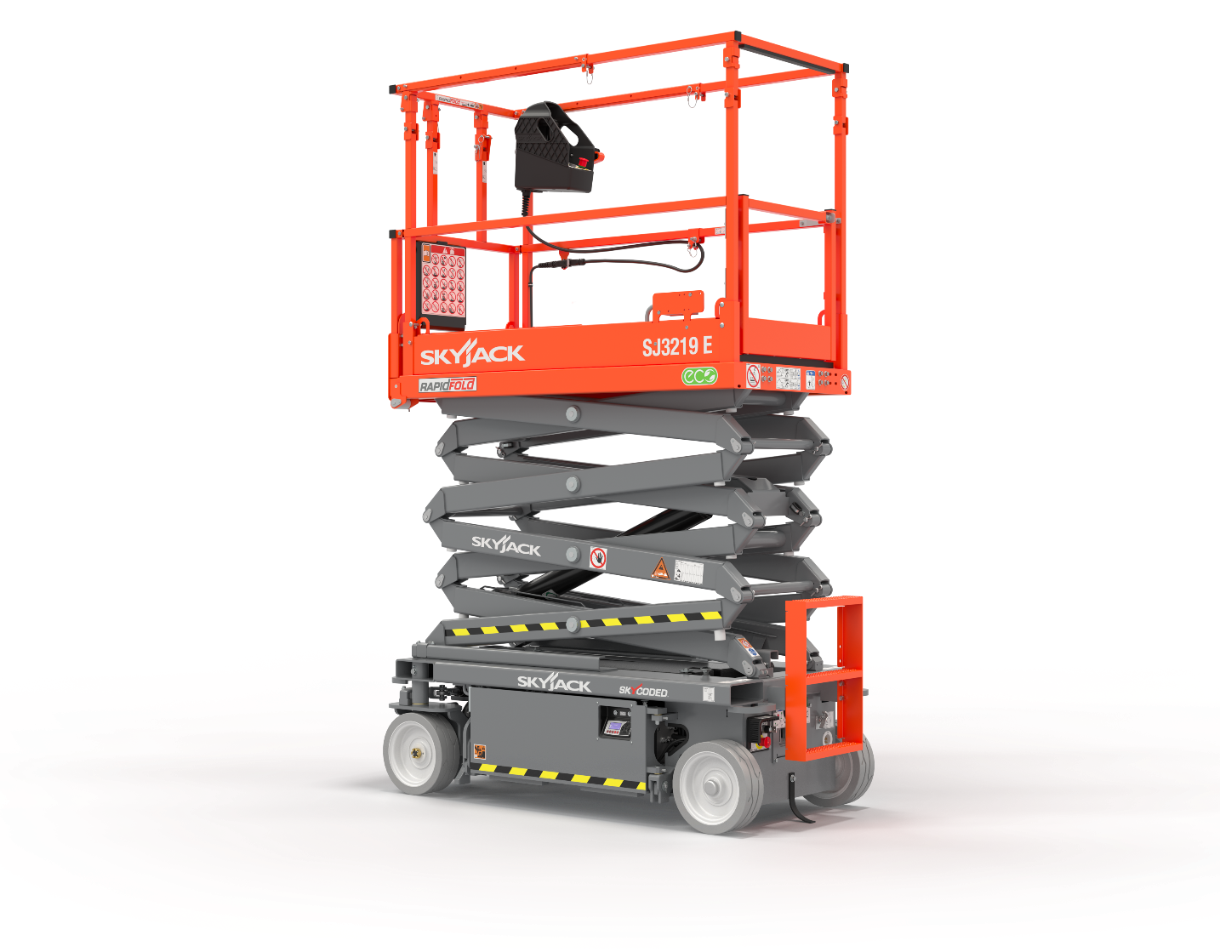
Full line of DC scissor lifts with platform heights from 15’ (4.6 m) to 40’ (12 m)

Slide 24
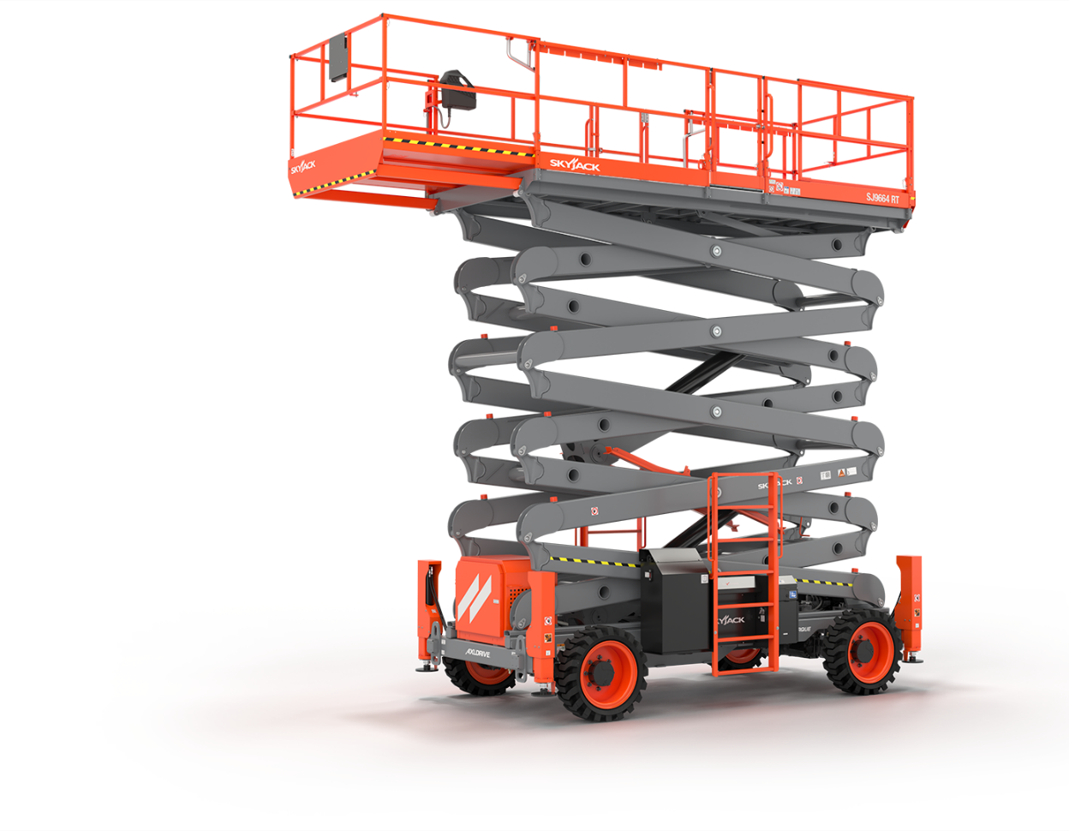
Rough terrain scissor lifts with platform heights from 26’ (7.92 m) to 64’ (19.51 m)

Slide 25
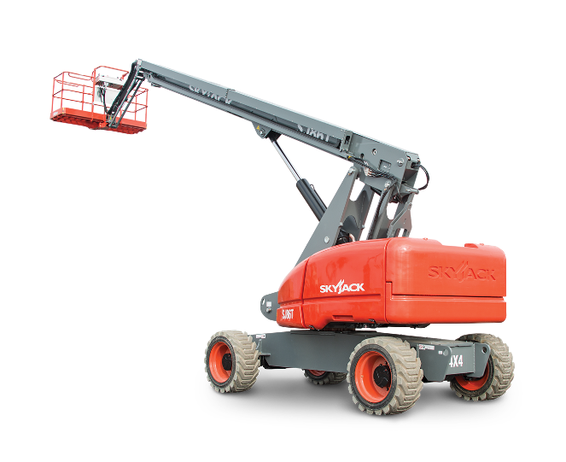
Telescopic booms with platform heights from 40’ (12.37 m) to 86’ (26.21 m)

Slide 26
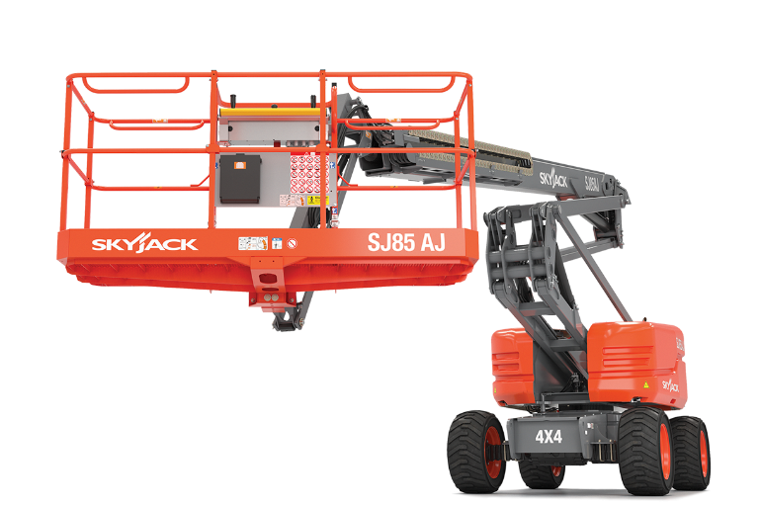
Articulating booms with platform heights from 30’ (9.07 m) to 85’ (25.91 m)

Slide 27
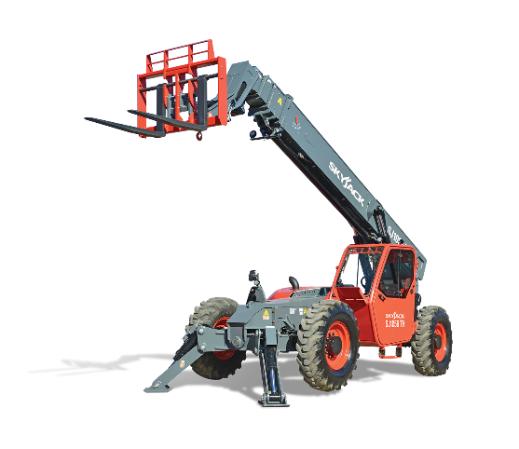
A range of construction rental telehandlers (TH series) with lifting capacities from 5,500 lbs (2,494 kg) up to 12,000 lbs (5,443 kg)

Slide 28
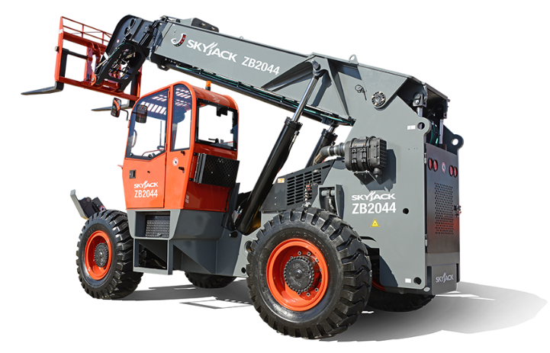
And a ZB model with a lifting capacity of 20,000 lbs (9,071 kg)

Slide 29
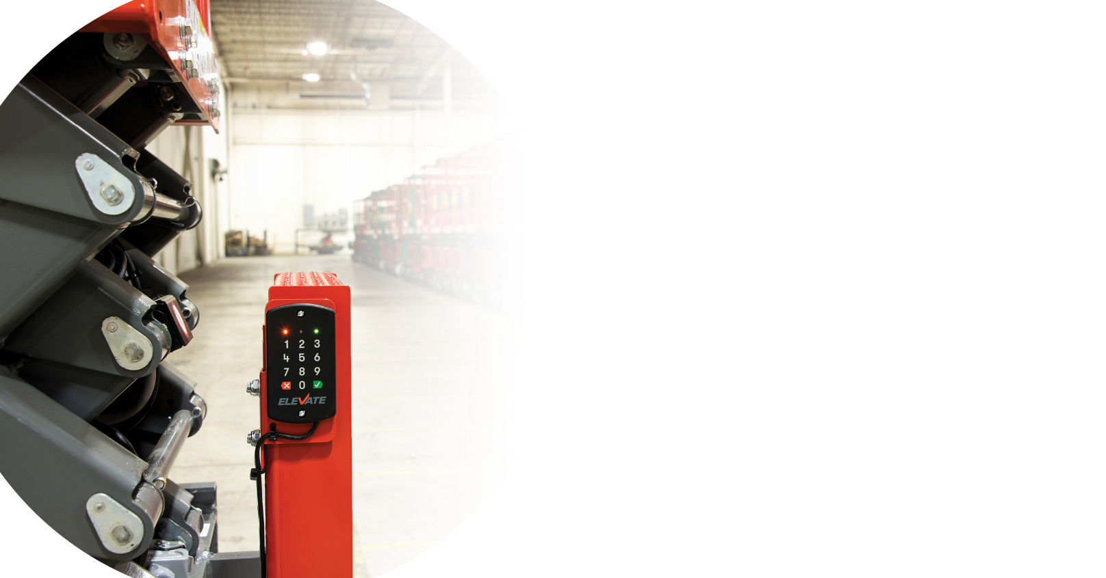

Actionable Insights.
Measurable benefits.
More than Telematics.

Slide 30
  Trademarks

Slide 31
Pride
Durability
Reliability
Designed for Rental
Quality
Passion
Serviceability

Slide 32
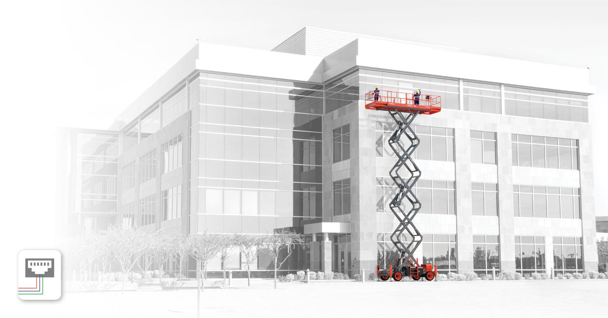

Skyjack’s colour coded and numbered wiring system makes our machines the easiest to troubleshoot and repair.
^{Available on all models}

Slide 33
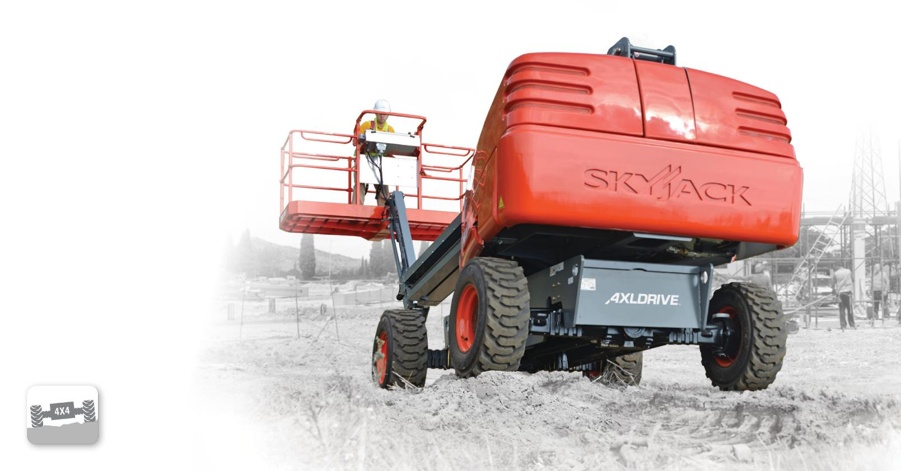

True axle-based four-wheel drive gives positive traction and excellent rough ground terrainability.
Available on all engine-powered booms,
full-size RT scissors, and telehandlers

Slide 34
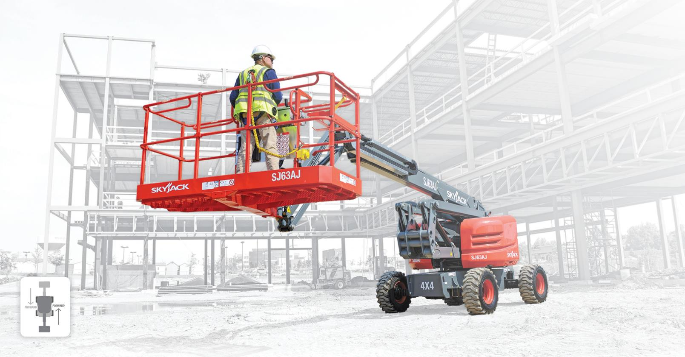

Keeps boom drive controls in the orientation of the boom regardless of position of the turret over chassis.
^{Available on all booms}

Slide 35
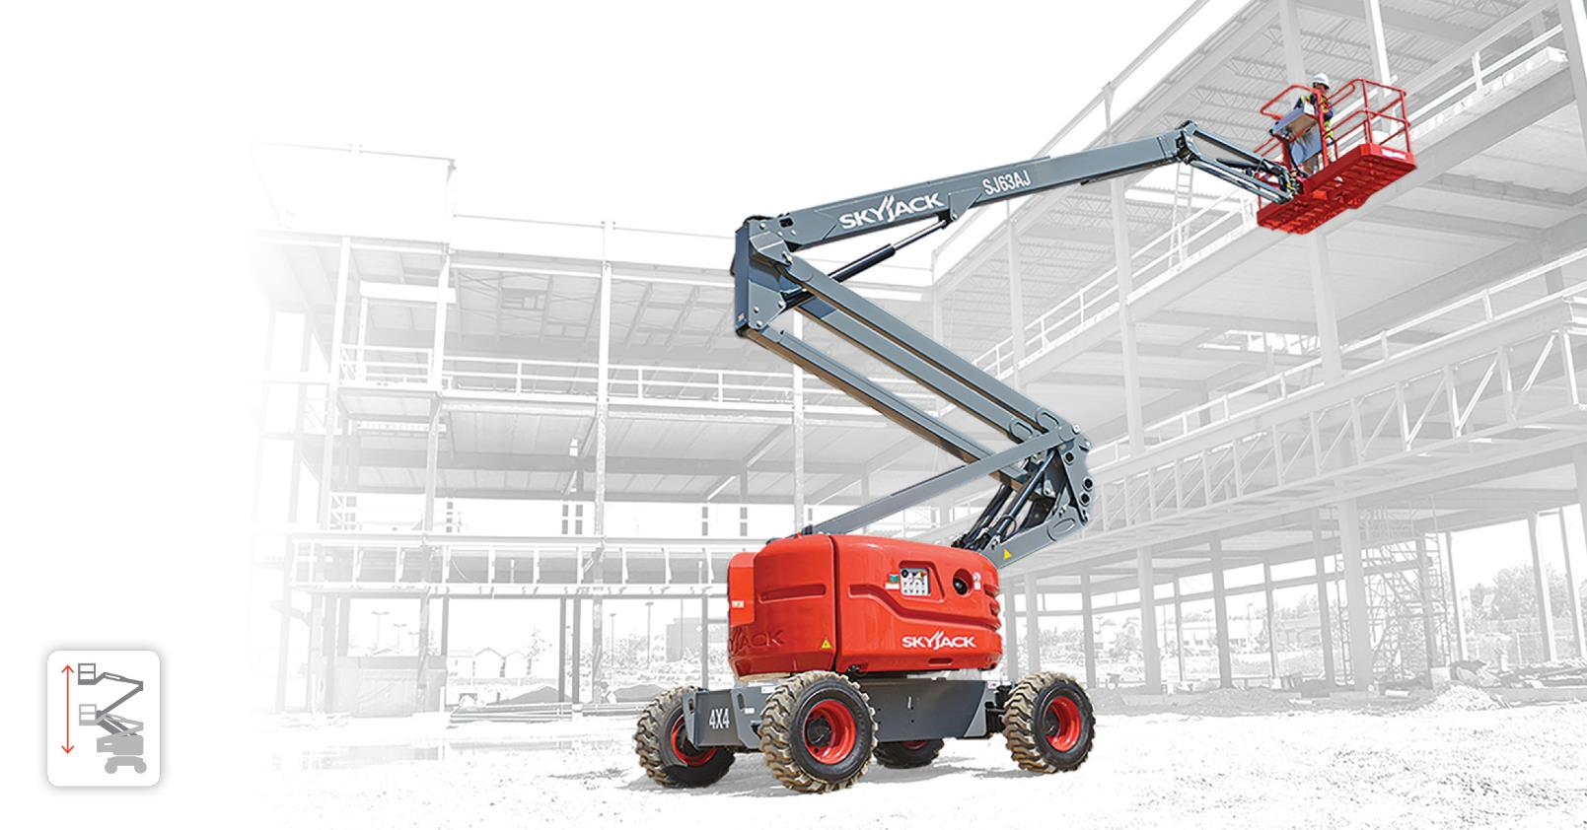

Ensures that the riser and main pivot point connecting the fly boom to the riser travel in a straight vertical line.
Available on SJ46, 63, and 85 AJ

Slide 36
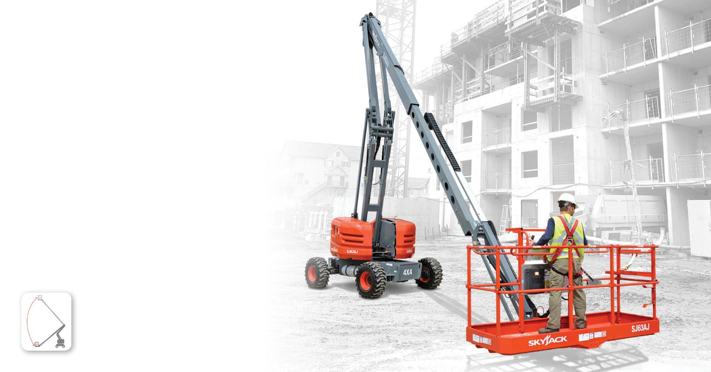

Cycles between max height and ground level quickly by engaging only the boom raise/lower function.
Available on SJ63 AJ and SJ85 AJ

Slide 37
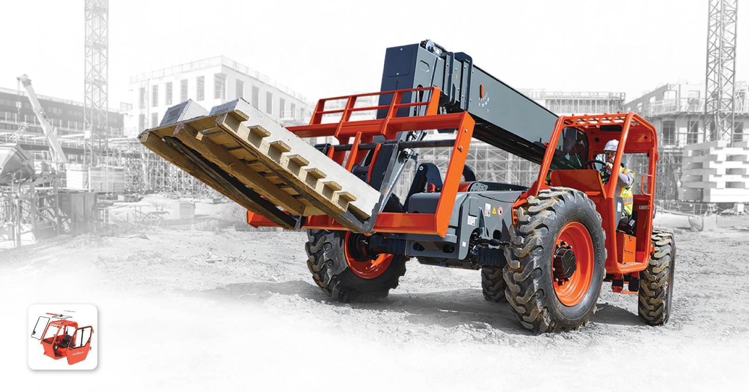

Bolt-on/off window retention system leads to increased uptime, and minimizes replacement costs.
Available on all TH series telehandlers

Slide 38
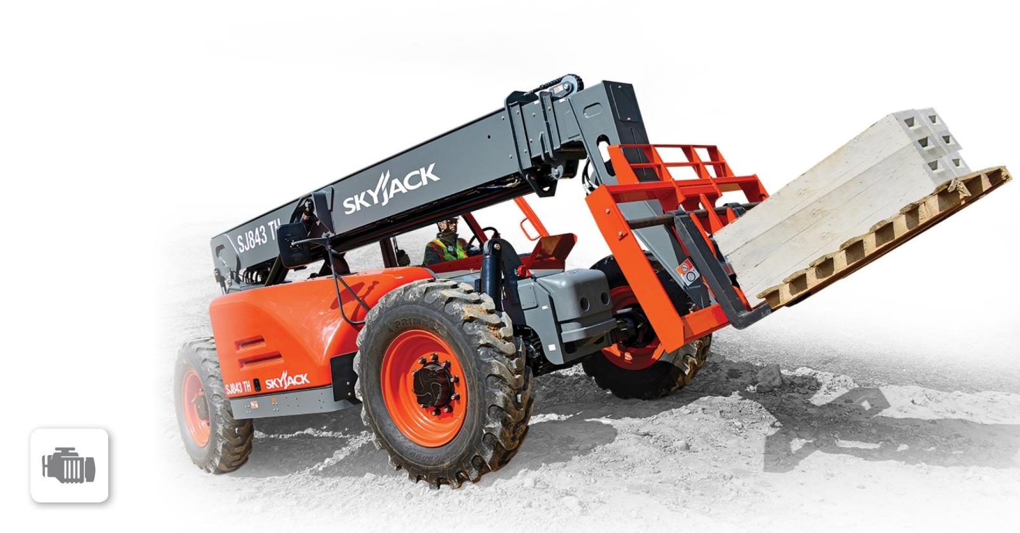
^{Engineered to require NO DPF,}
NO DEF, and NO other active exhaust after treatment.
Available on SJ643, SJ843, SJ1044,
^{and SJ1056 TH}

Slide 39
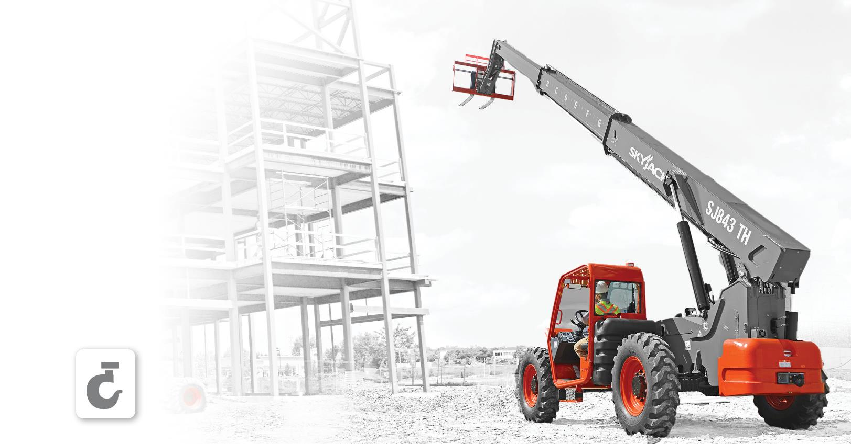

Allows the safe under-slinging of loads and avoids the practice of using the forks as an underslung lifting device.
Available on SJ643, SJ843, SJ1044,
^{SJ1056 TH, and SJ1256 THS}

Slide 40
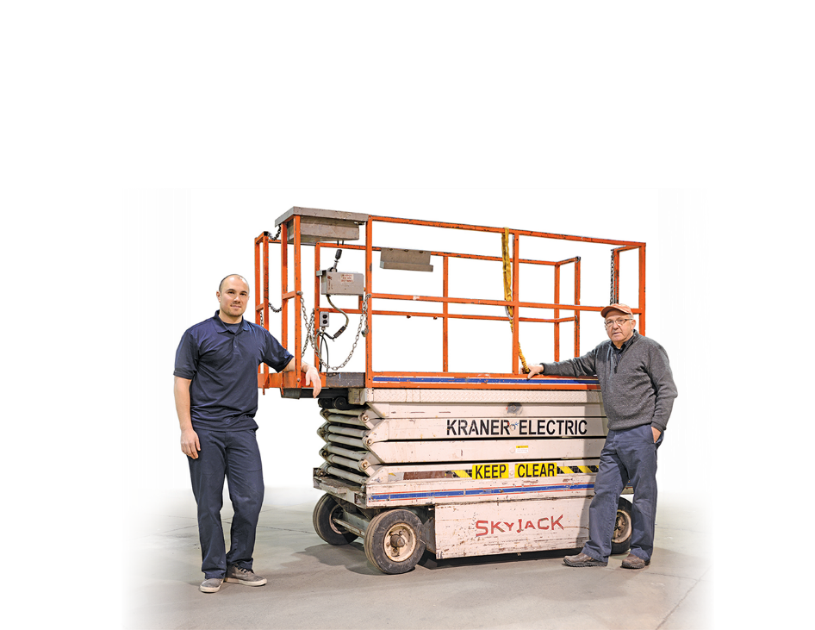


This 30-year old machine was found in 2015 and was still simply reliable

Slide 41
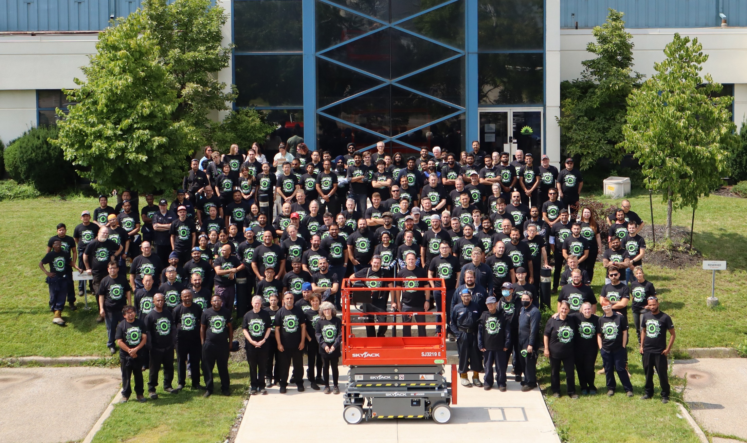
Notes:
Design team photo

