Slide 1
SJ12/16/20E Machine Overview
Rafael Bazzarella
1/10/2022

Slide 2
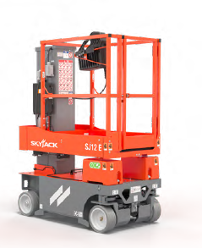
SJxxE Overview
AC brushless electric drive
Mast in-line with platform height ( SJ12/16E)
Full Unrestricted view - mesh bottom platform design
Self closing half height gate
Load sensing included
Wind rated SJ12E – optional on SJ16/20 E
Leak containment *Optional
Traversing 16” (0.41m) extension for up and over reach
4” (10cm) wide tires
90° front wheel steering provides zero turning radius

Slide 3
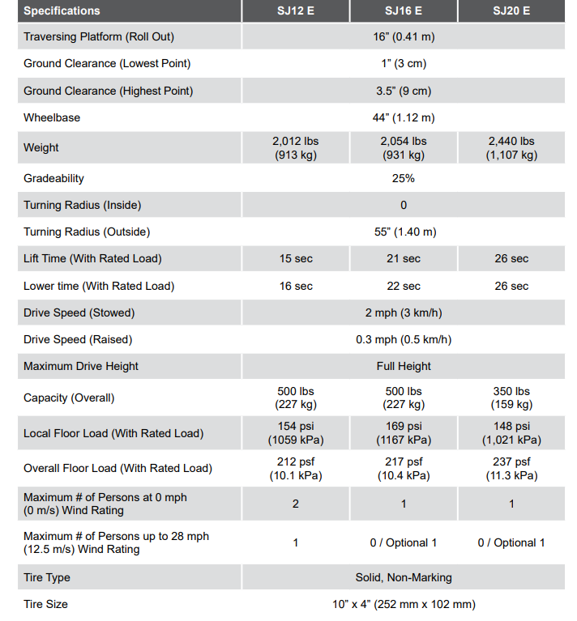
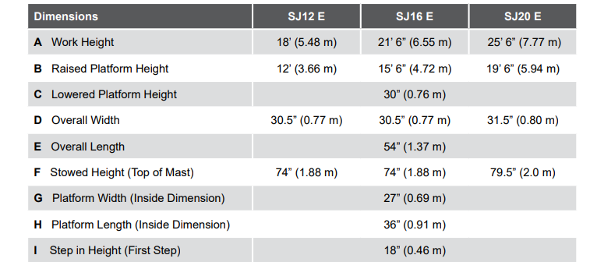
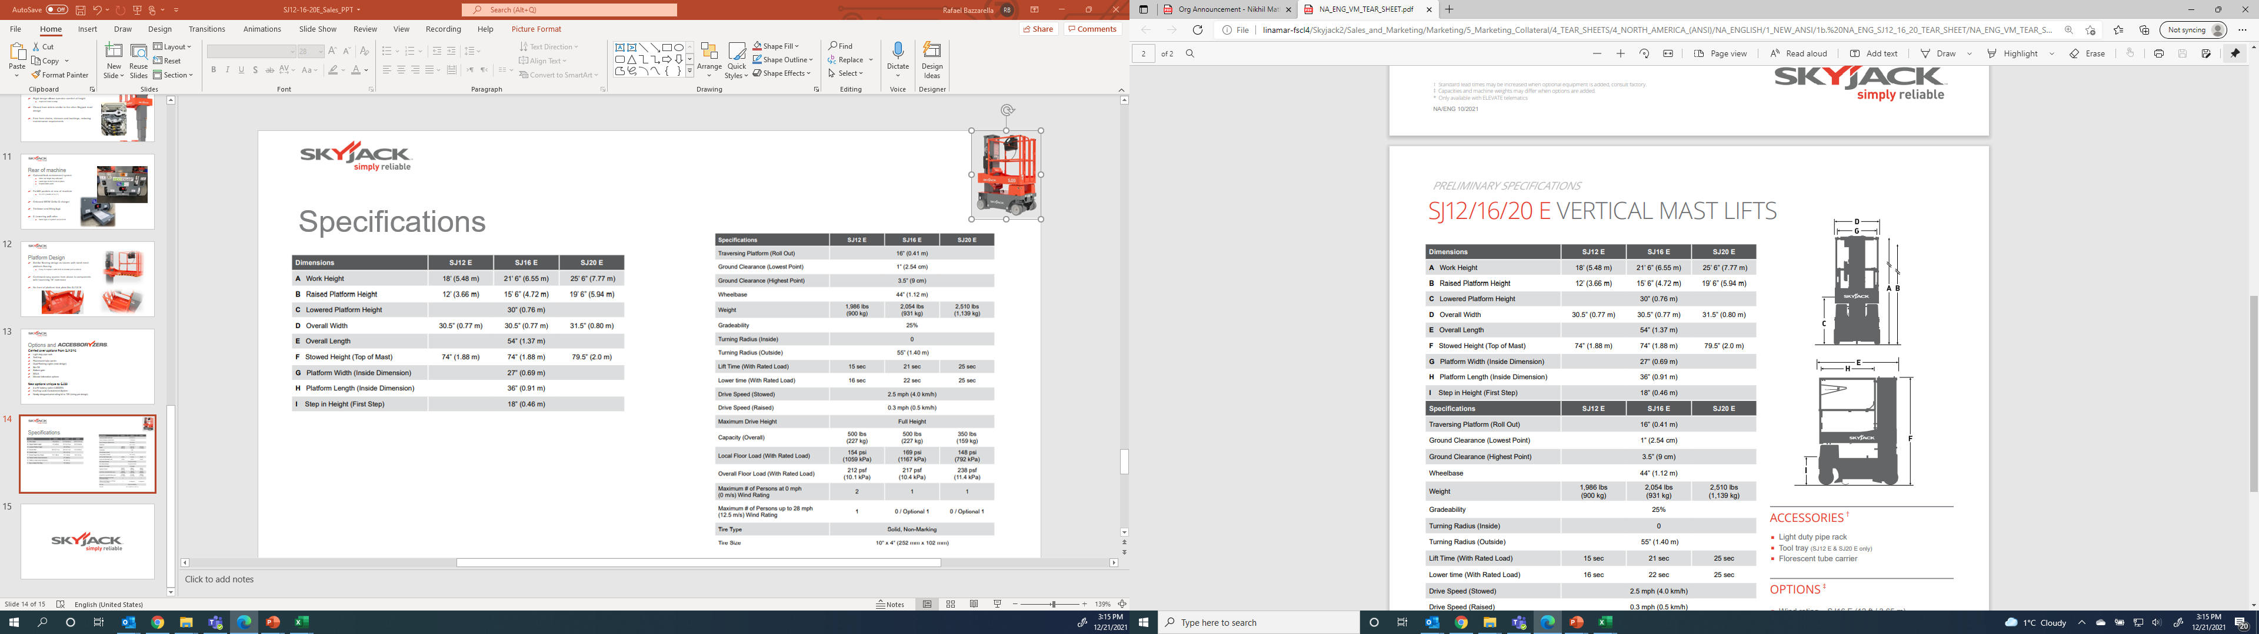
Spec Overview

Slide 4

Options and
Wind rating – SJ16 E (12 ft / 3.65 m)
SJ20 E (13 ft / 3.96 m)
Dual flashing lights
4 x 6V (220Ah) Batteries
White Noise Alarm
Saloon gate
Bio oil
Secondary guarding lift enable (SGLE)
Non-destructive testing
ELEVATE Telematics and ELEVATE Battery Management System (BMS) *
Warranty Options (3 year or 5 year plans available)
Light duty pipe rack
Tool tray (SJ12 & SJ20 only)
Fluorescent tube carrier
EcoTray Leak Containment System

Slide 5
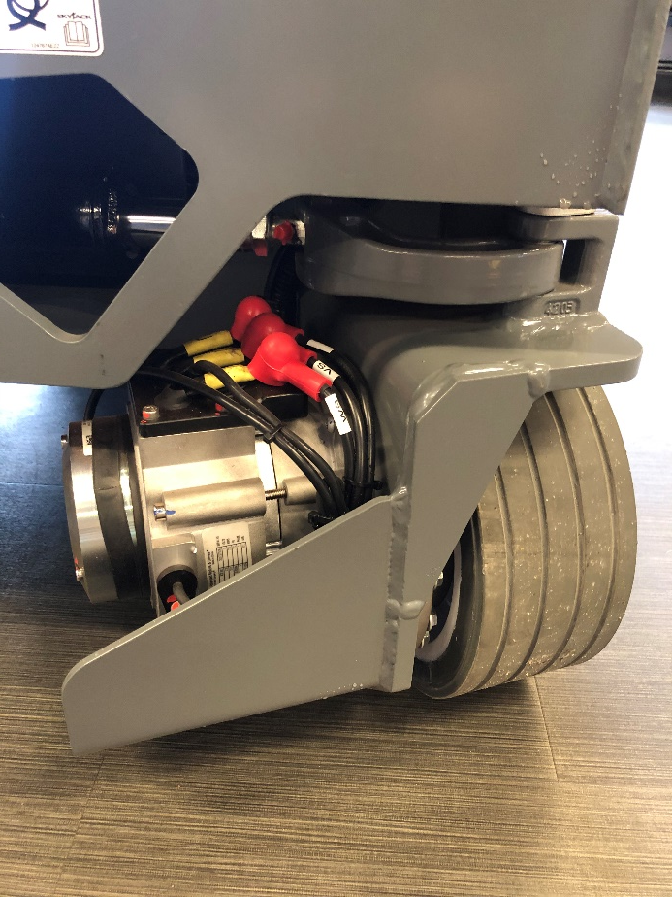
Electric Drive/ Components
Front wheel AC electric drive motors supplied by Nidec
  Consistent torque and speed
  Improves loading/ offloading onto trucks
  25% gradeability
  70% less hydraulic connections
  30% improvement in duty cycle
Drive gearbox supplied by Omni
Hydraulic front wheel steering
  Steering cylinder mounted underneath chassis
  Zero inside turning radius

Slide 6
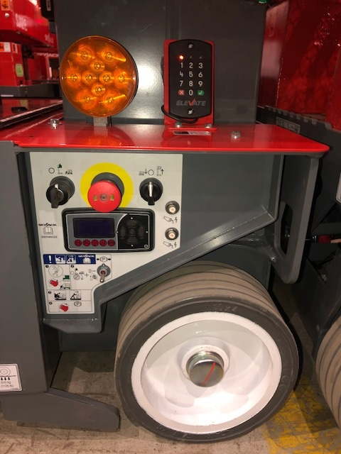
Onboard Diagnostics
Zapi display with onboard diagnostic readouts
  Same supplier as other Skyjack product (SJ30ARJE)
Plain simple language similar to what we have on our DC scissors with drop down menus
Mounted in rear wheel well, offset inside for protection against debris
CAN based fully integrated controls
Electrical brake release

Slide 7
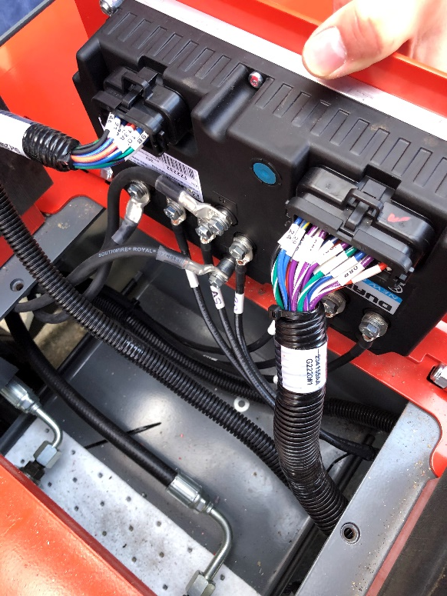
Controller
Hardwired Zapi controller (same supplier as other Skyjack product, 30ARJE)
Mounted on a bracket that’s underneath the top plate of the base
  Easy access with 2 bolts but out of the way from debris and water intrusion
  Separate from service latch

Slide 8
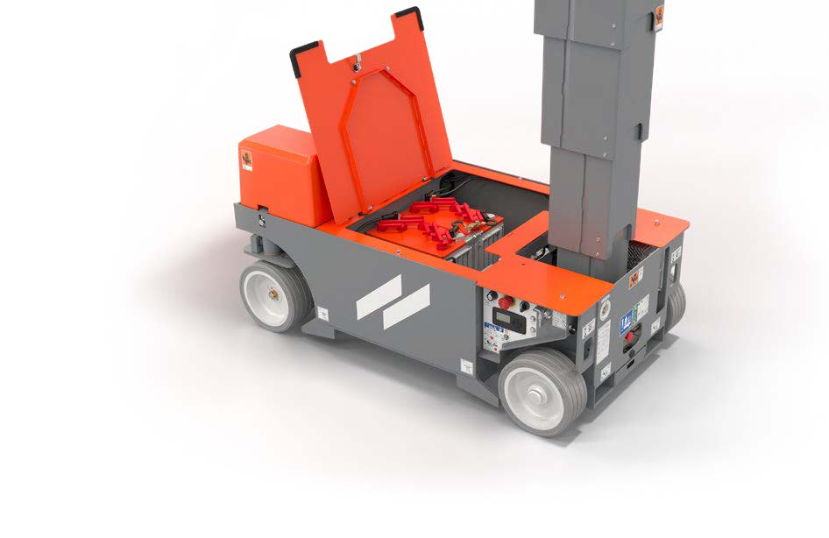
Internal Components
Flip up access lid for main service components
Bucher pump/motor combo mounted inside with access to all valves and service parts
Delta-Q 650W charger mounted inside rear of machine
  LED lights can be seen from rear of base
Main manifold with spin off oil filter for ease of service
2 x 12V battery configuration standard with 4 x 6V as an option (4 x 6V standard for CE and AS)
  HIRD data on 2 x 12V battery pack similar to SJ3220/26

Slide 9
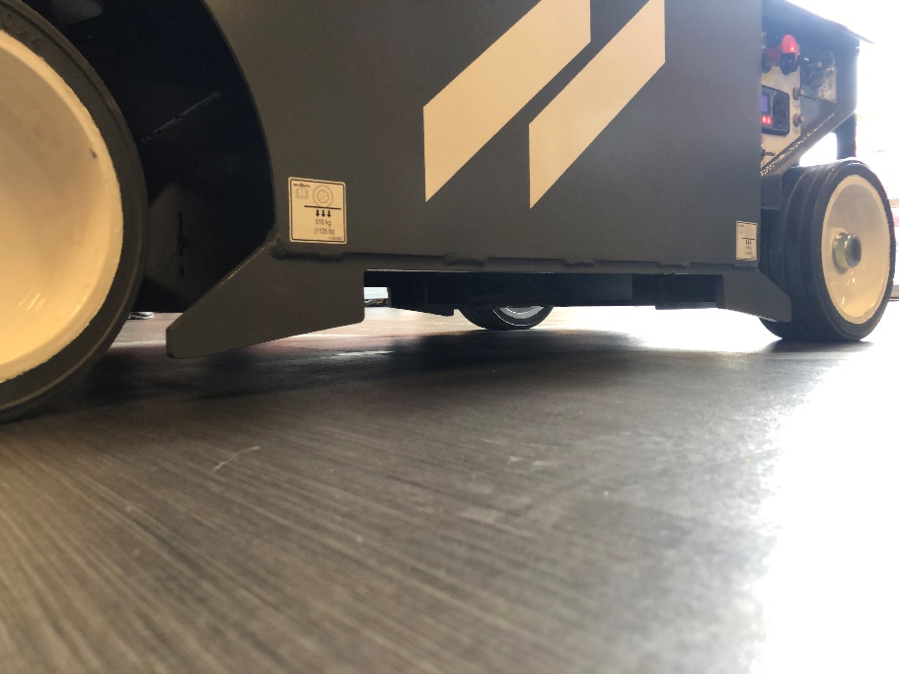
Pothole Protection
Fixed pothole protection system
Designed to go over cables without issues of “catching up”
Freedom to forklift from the side like other models
  Welded plates act as catch system incase of slippage when loading/ offloading
Lowest clearance is 1" and 3.5“ highest point
  Improved ground clearance over other previous VM’s and SJ3219

Slide 10
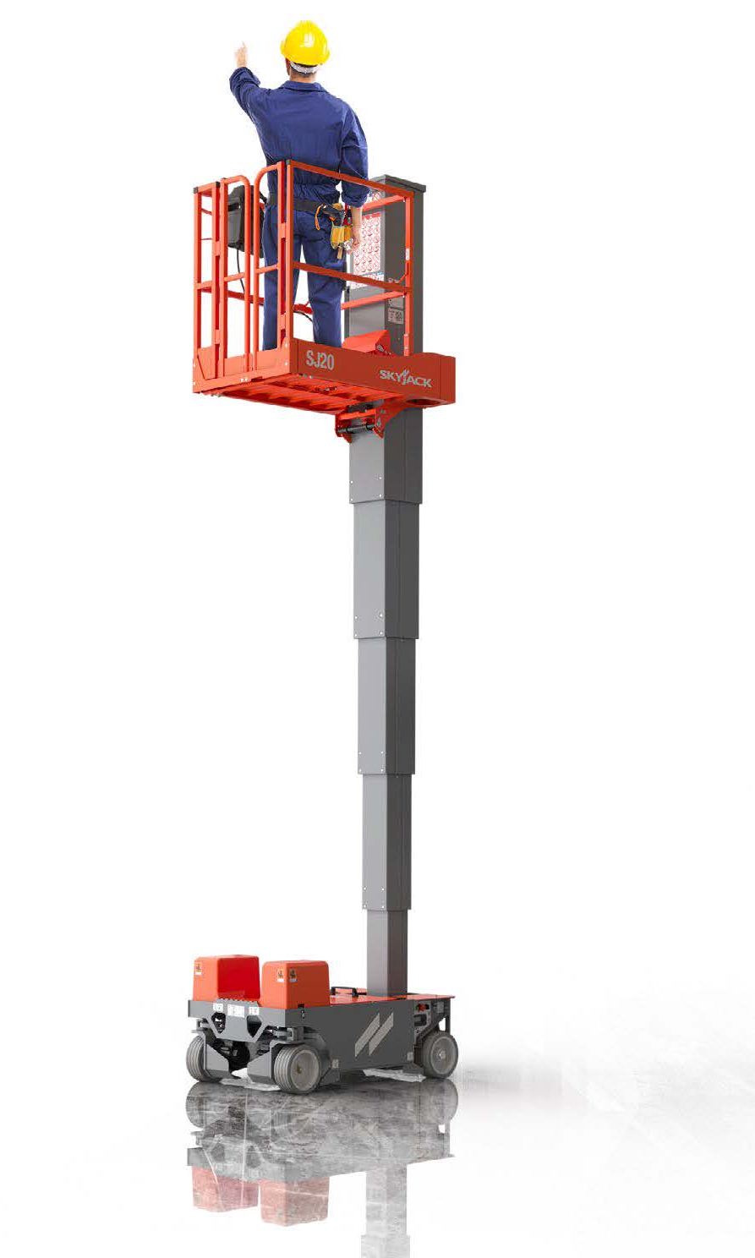
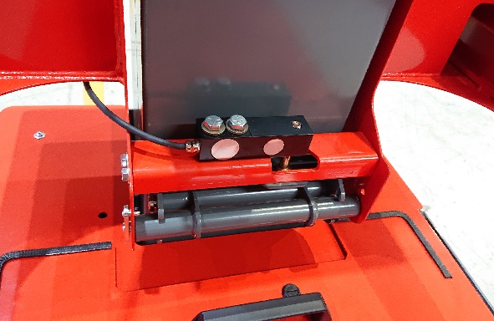
Load Sense
Standard Dual Load Cell
  2 different load cells beneath platform (2 sides and one on rear)
  Wiring goes into a junction box and then feeds back into the main controller

Slide 11
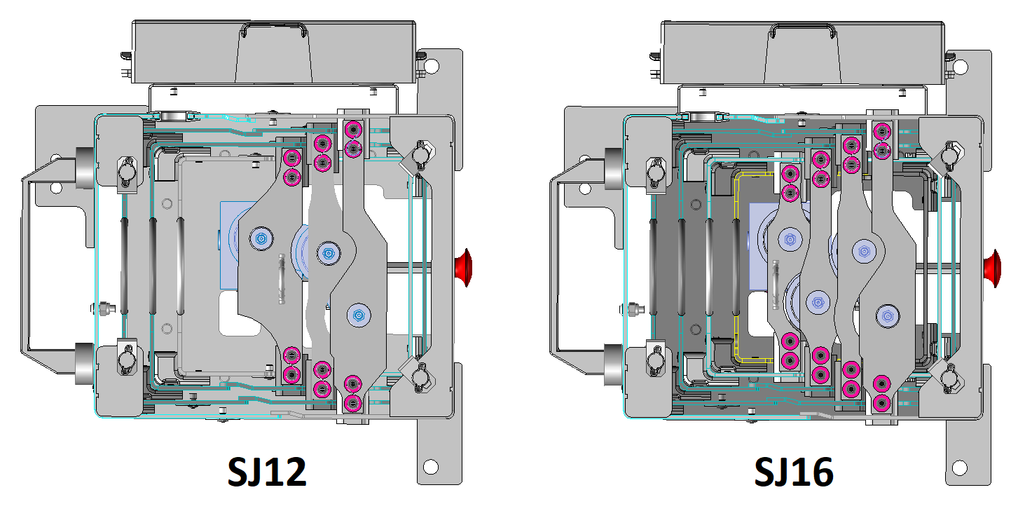
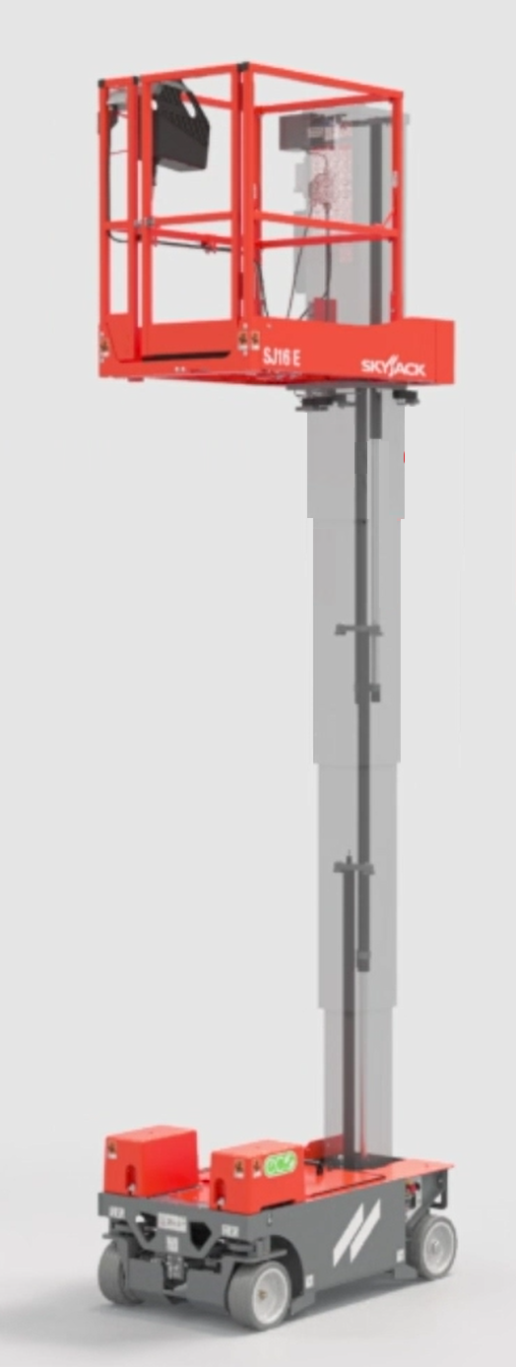
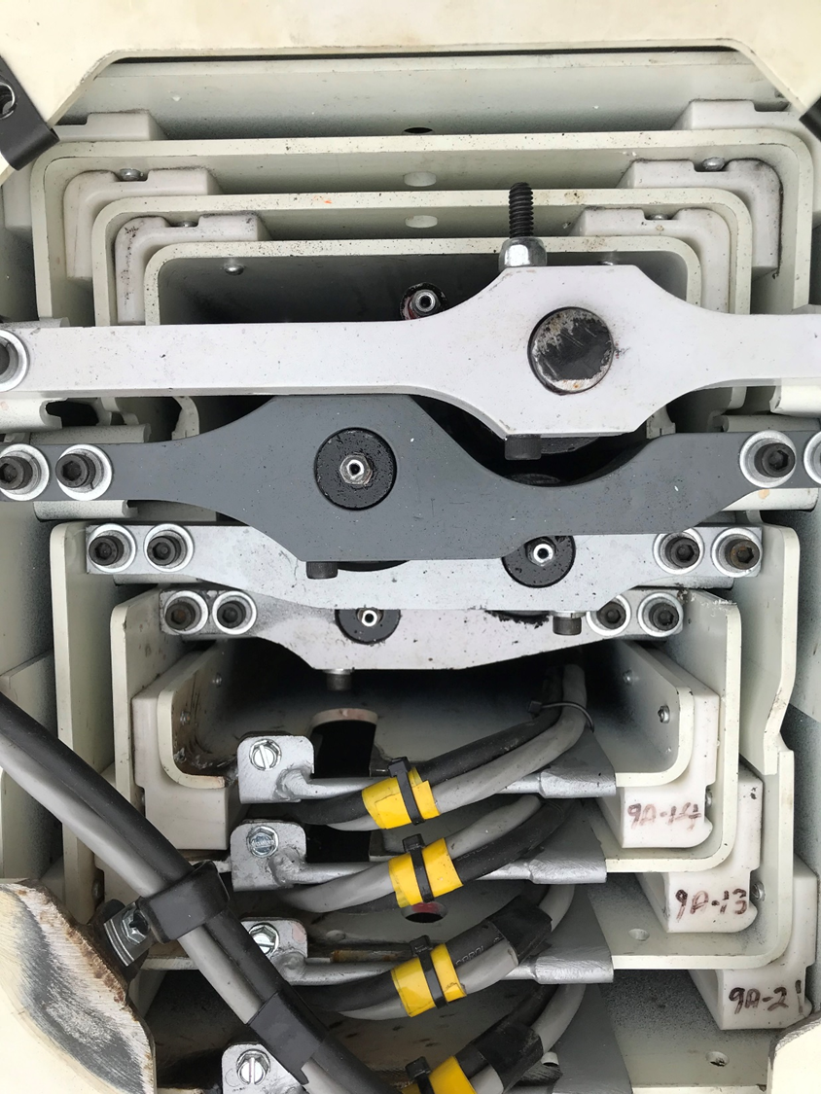
Mast Design
SJ12E – 4 section mast with 3 stage lift cylinder
SJ16E and SJ20E – 5 section mast with 4 stage lift cylinder
Multi-stage lifting cylinder
  Eliminates chains, sheaves and bushings, reducing maintenance ce requirements
Rigid design allows operator comfort at height
  Improved mast overlap
Closed from debris ingress similar to previous design

Slide 12
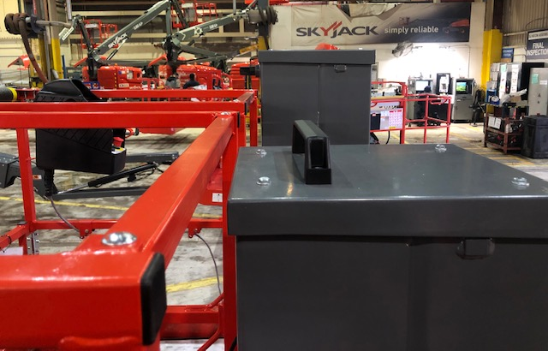
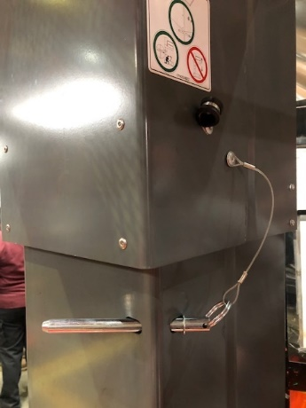
Mast Design
SJ12/16E – Mast inline with platform
SJ20E – Mast slightly higher than platform
Added Maintenance pin for safety.

Slide 13
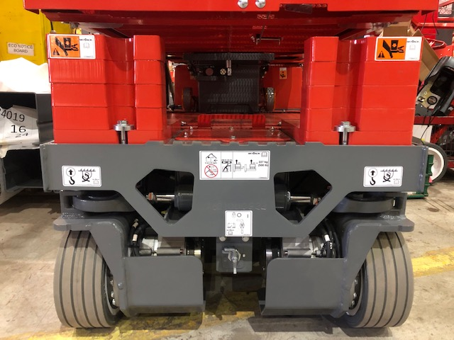
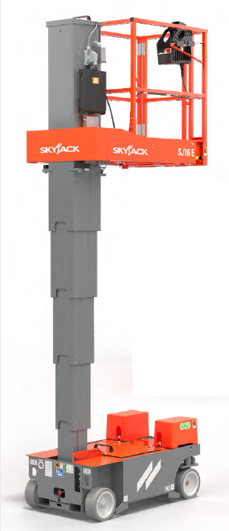
Front of Machine
Global external counterweights similar to current SJ20 but unique to each model
Battery disconnect relocated to front of machine

Slide 14
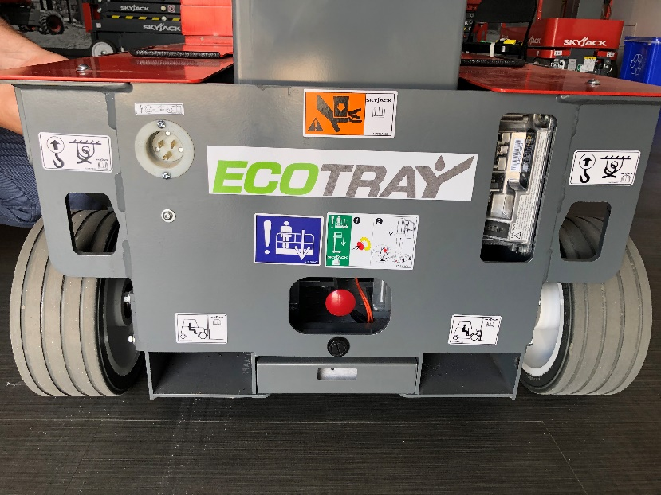
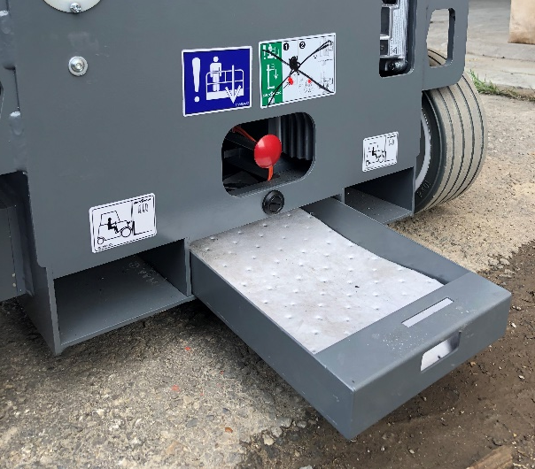
Rear of machine
Optional leak containment system
  Slide out single tray with pad
  Latch type hook to lock in place
  Replaceable pads
Forklift pockets at rear of machine
  5 x 2.5”
Onboard 650W Delta-Q charger
Tie/down and lifting lugs
Manual E-Lowering pull valve
Power to Platform plug

Slide 15
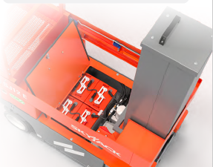
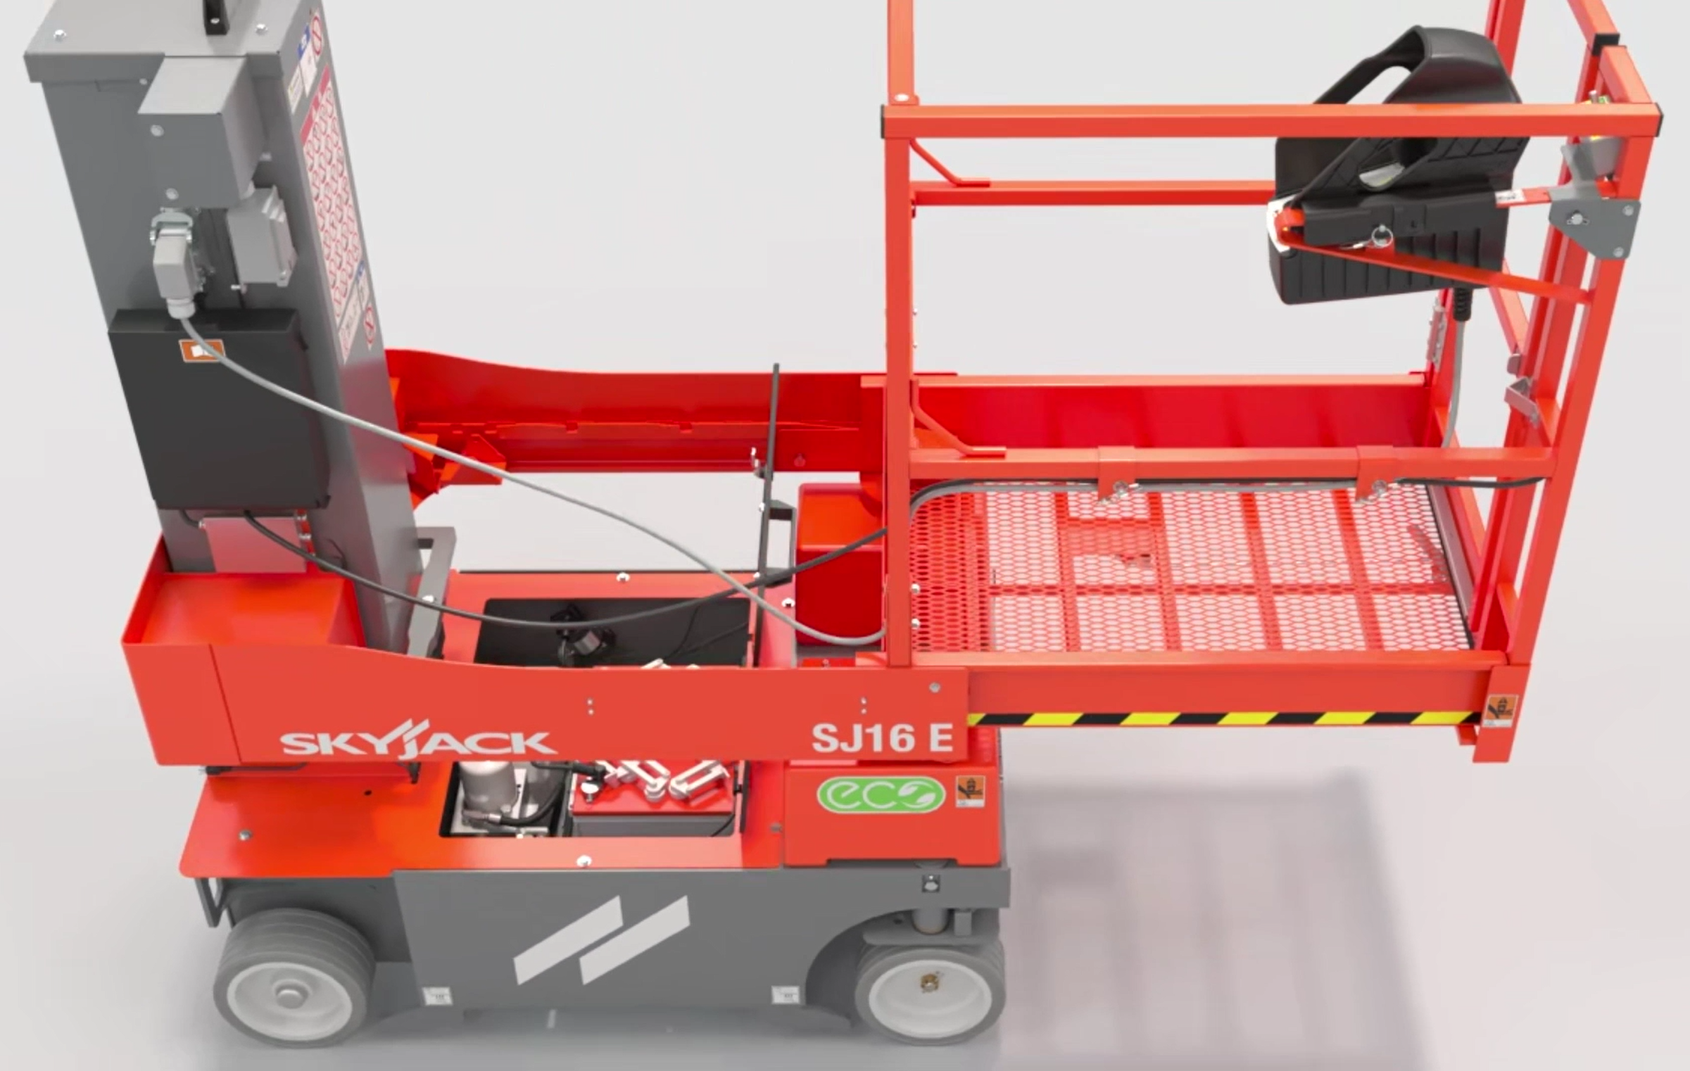
Platform Design
Similar flooring design as booms with steel mesh platform flooring
  Easy to replace with bolt on install (not welded)
Up and over reach with traversing 16” (0.41m) extension
Unrestricted access to all components
  (platform slides forward for access when stowed, maintenance pin also included to lock mast in elevated position for easier battery removal)

Slide 16

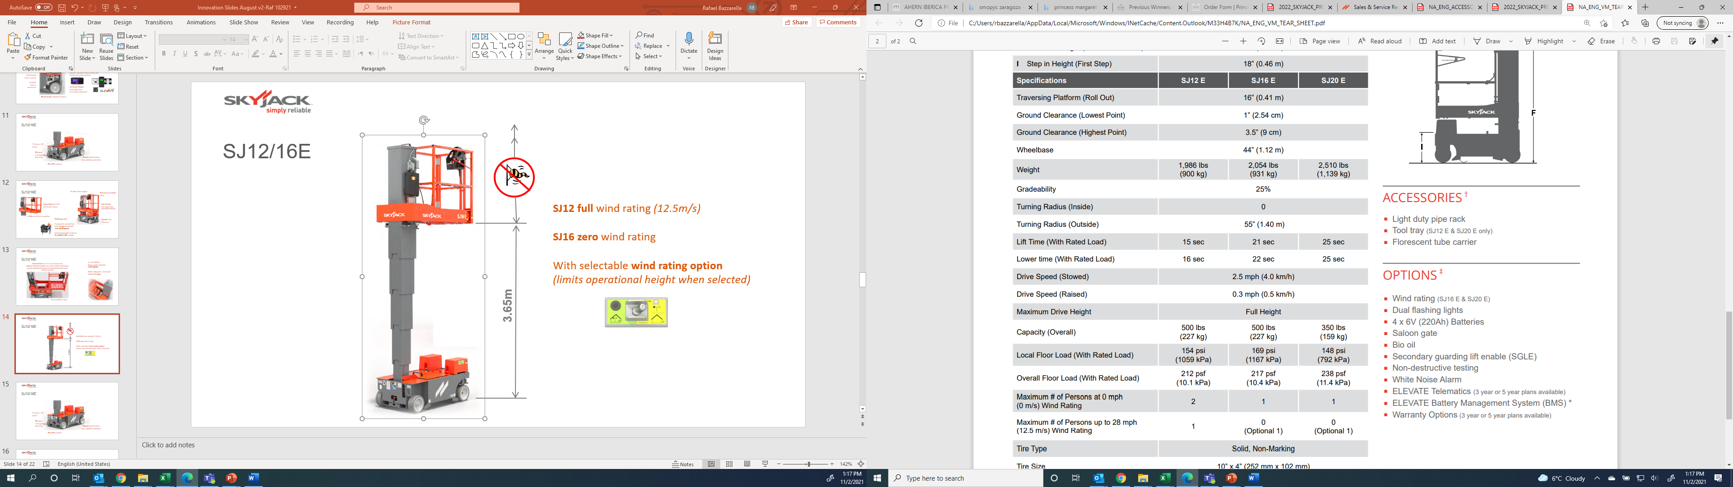
Wind Rating
SJ12E full wind rating (12.5m/s)
SJ16/20E zero wind rating
With selectable wind rating option
(limits operational height when selected)
SJ16E - 12’ - 3.65 m
SJ20E – 13’ - 3.96 m

Slide 17
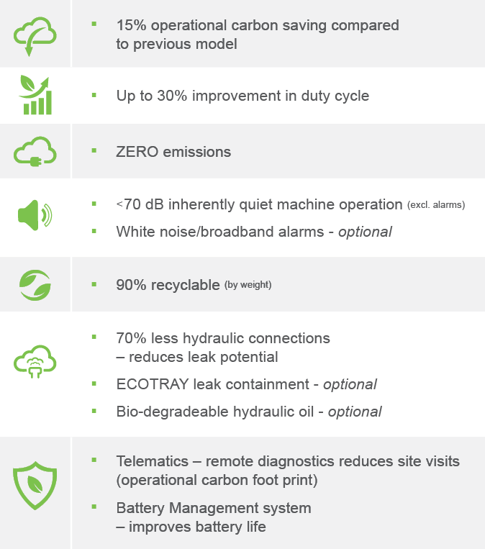


ECO Logo and Matrix
Launched with new VM’s - the ECO logo will highlight our focus on sustainable products and to actively reduce our overall environmental impact.
The label also is accompanied by relevant information in the form of an ECO Matrix that details what constitutes the improvement in sustainability that we have achieved.
Bridging the gap between practicality and sustainable efficiency by decreasing the overall carbon footprint for our customers

