Slide 1
Skyjack ZB Telehandler

Slide 2
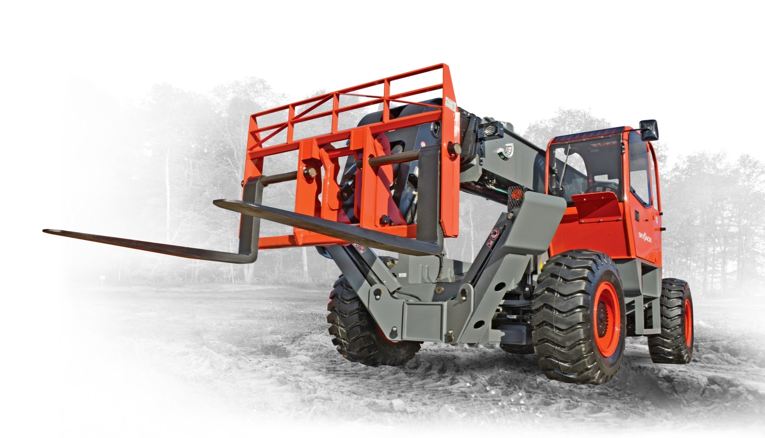
Skyjack ZB2044 Overview

Slide 3
Spec Overview
Dimensions Imperial Metric

Slide 4
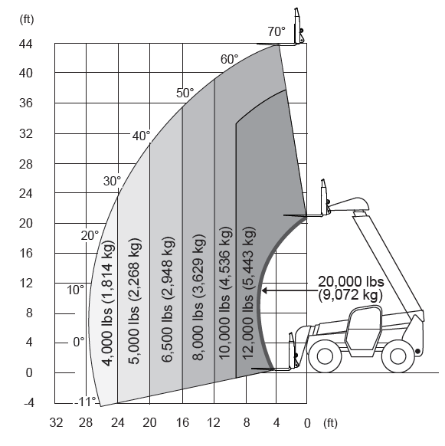
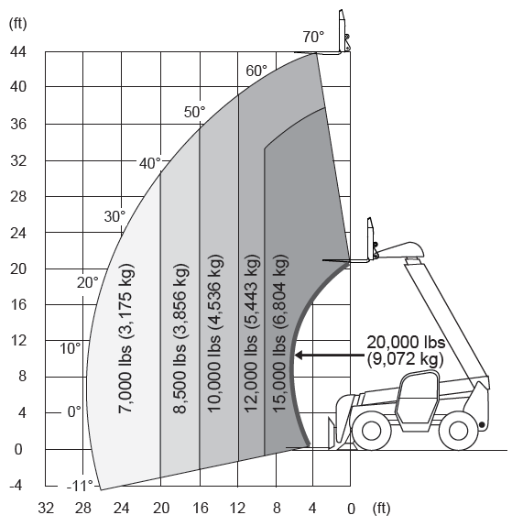
Load Charts
Dimensions Imperial Metric
Outriggers Up
Lifts max. capacity of 20,000 lbs to 21’
Lifts 12,000 lbs to max. height of 44’ 10”
Lifts 7,000 lbs to max. reach of 27’ 5”
Outriggers Up
Lifts max. capacity of 20,000 lbs to 21’
Lifts 10,000 lbs to max. height of 44’ 10”
Lifts 4,000 lbs to max. reach of 27’ 5”

Slide 5
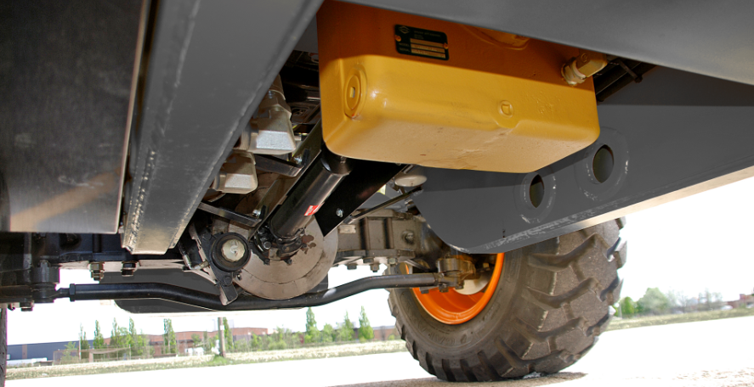
Unique to Skyjack
Dimensions Imperial Metric
Dana Spicer T32000 powershift transmission
Axletech outboard planetary axles front and rear
Dual service brakes
External disks on hub of each axle
SAHR parking brakes on front axle

Slide 6
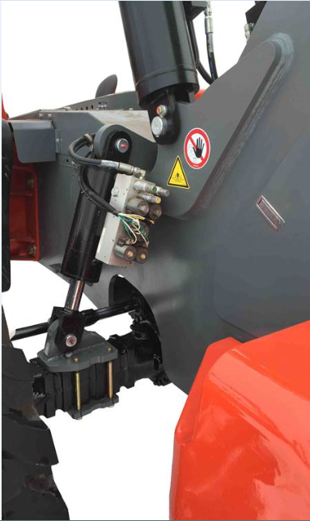
Unique to Skyjack
Dimensions Imperial Metric
Designed to improve stability by modifying the stance of the machine when boom is raised beyond 45˚ by locking rear axle in position
Robust rear axle stabilization cylinder mound weldment for added protection
Axle lock indicator light on the operator’s instrument console

Slide 7
Unique to Skyjack
Dimensions Imperial Metric
SKYCODED™ is located at the heart of every Skyjack machine
Simple relay based control system using color coded and numbered wiring system
Results in decreased downtime and lower maintenance costs

Slide 8
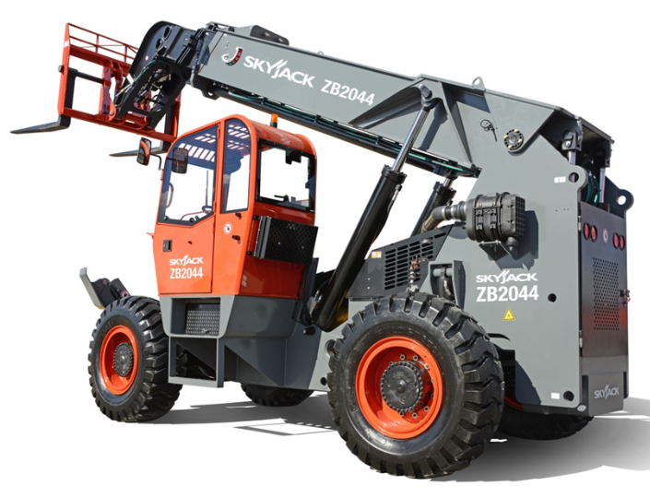
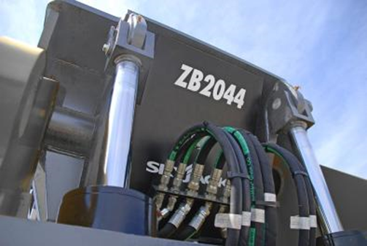
Boom Features
Dimensions Imperial Metric
Three section high mounted boom
Superior boom construction for solid, robust feel
Minimum 25% overlap between sections to reduce flex when picking loads
Extension cylinder and hoses well protected with added steel flanges
Dual lift cylinders for optimum stability
Dual slave cylinders are well protected within the frame and positioned for ease of service
Hose bulkhead for easy service and replacement of boom hydraulic hoses if needed

Slide 9
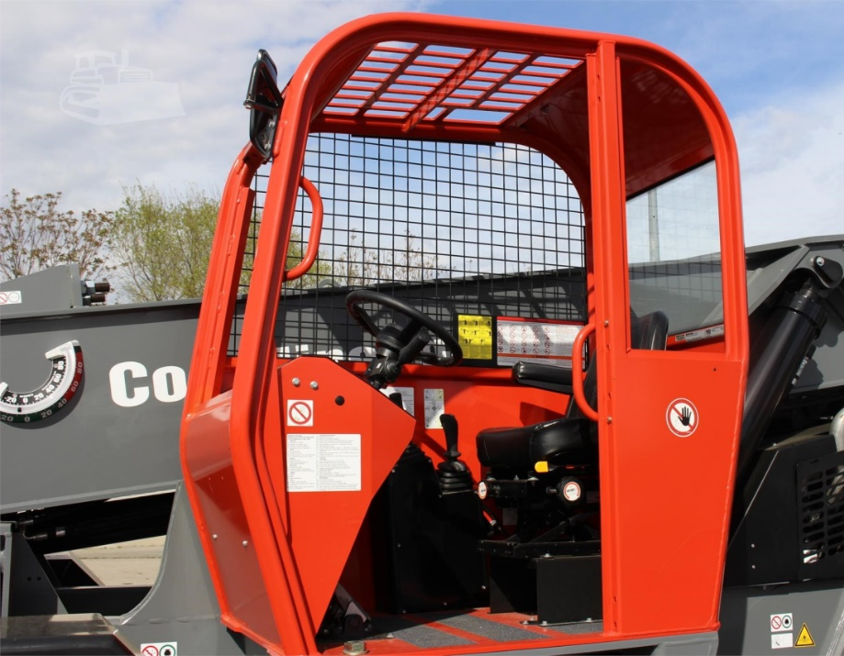
Operator Cab
Dimensions Imperial Metric
Standard adjustable deluxe suspension seat
Standard engine powerview multifunction display
Standard rear glass window and side mesh
Lockable under cab storage compartment / step
Dual joystick pilot operated controls for boom and frame level functions
Tilt adjustable joystick console

Slide 10
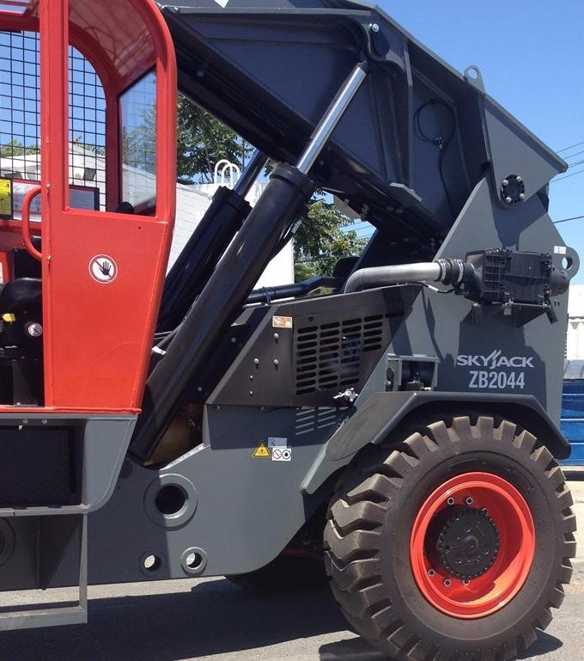
Chassis Features
Dimensions Imperial Metric
Low mid mount design, well protected by chassis weldment
All service components are easily accessible from both sides of ZB2044
Remote oil filter located underneath chassis for easy access and service

Slide 11
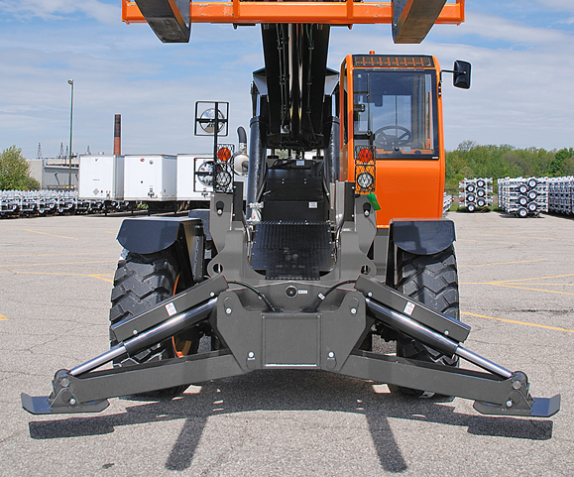
Chassis Features
Dimensions Imperial Metric
Strong, robust design keep components well protected
Axle mounted outriggers allows for frame leveling when outriggers deployed
No boom interlock on outriggers
Steel fuel and hydraulic tanks

Slide 12
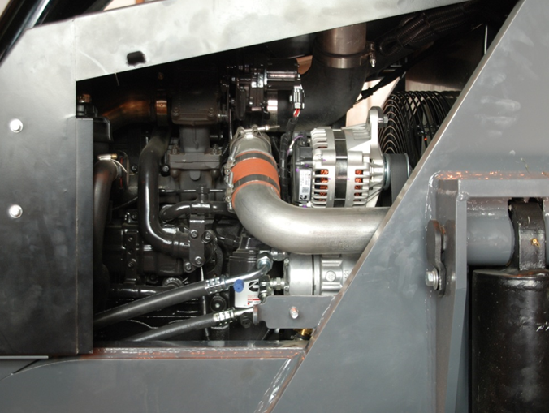
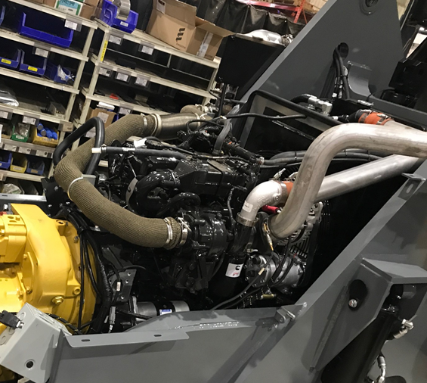
Engine
Dimensions Imperial Metric
Cummins Tier 4 Final QSB 4.5C turbocharged
Charge-air cooled diesel
168hp @ 2300rpm
466 ft-lbs @ 1500 RPM
Uses DEF, includes SCR but requires no regular regeneration

Slide 13
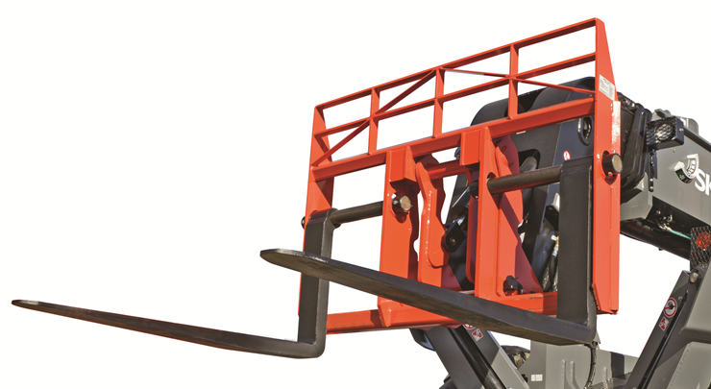
Carriage
Dimensions Imperial Metric
Robust yoke design with dual carriage tilt cylinders mounted inside yoke for optimum protection
Standard :
72” quick attach, floating pin carriage
Pallet forks, 2.75”x6”x60”, 22,100lbs capacity

Slide 14
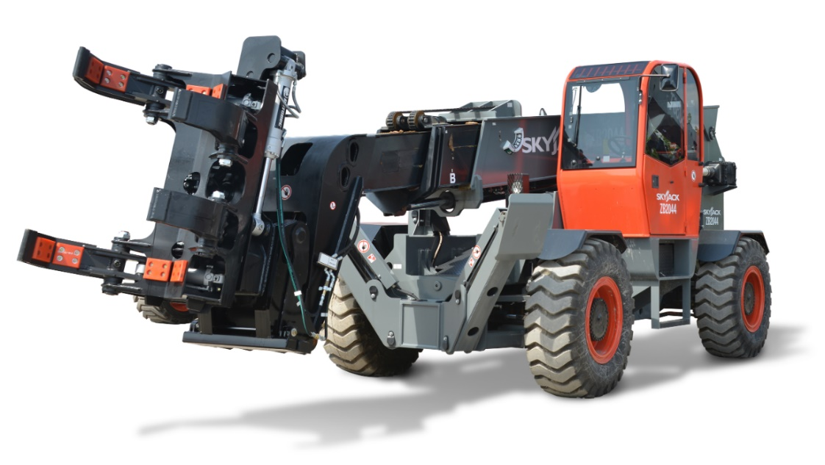
Quick Attach Carriages / Attachments
Dimensions Imperial Metric
72” or 84” Dual hydraulic fork positioner, 20,000 lbs capacity
72” or 84” Side shift carriage and dual hydraulic fork positioner, 19,000 lbs capacity
2.0 cu. yd. Light material handling bucket, 4,000 lbs capacity
Bridge stripper, 18,000 lbs capacity
Hydraulic winch, 15,000 lbs capacity
5’ Jib boom, 20,000 lbs capacity
Pipe and pole clamp, 18,000 lbs capacity
Rotating pipe and pole manipulator, 8,000 lbs capacity

Slide 15
