Slide 1
Skyjack TH Telehandlers

Slide 2
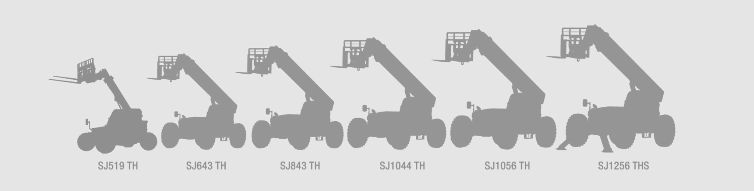
Skyjack TH Series Product Line Overview
Simple, Serviceable, Reliable, Skyjack

Slide 3
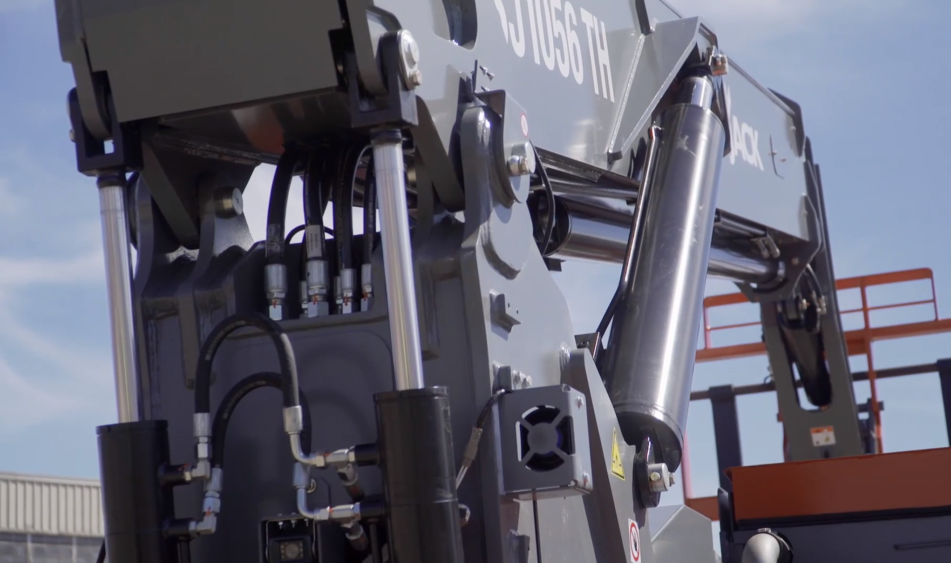
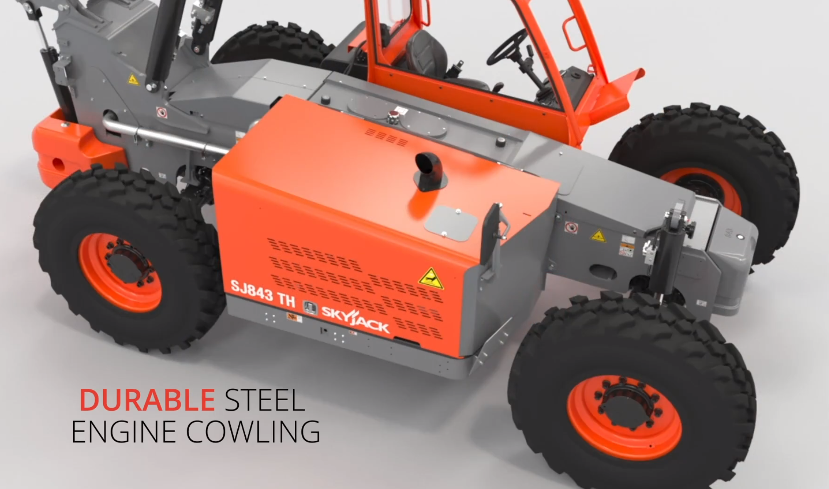

New Improvements
Dimensions Imperial Metric
A new dual-tilt compensation cylinder design improves load distribution and reliability.
New durable and rental yard repairable steel engine cowling.
New maintenance-free (greaseless) main bearings.
A relocated ECU for easier service access.
A new high-pressure filter system and improved hydraulic tank design – significantly reducing contamination.
New ergonomic seat with improved weather protection.
Skyjack TH Series on Vimeo

Slide 4
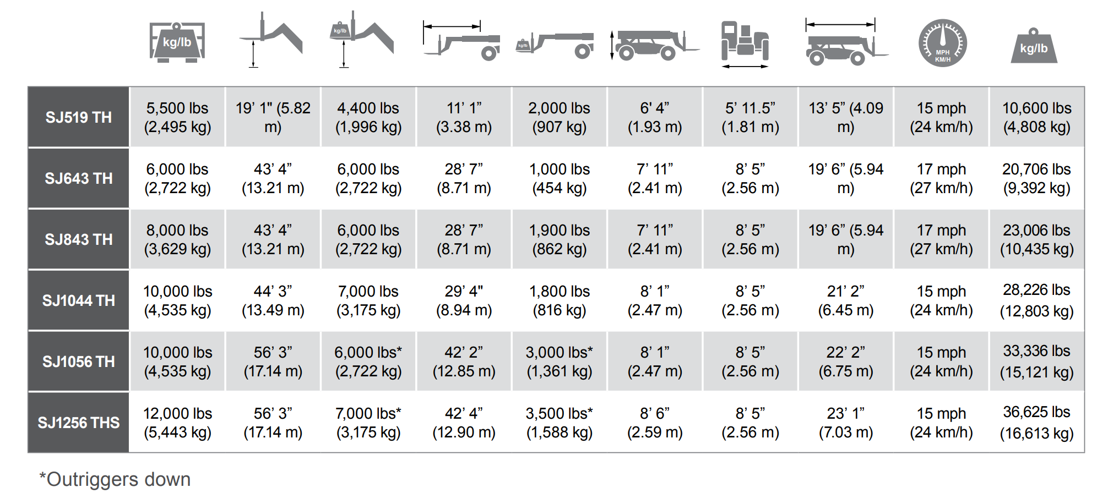
Spec Overview
Dimensions Imperial Metric

Slide 5
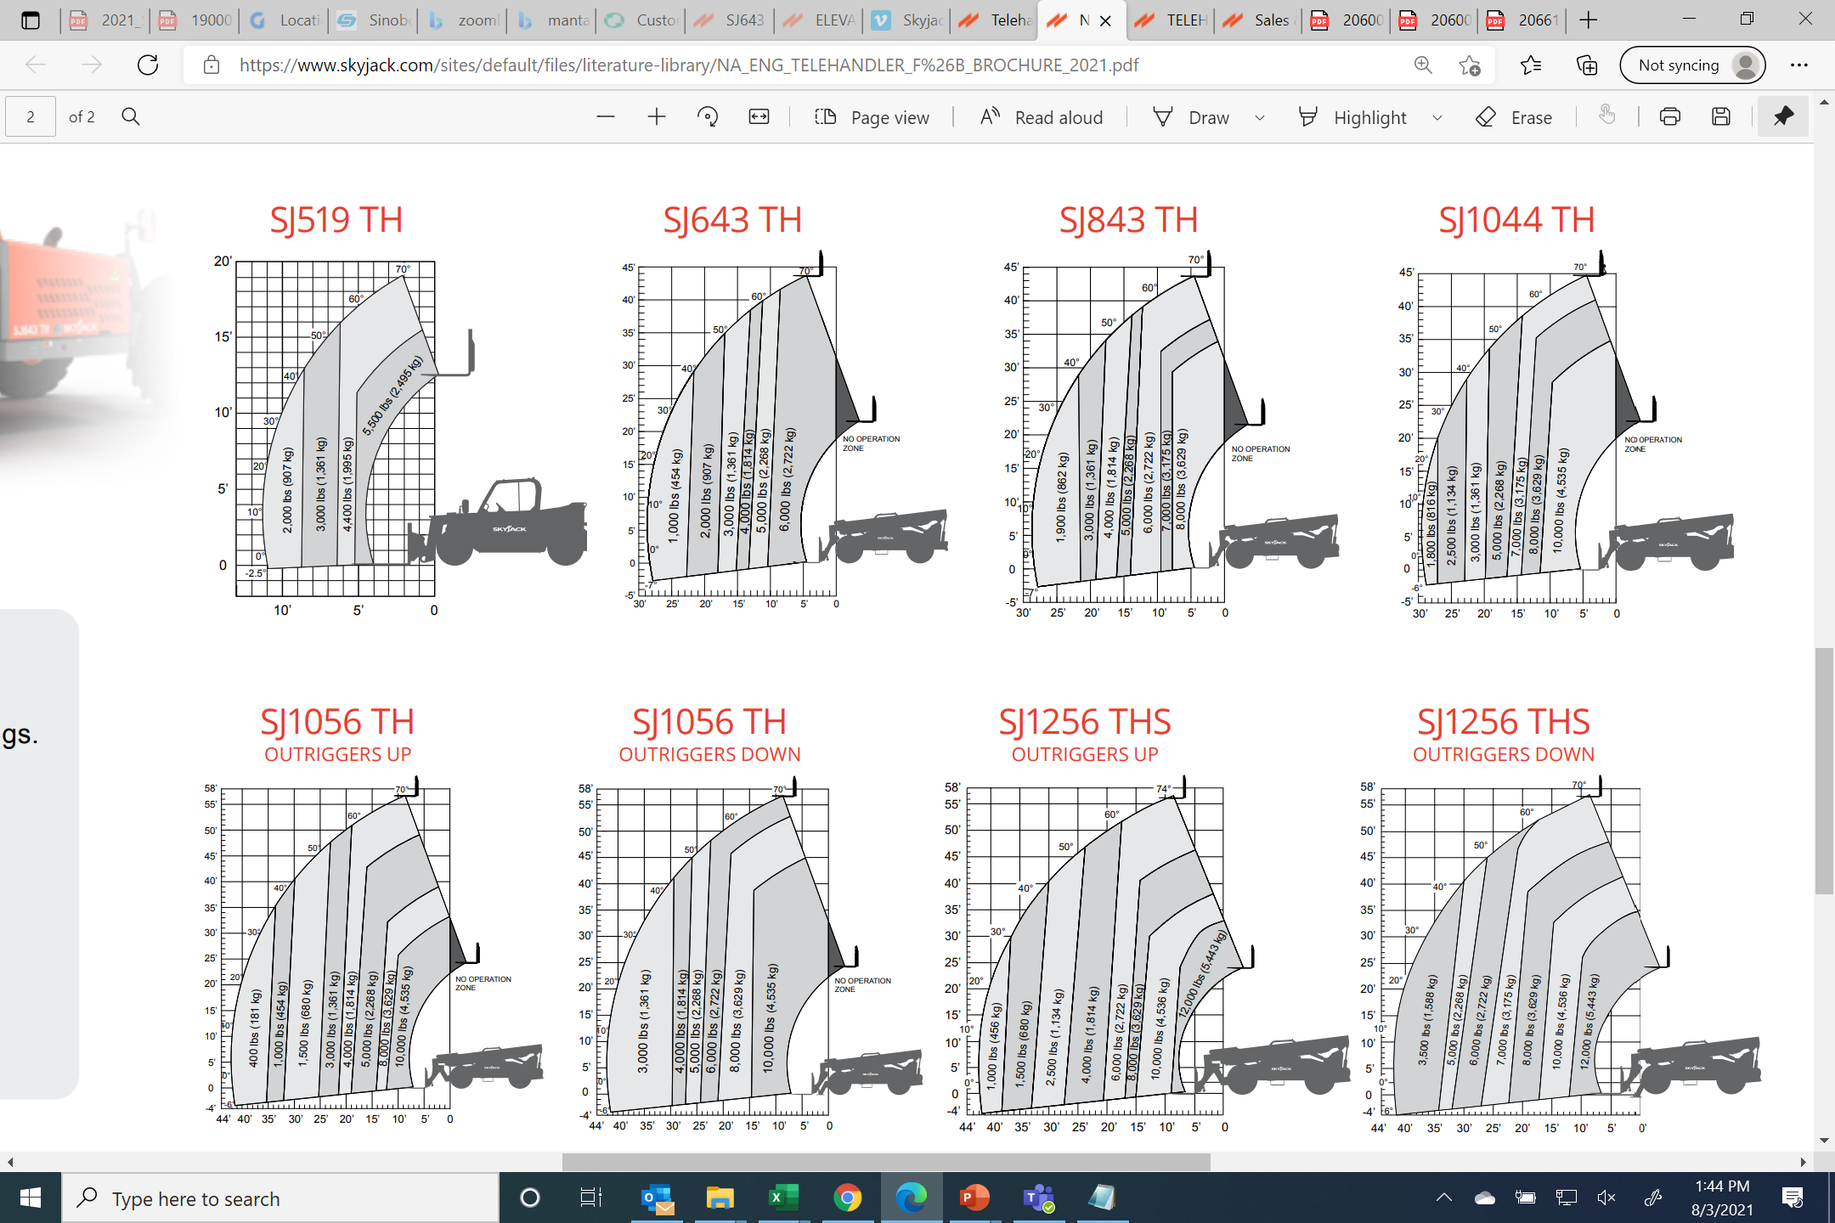
Standard Load Charts
Dimensions Imperial Metric
The TH Series offers competitive and often superior capacities at max. height and at full extension when compared to similar models at 24” load center
Multiple attachments also allow for job site versatility

Slide 6
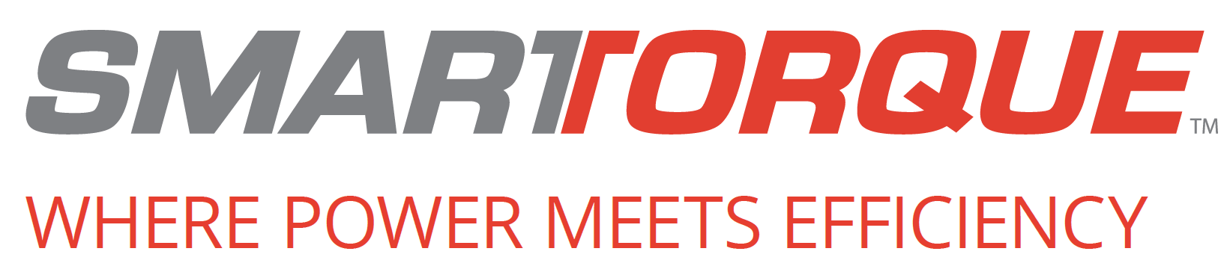
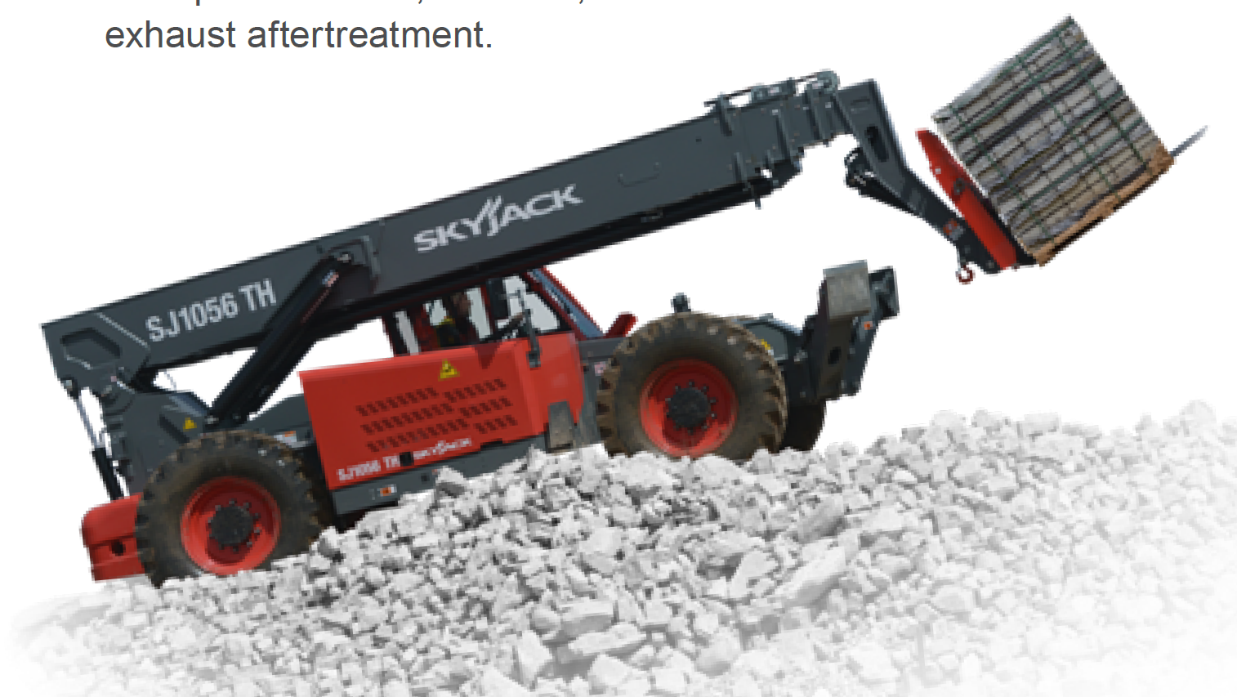
Unique to Skyjack
Dimensions Imperial Metric
Through the use of improved gearing and a high-efficiency hydraulics package, Skyjack’s TH Series’ 74 hp engines deliver the same on-site job performance as higher horsepower units
SMARTORQUE™ is also engineered to require NO DPF, NO DEF, and NO other active exhaust aftertreatment

Slide 7

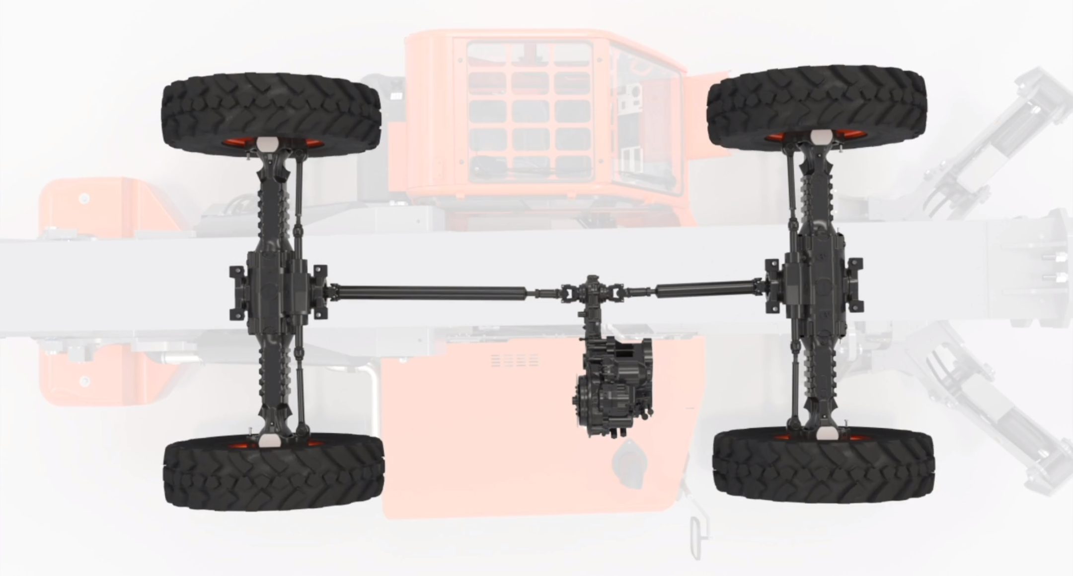
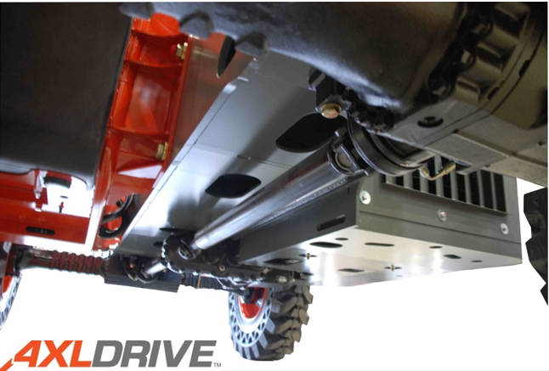
Unique to Skyjack
Dimensions Imperial Metric
Dana axle drive system
Positive traction and industry leading rough ground ‘terrain-ability’

Slide 8
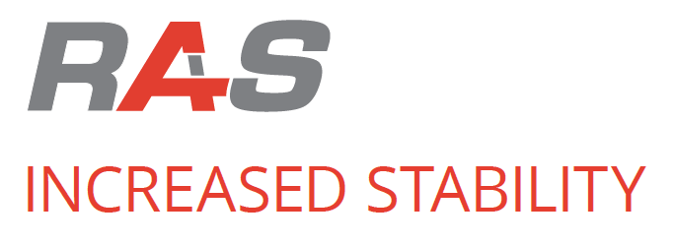
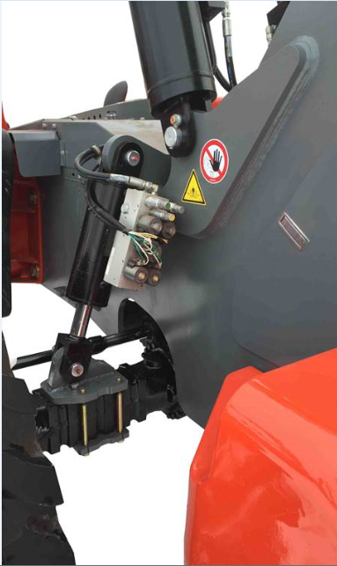
Unique to Skyjack
Dimensions Imperial Metric
Unique system offering increased stability at height that requires no operator inputs
Offers 3 modes of operation
Normal Free Pivot
Restricted Mode
Locked
With boom elevated to 40˚ of more, the rear axle switches from free pivot mode to a restricted mode
Only allows up to 3˚ frame level
Standard on SJ1044 TH, SJ1056 TH, SJ1256 THS

Slide 9
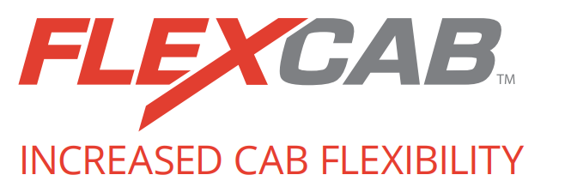
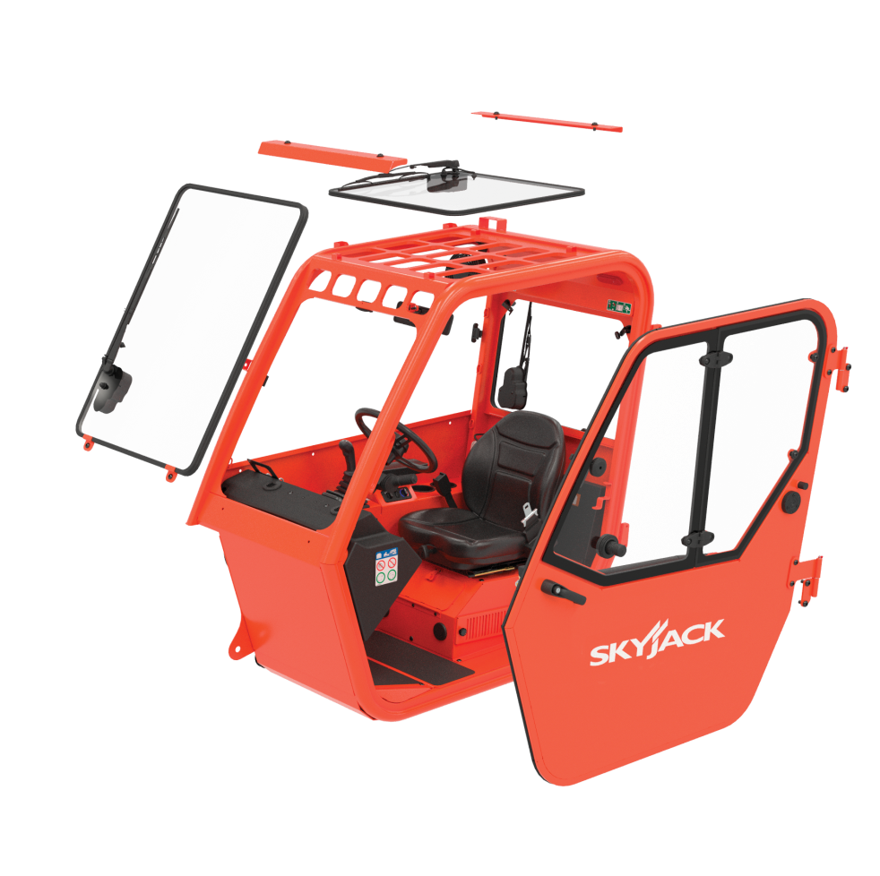
Unique to Skyjack
Dimensions Imperial Metric
Innovative cab design enabling fleet owners to effortlessly convert from open to enclosed cabs
Allows for complete machine utilization in all types of weather
Minimal downtime and incurred cost if glass is damaged in the field
Glass panels are the same part number across TH Series
Ex. SJ519 TH windshield can be used on an SJ1256 THS and vice versa

Slide 10
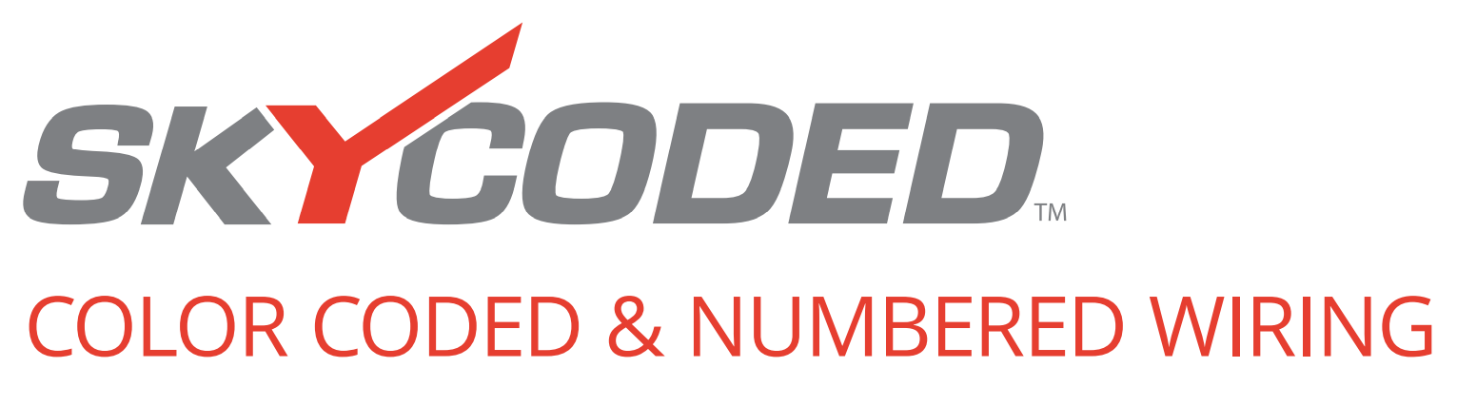
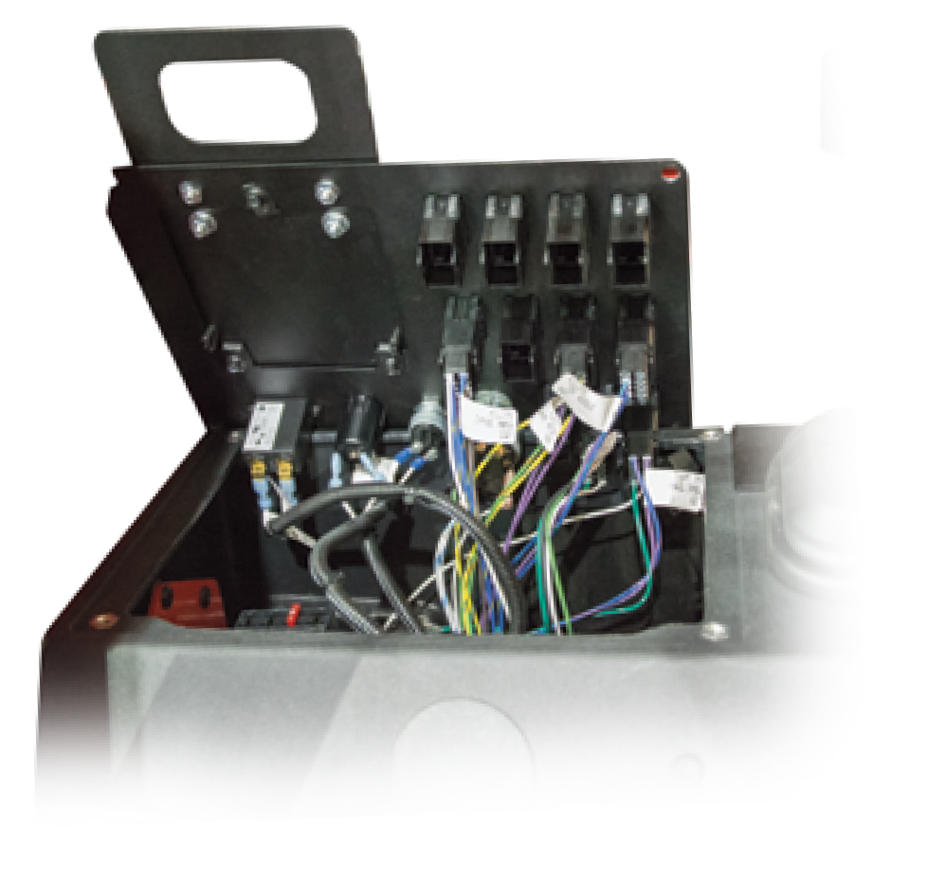
Unique to Skyjack
Dimensions Imperial Metric
SKYCODED™ is located at the heart of every Skyjack machine
Simple relay-based control system using color coded and numbered wiring system
Results in decreased downtime and lower maintenance costs

Slide 11
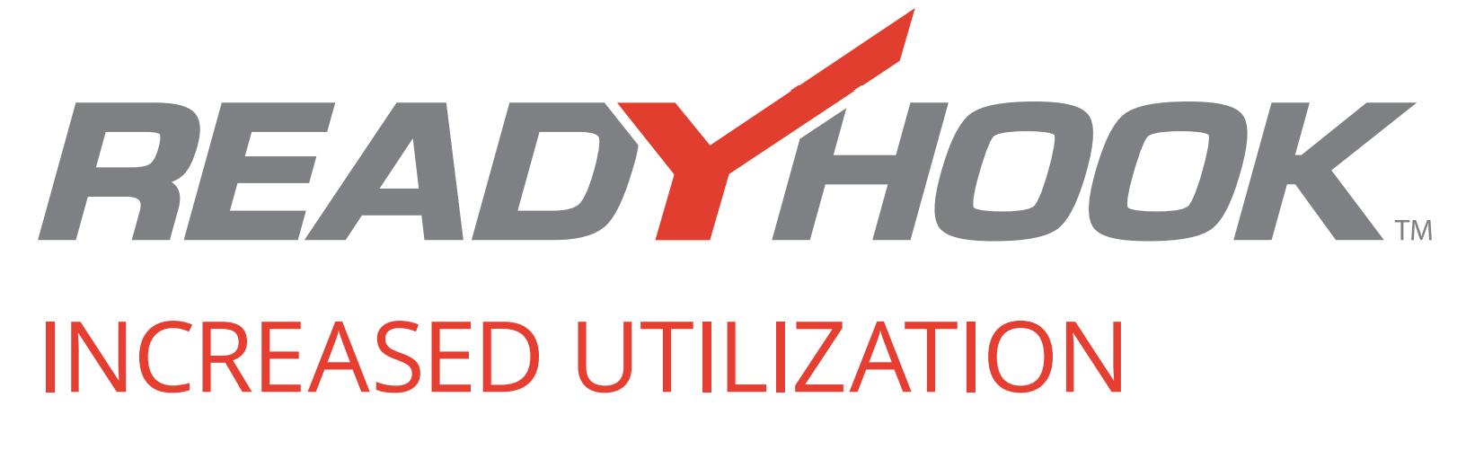
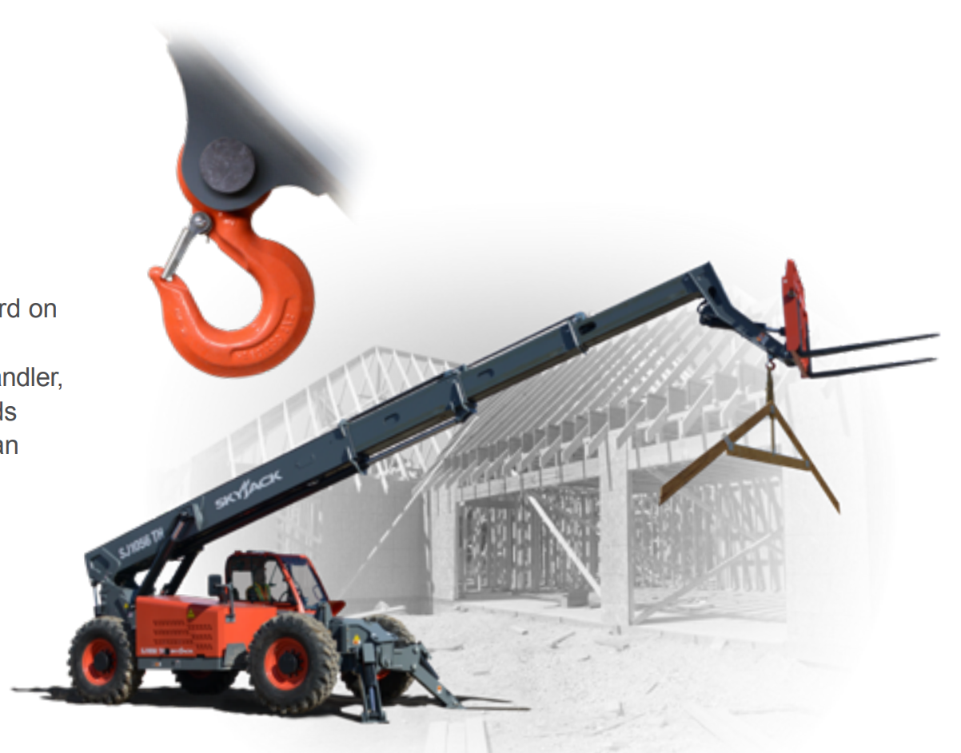
Unique to Skyjack
Dimensions Imperial Metric
A yoke mounted lifting hook that is fitted as standard across whole TH series
Capacities of yoke match the maximum lift capability of TH
Allows safe under-slinging of loads
Avoids the practice of using the forks as an underslung lifting device
Standard yoke mounted lifting shackle on SJ519TH

Slide 12
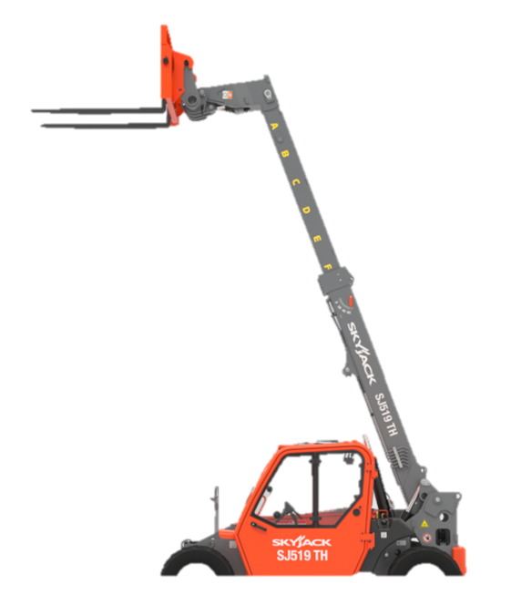
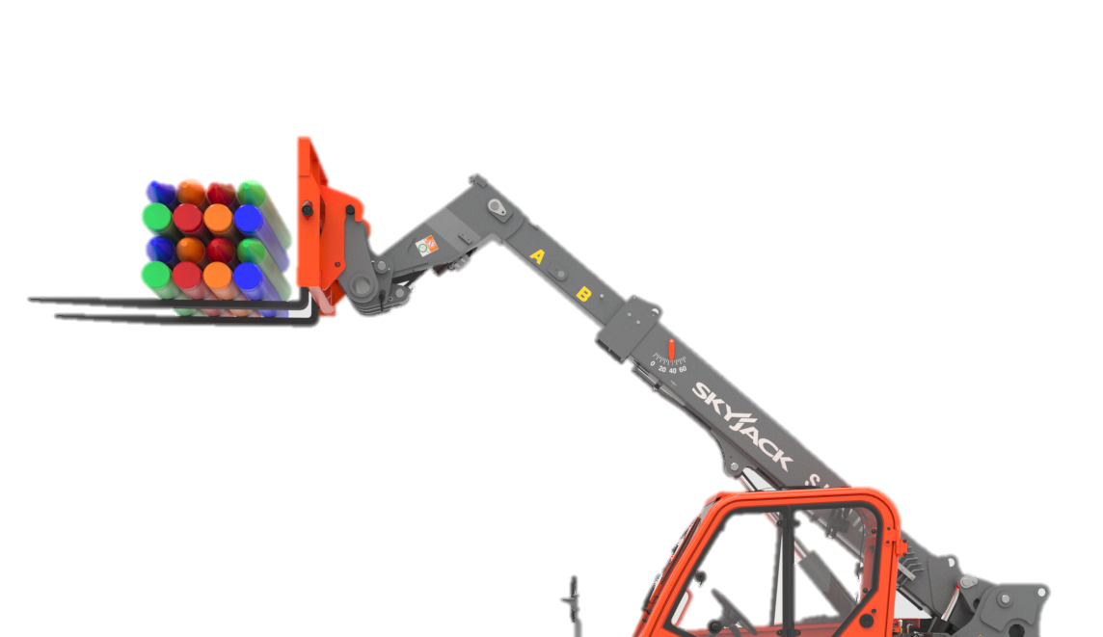
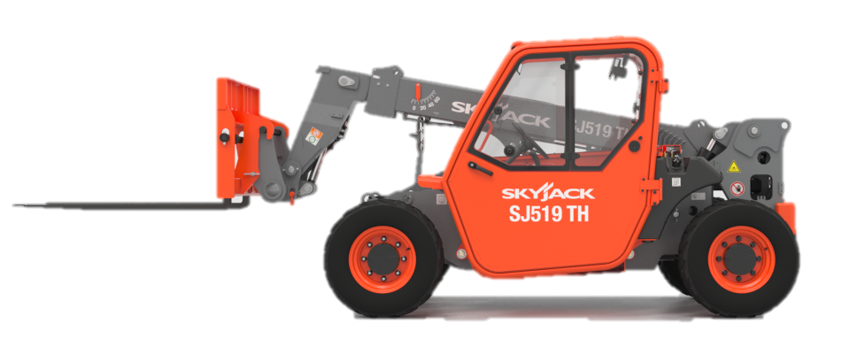
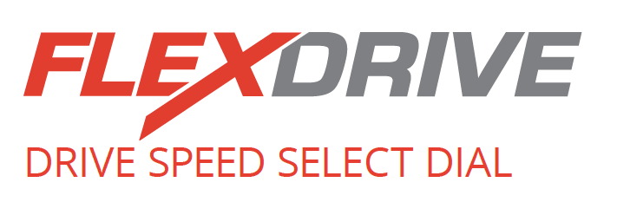
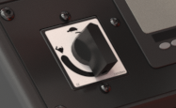
Unique to Skyjack
Dimensions Imperial Metric
Machine Function Speeds Do Not Change
Available for the SJ519 TH, FLEXDRIVE option allows the operator to reduce drive speed while keeping all function speeds the same.
By allowing low travel speed at high engine RPM, the operator is able to creep forward and reverse while maintaining all function and hydraulic performance required to complete the job.
Reduces Drive Speed

Slide 13
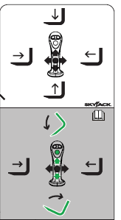
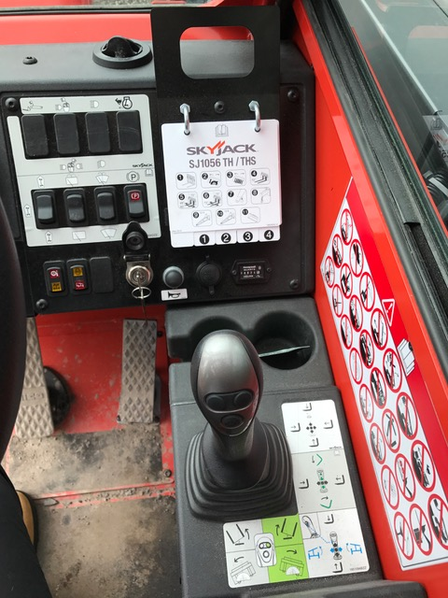
Joystick Controls
Dimensions Imperial Metric
Multifunctional Joystick Directions

Slide 14
Main Boom
BOOM
LOWER
Dimensions Imperial Metric
BOOM
RETRACT
BOOM
EXTEND
BOOM
LIFT

Slide 15
Carriage Tilt
CARRIAGE
FORWARD TILT
Dimensions Imperial Metric
BOOM
RETRACT
BOOM
EXTEND
CARRIAGE
REVERSE TILT
Hold Bottom Middle Button to Activate Carriage Tilt Forward/Back

Slide 16
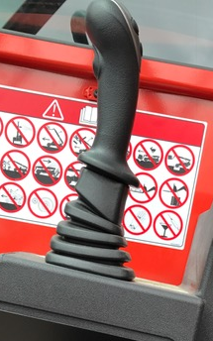
Frame Level Enable Switch
Frame Tilt
BOOM
LOWER
Dimensions Imperial Metric
FRAME
TILT LEFT
FRAME
TILT RIGHT
BOOM
LIFT
Hold Bottom Located on Back of Joystick to enable Frame Leveling

Slide 17
Attachment Functions
Dimensions Imperial Metric
ATTACHMENT TILT
OR ROTATE LEFT
ATTACHMENT TILT
OR ROTATE RIGHT
Select (L/R) Aux. Attachment Button to Tilt / Rotate Attachment

