Slide 2
Telescopic Booms

Slide 3
Skyjack proudly provides companies with quality-engineered, simple and reliable access and material handling equipment globally so they can maximize utilization and their return on investment.

Slide 4
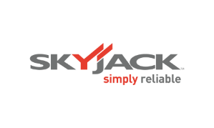
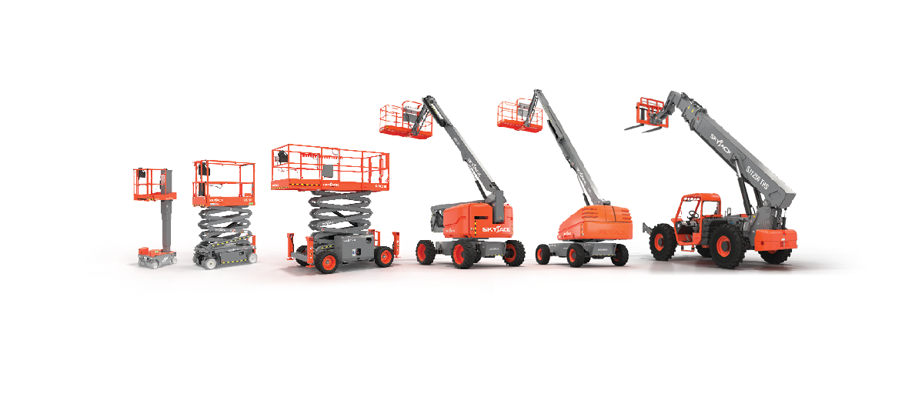
Simple, reliable products

Slide 5
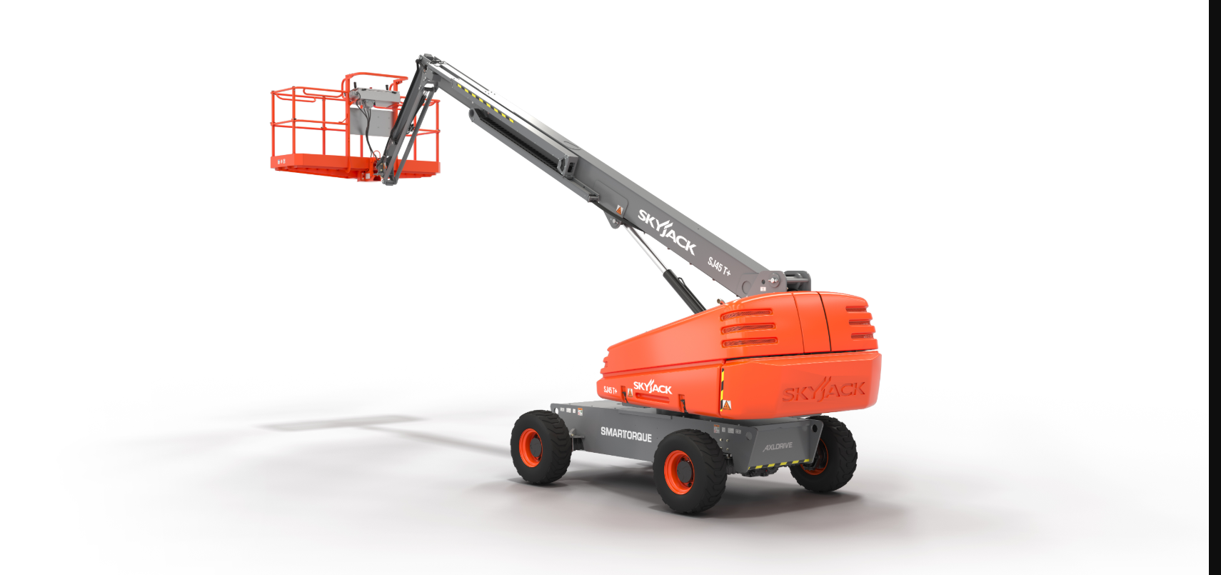
Click image for video

Slide 6
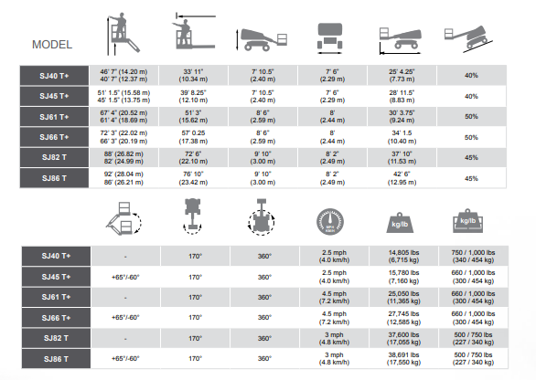

Slide 7
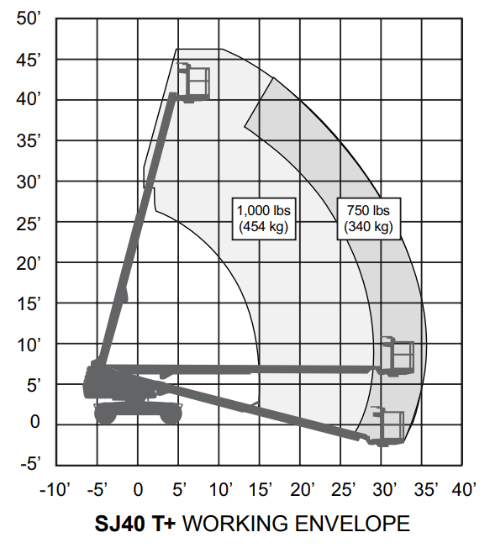
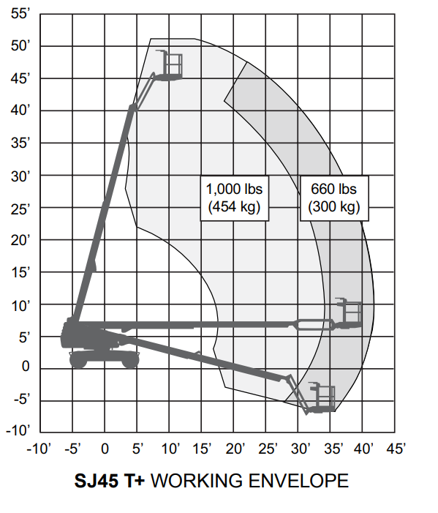
Dual Zone

Slide 8
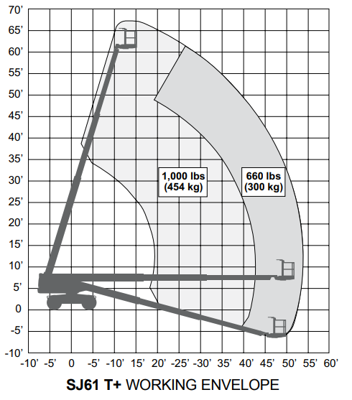
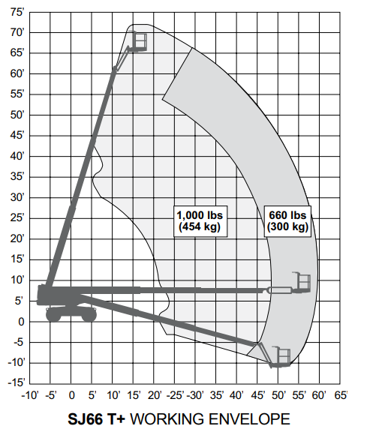
Dual Zone

Slide 9
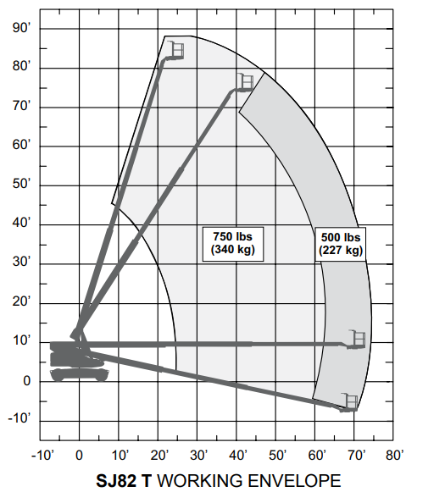
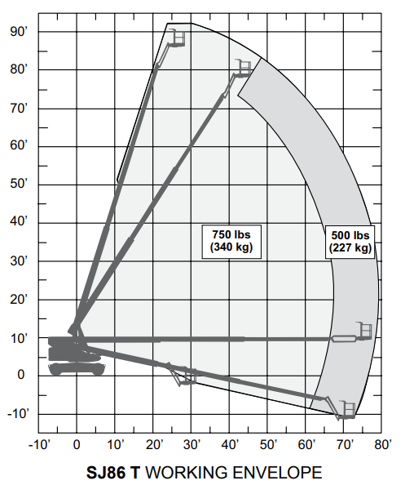
Dual Zone

Slide 10
Outreach and Control
Telescopic booms provide excellent outreach when fully extended, the articulating jib and platform rotation offer an extra degree of fine control and flexibility.
Function speed adjuster allows speed adjustment for platform toggle switch functions (platform rotate, jib, boom extension).

Slide 11
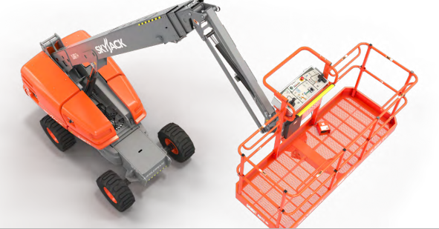
Let’s Talk Torque – SJ40 T + and SJ 45 T +.
An optimized balance of engine horsepower, torque, and hydraulic performance, delivers the same on-site job performance as higher-powered units - providing excellent performance with less engine horsepower.
Less emission controlling components avoids the cost associated with their complexity, as well as the time and inconvenience required in maintaining them.- powered to meet true job site performance expectation.

Slide 12
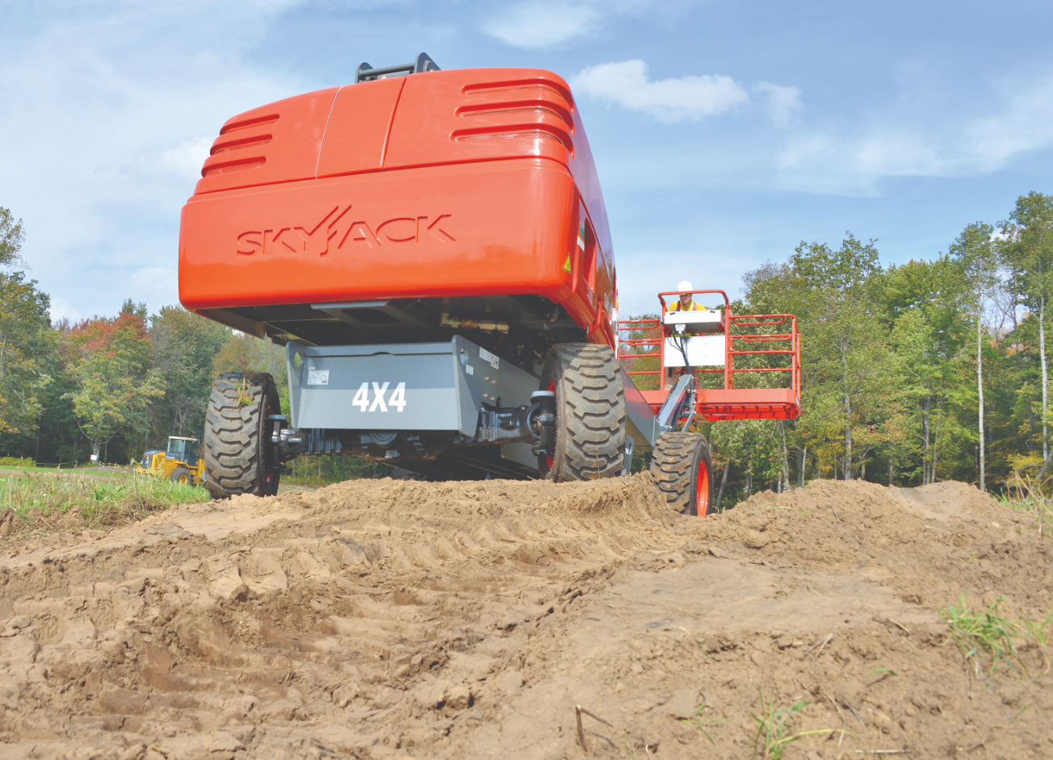
Let’s Talk Torque
The return of simple, straightforward service and maintenance of engines.
Avoidance of expensive emission controlling sensors.
Reduced calls to customers who have a machine down ultimately due to failed emission controlling components.
No need to monitor operators to ensure they are treating emission modules correctly.
Reduced risk of costly emission controlling component replacements or in some cases engine replacements.
Smaller engines require less fuel.

Slide 13
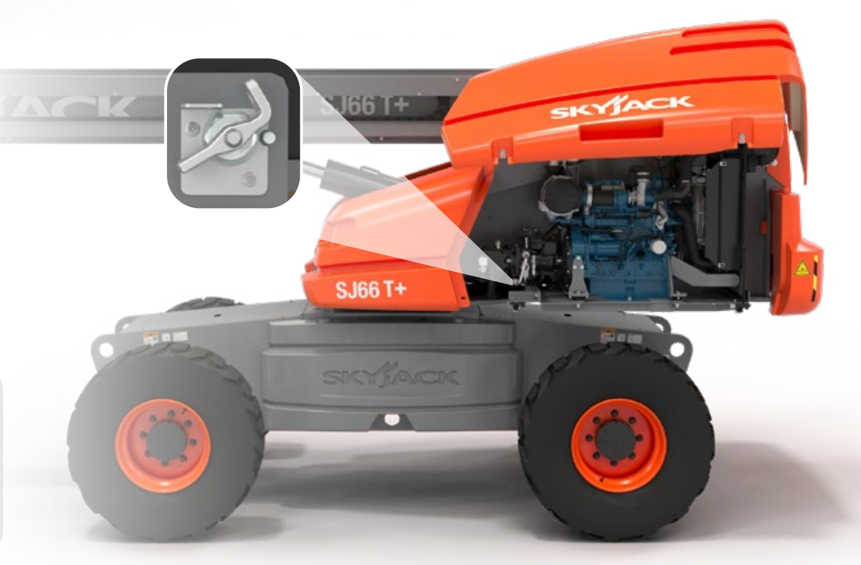
Ease of Maintenance
Designed with Ease of Maintenance in Mind
All Skyjack telescopic booms are designed with ease of maintenance and service in mind.
Key components are easily accessible and all wiring is colour coded and numbered to minimize downtime.
Strategic placement of hydraulic and other components for optimum hose routing.
Lockable battery disconnect that fully disables operation.

Slide 14
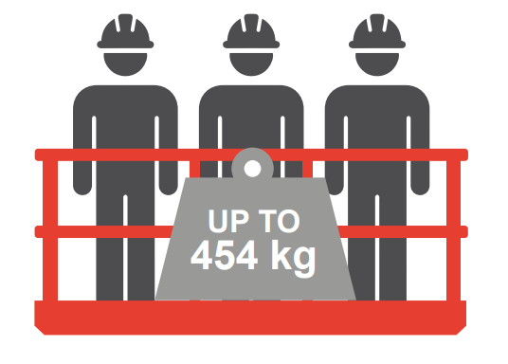
Platform Capacities
Capacities up to 1,000 lbs (454kg) and 3 People in the Platform
Increases productivity.
Higher capacities allow for fewer trips and more efficient use of time and resources.
Integrated with load sensing.
Lights on control box indicate zone…
based on weight and position.

Slide 15
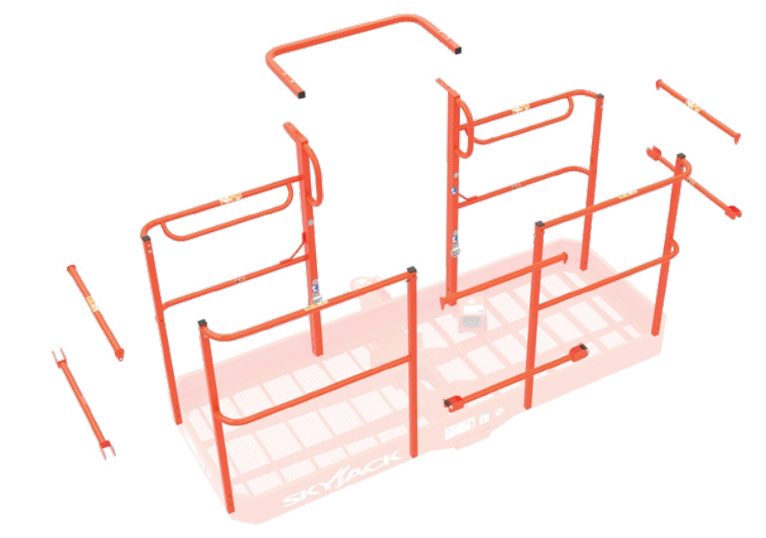
Simple to Replace Bolt-in Railings
Bolt-in platform railings provide a durable structure but also a service part that’s easily replaceable.
Sections can be replaced individually which translates to lower replacement costs for both parts and labor.
Optional gate entrances and different sized platforms are also available.

Slide 16
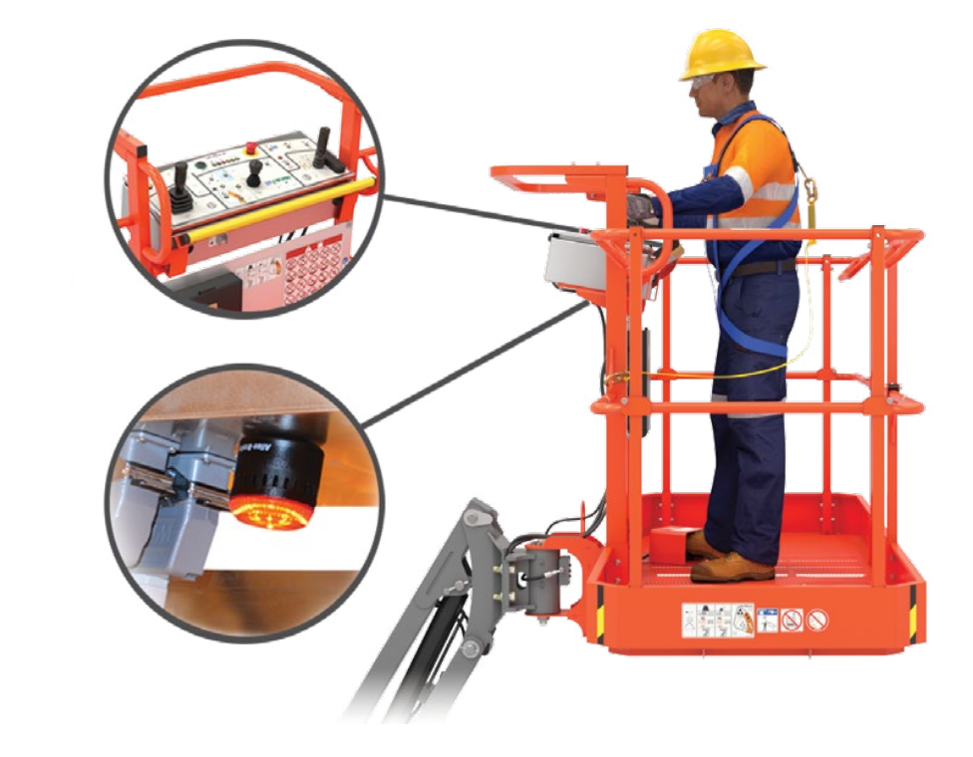
Secondary Guarding (Electrical) System Standard
Skyjack’s SGE system is intended to prevent sustained involuntary operation.
When pushed, the sensor bar instantly stops all functions and initiates an audible siren and high-intensity flashing beacon.

Slide 17
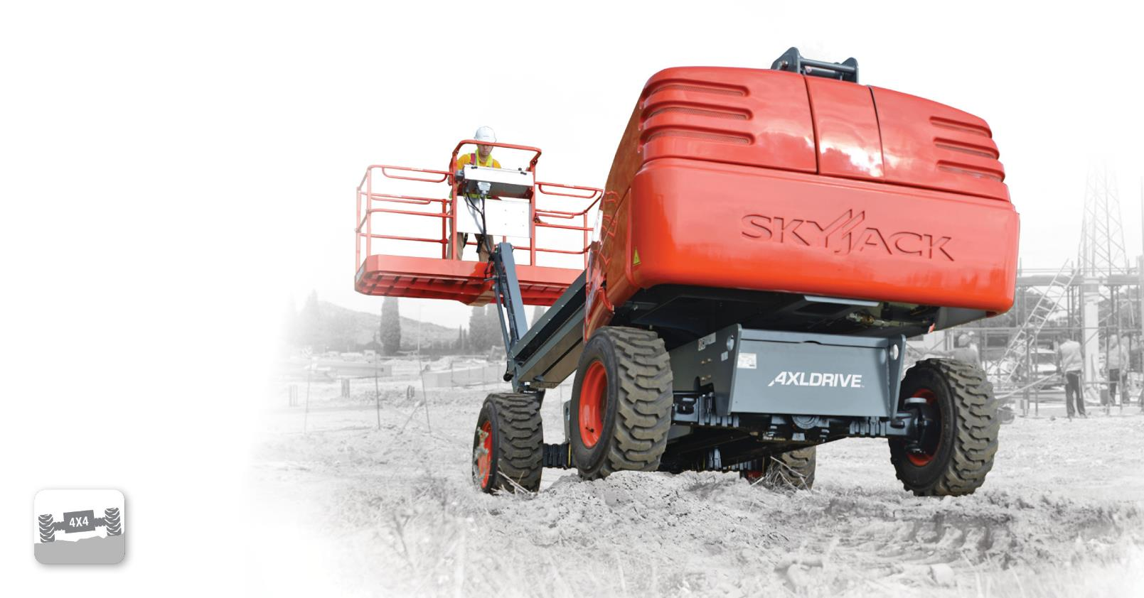
True axle-based four-wheel drive gives positive traction and excellent rough ground terrainability.
Available on all engine-powered booms,
full-size RT scissors, and telehandlers

Slide 18
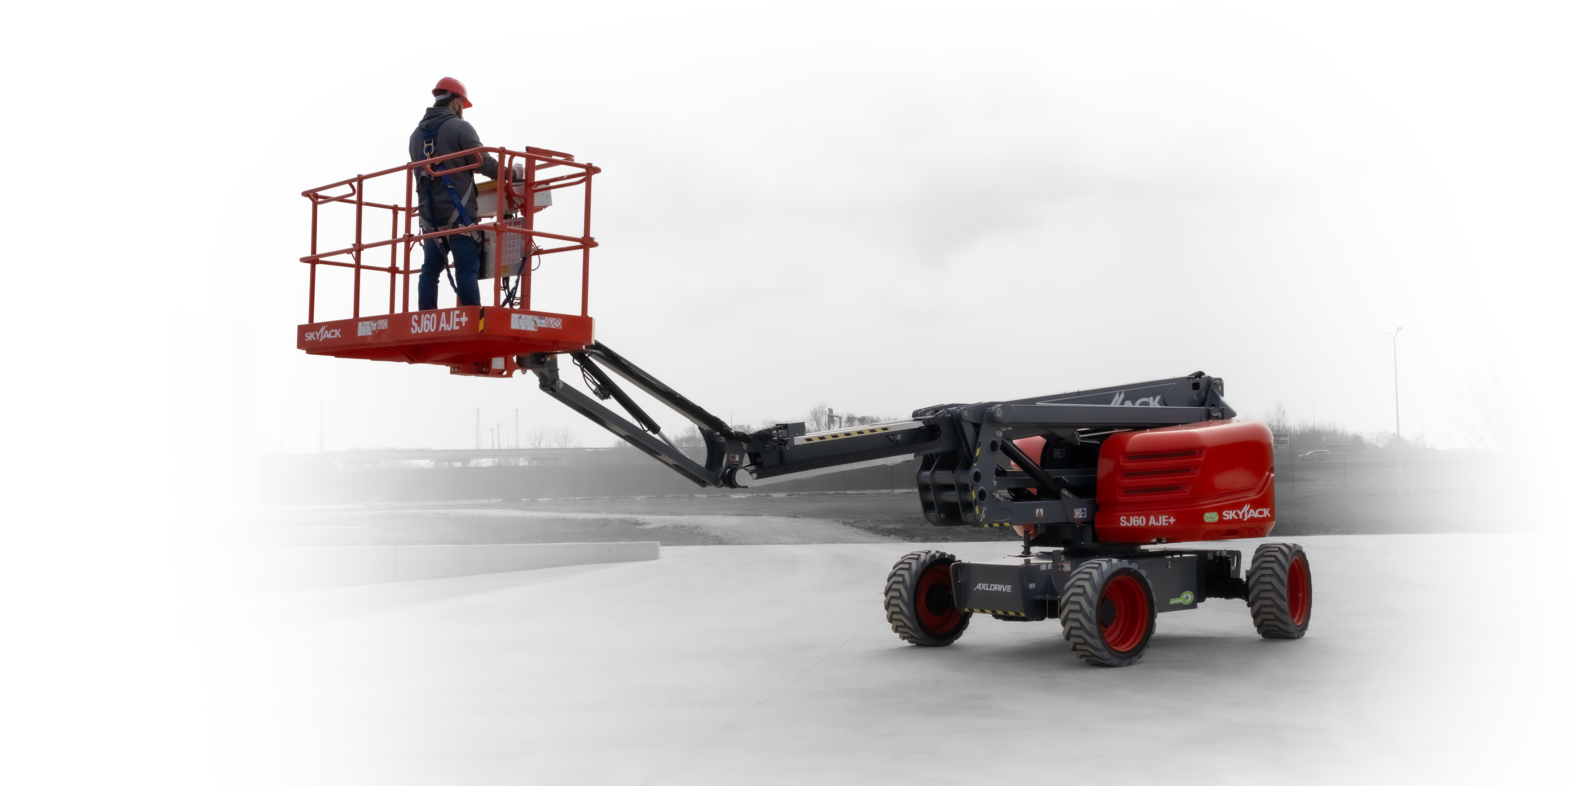
Keeps boom drive controls in the orientation of the boom regardless of position of the turret over chassis.
^{On all booms}

Slide 19
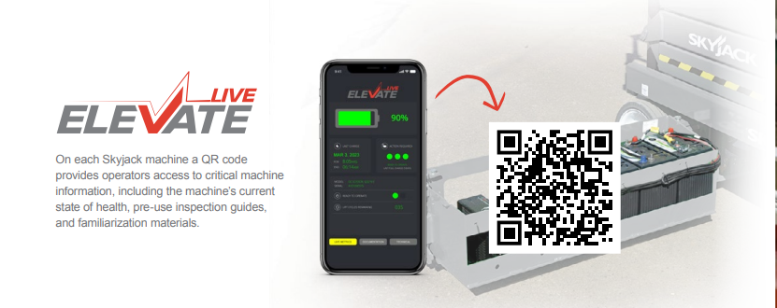
On each Skyjack machine a QR code provides operators access to critical machine information, including the machine’s current state of health, pre-use inspection guides, and familiarization materials.

Slide 20
HVO
Helping Rental to go Carbon Neutral
HVO has been shown to reduce greenhouse gas emissions, compared to standard diesel and can help with carbon footprint reduction strategies.
When using HVO shorter maintenance intervals may be required, including replacing fuel filters and system cleaning. Since the density of EN15940 is less than EN590 diesel, when using HVO a reduction in performance may be experienced.

Slide 21
Pipe Rack.
Glazer Kit.
Tool Caddy.

Slide 22
Options
Kubota WG972 dual fuel engine (SJ6X T+ only)
Flashing light.
36 x 72” Platform.
Side spring hinged entry gate.
Auxiliary top rail.
3.5 kW generator.
Welder ready package (Includes 7.5 kW generator, 3-phase power connection in platform, and welder mount).
Cold weather start kit (Recommended for regions where average monthly low temperatures can reach 14°F / -10°C (Includes cold start engine oil, battery blanket, and hydraulic tank heater).

Slide 23
Options
Arctic weather package (Recommended for regions where average monthly low temperatures can reach -0.4F / -18°C (Includes arctic engine oil, battery blanket, hydraulic tank heater, block heater, arctic hydraulic oil, and arctic gear oil in the axles and swing drive. Glow plugs, arctic hydraulic hoses (all), arctic platform rotator and oversized foot switch cover are also included (standard equipment).
Control box cover.
Diesel scrubber for sub 25hp engine.
Positive air shut-off valve (diesel only).
Bio oil.
White noise alarm.
Turf Tires. (SJ4x and SJ 6x T).
Platform mesh.
Non-destructive testing.
Grip lug non-marking tires.
ELEVATE telematics.
Extended warranty.

Slide 24
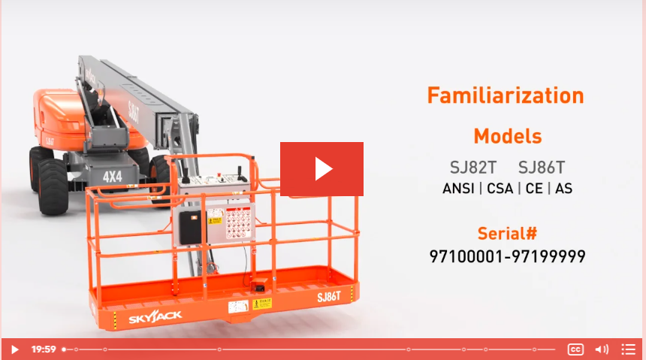
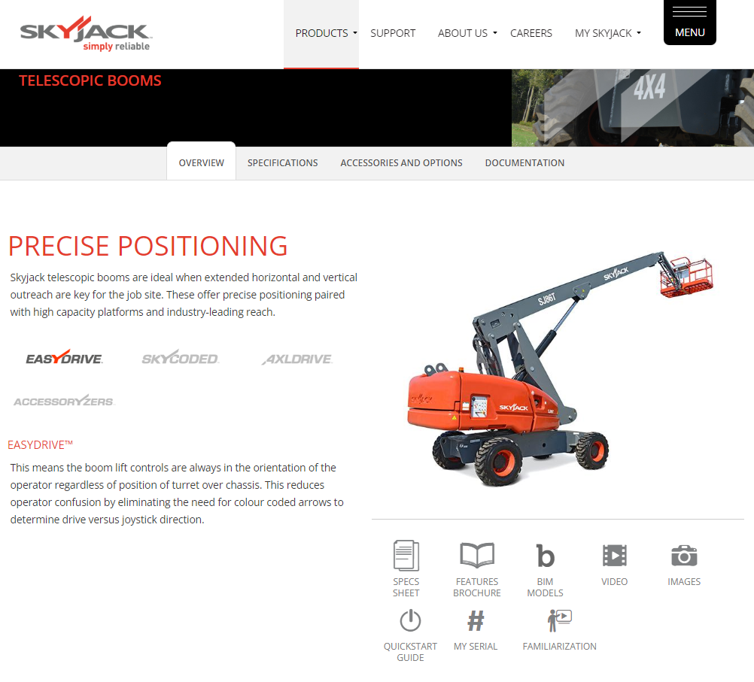
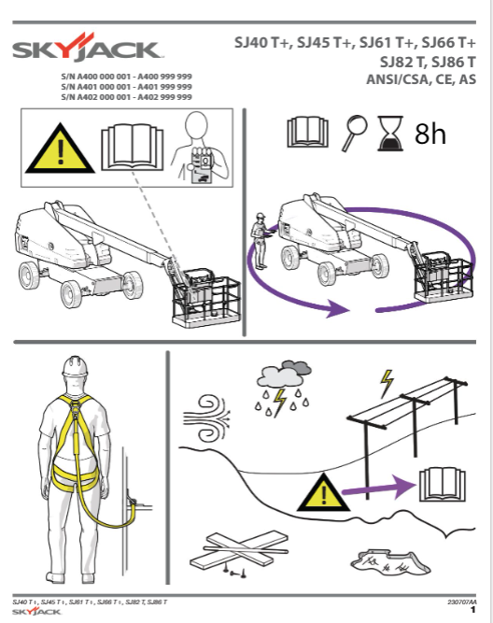
More Information
www.skyjack.com

