Slide 2
TH Series Telehandlers

Slide 3
Skyjack proudly provides companies with quality-engineered, simple and reliable access and material handling equipment globally so they can maximize utilization and their return on investment.

Slide 4
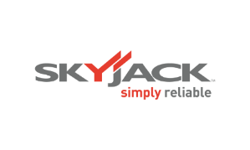
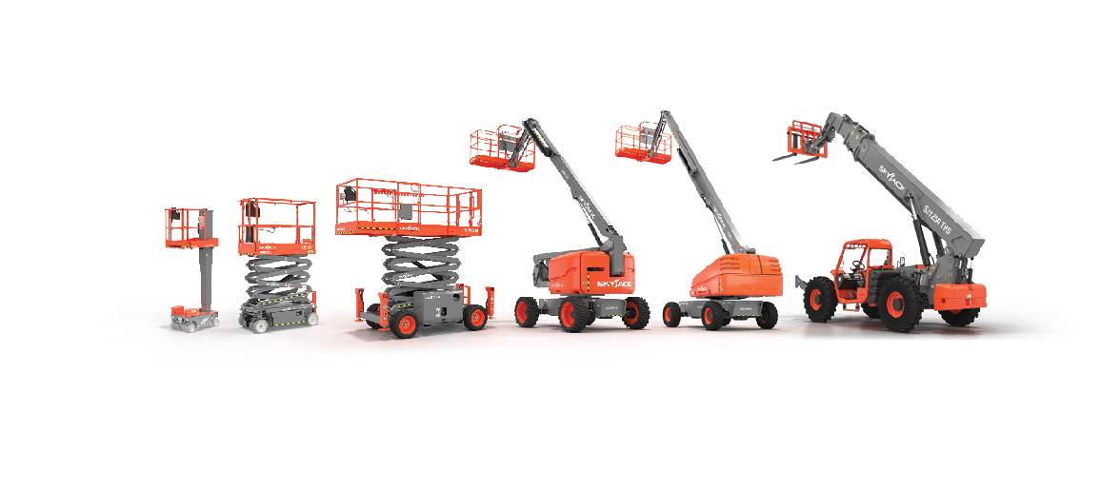
Simple, reliable products

Slide 5
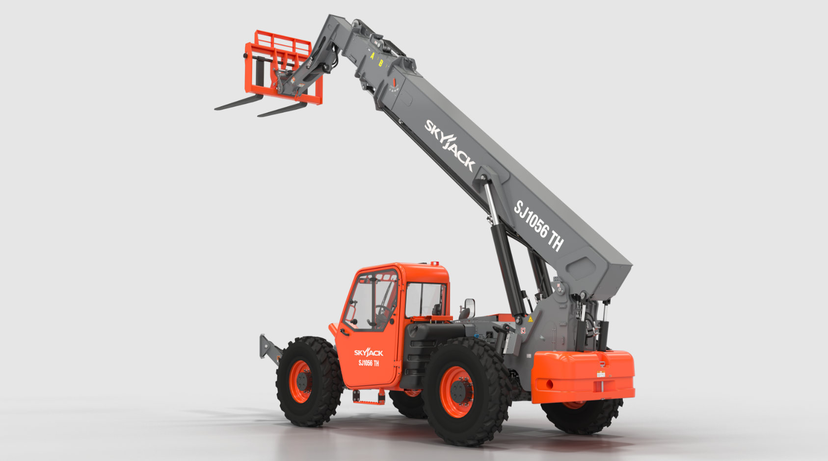

Slide 6
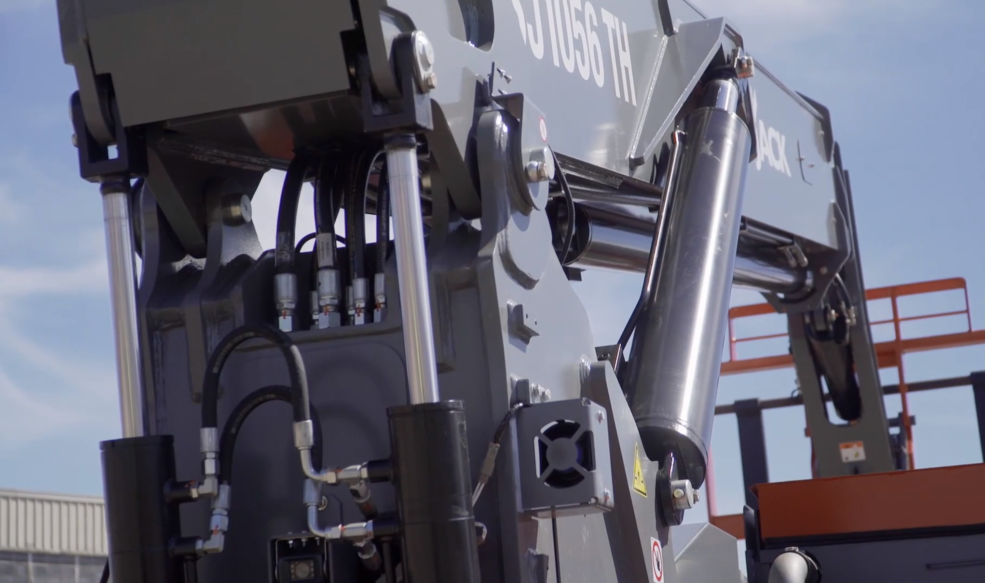
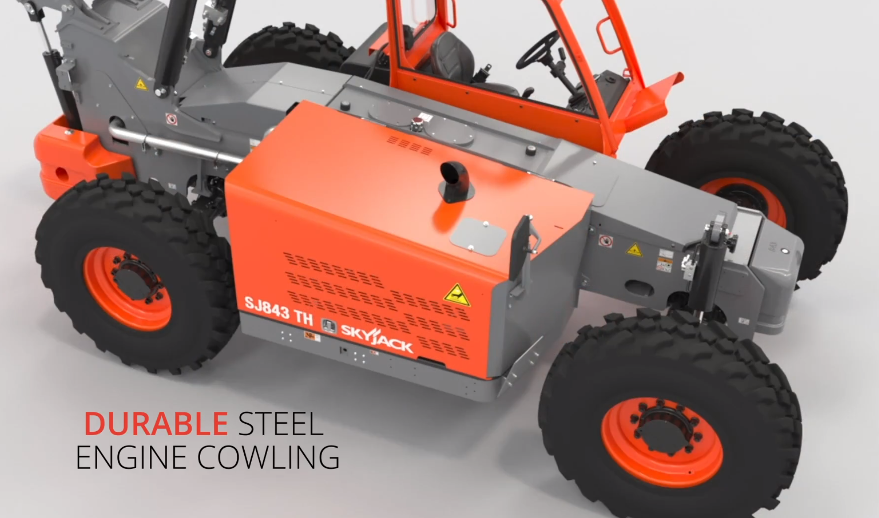
Recent Improvements
NEW dual-tilt compensation cylinder design improves load distribution and reliability.
NEW durable and rental yard repairable steel engine cowling.
NEW maintenance-free (greaseless) main bearings.
Relocated ECU for easier service access.
NEW high-pressure filter system and improved hydraulic tank design – significantly reducing contamination.
NEW ergonomic seat with improved weather protection.

Slide 7
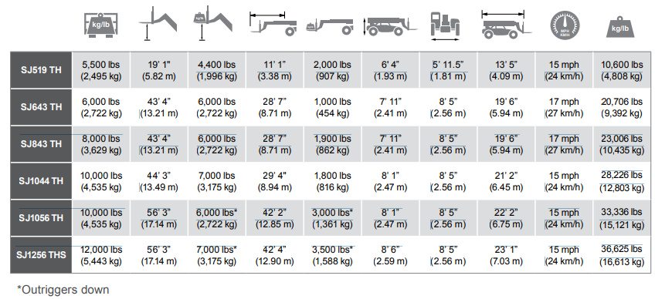
Dimensions Imperial Metric

Slide 8
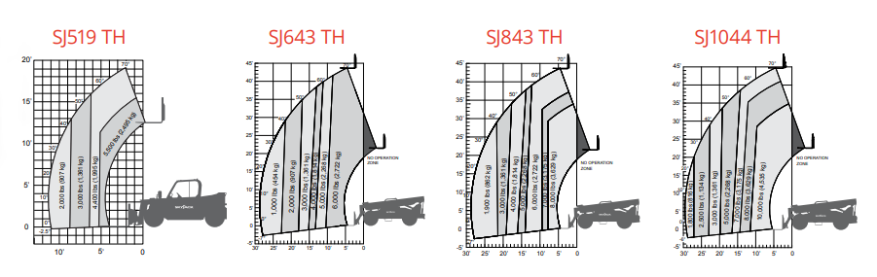
Load Charts
Competitive and Often Superior
The TH Series offers competitive and often superior capacities at max. height and at full extension when compared to similar models
at 24” load center.
Multiple attachments also allow for job site versatility.

Slide 9
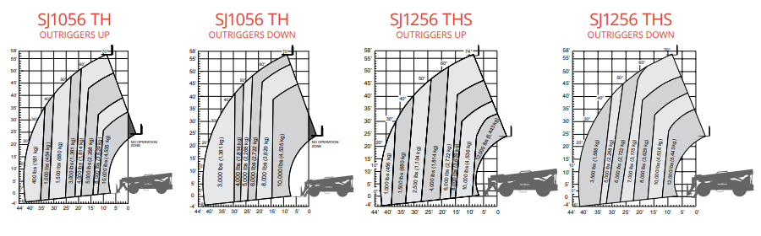
Load Charts
Competitive and Often Superior
The TH Series offers competitive and often superior capacities at max. height and at full extension when compared to similar models
at 24” load center.
Multiple attachments also allow for job site versatility.

Slide 10
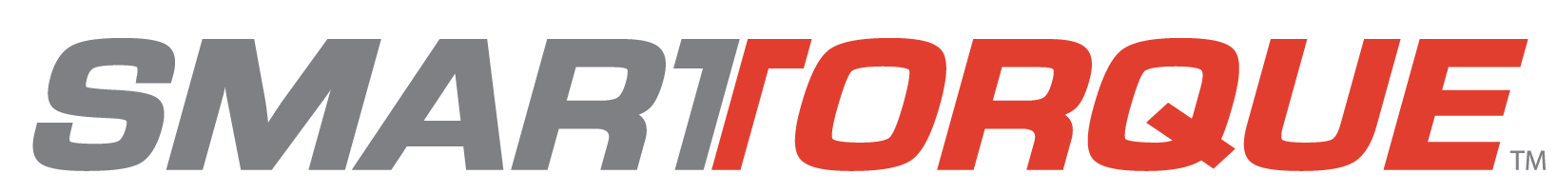

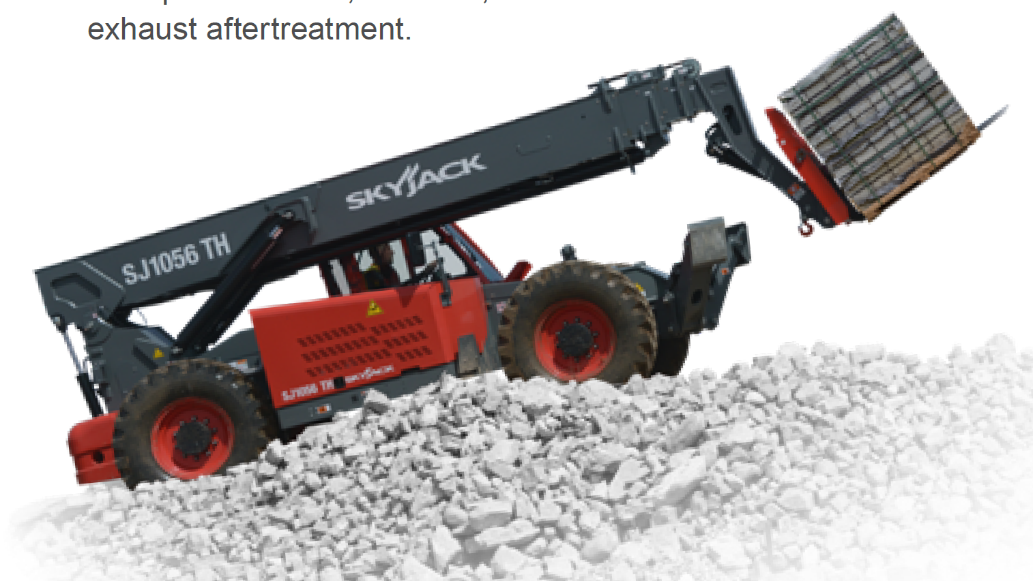

Where Power Meets Efficiency
By using improved gearing and a high-efficiency hydraulics package. Skyjack’s TH Series’ 74 hp engines deliver
the same on-site job performance as higher
horsepower units.
SMARTORQUE™ is also engineered to
require NO DPF, NO DEF, and NO other
active exhaust after treatment.

Slide 11

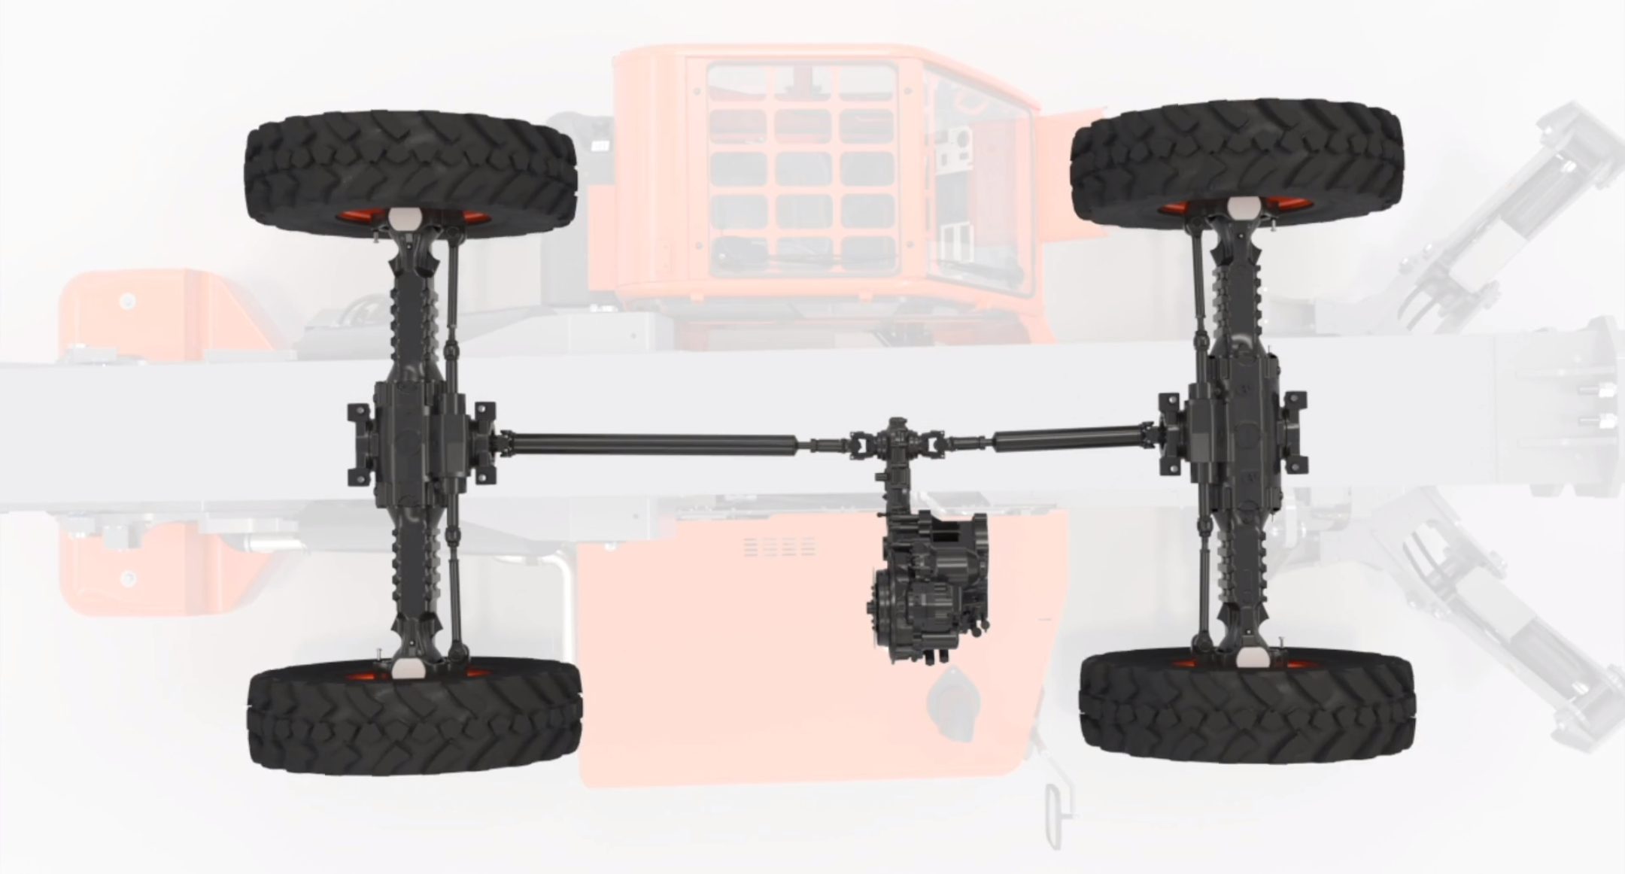
True axle based 4-Wheel drive, Positive Traction & Excellent Rough Terrain Performance

Slide 12
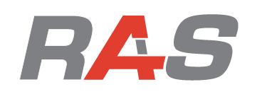
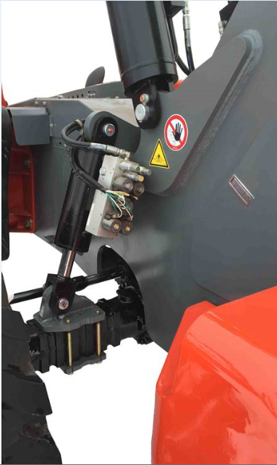
Rear Axle Stability – Increased Machine Stability
Unique system offering increased stability at height that requires no operator inputs.
Offers 3 modes of operation…
  Normal Free Pivot.
  Restricted Mode.
  Locked.
With boom elevated to 40˚ or above, rear axle switches from free pivot mode to a restricted mode and only allows up to 3˚ frame level.
Standard on SJ1044 TH, SJ1056 TH, SJ1256 THS.

Slide 13
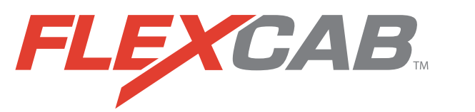
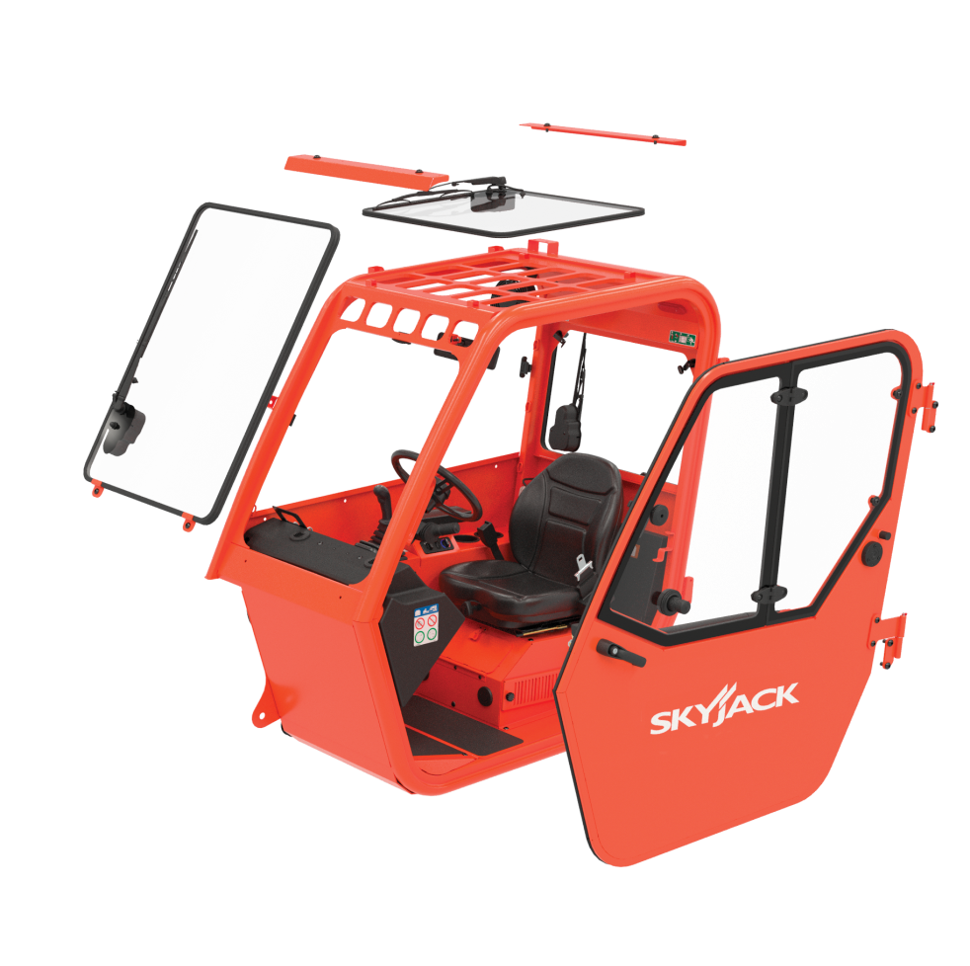
Increased Fleet Flexibility
Innovative cab design enabling fleet owners to effortlessly convert from open to enclosed cabs.
Allows for complete machine utilization in all types of weather.
Minimal downtime and incurred cost if glass is damaged in the field.
Glass panels are the same part number across TH Series…
  E.G. SJ519 TH windshield can be used on an SJ1256 THS and vice versa.

Slide 14
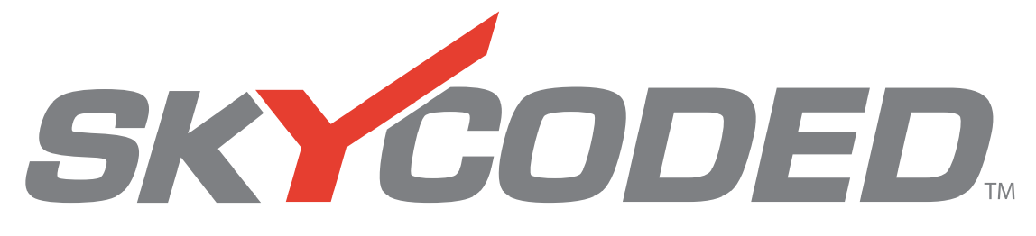
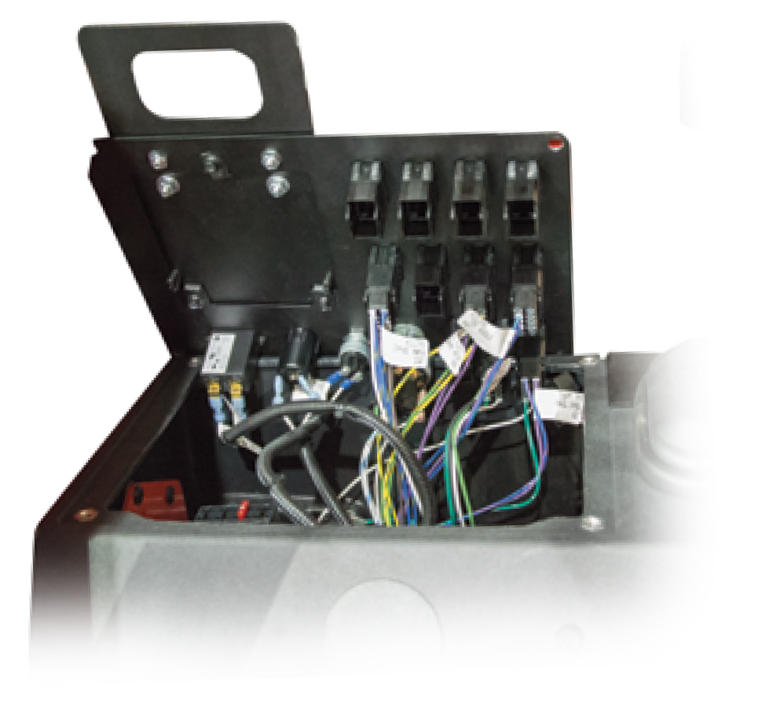
Color Codes and Numbered Wiring
SKYCODED™ is located at the heart of every Skyjack machine.
Simple relay-based control system using color coded and numbered wiring system.
Results in decreased downtime and lower maintenance costs.

Slide 15
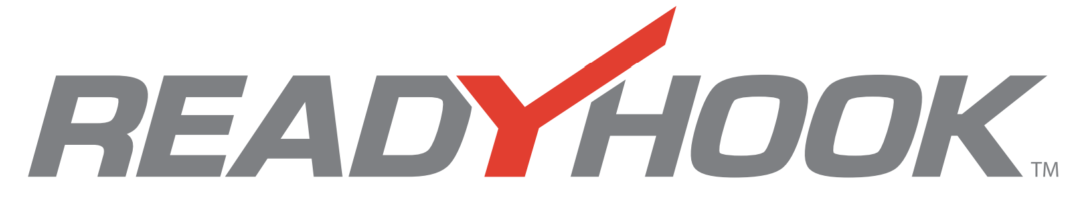
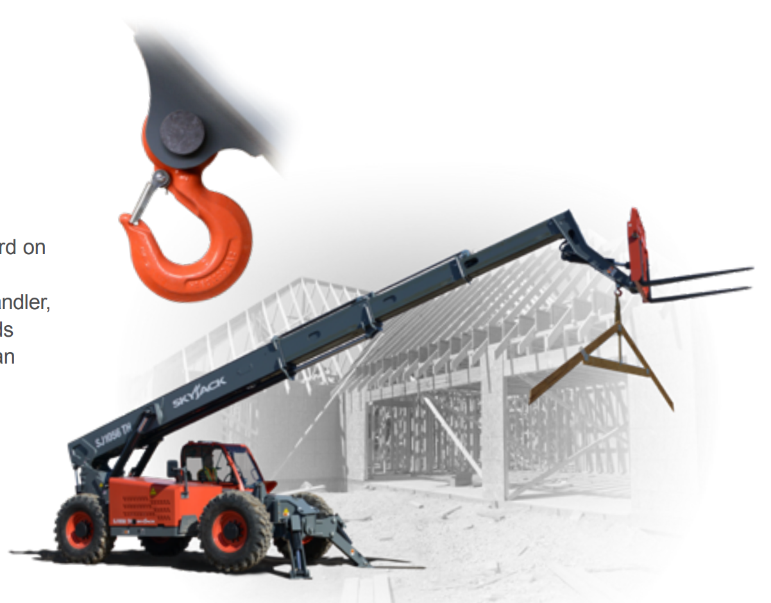
Increased Utilization
A yoke mounted lifting hook that is fitted as standard across whole TH series.
Capacities of yoke match the maximum lift capability of TH model concerned.
Allows safe under-slinging of loads.
Avoids the practice of using the forks as an underslung lifting device.
Standard yoke mounted lifting shackle on SJ519TH.

Slide 16
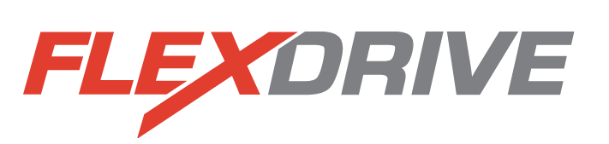
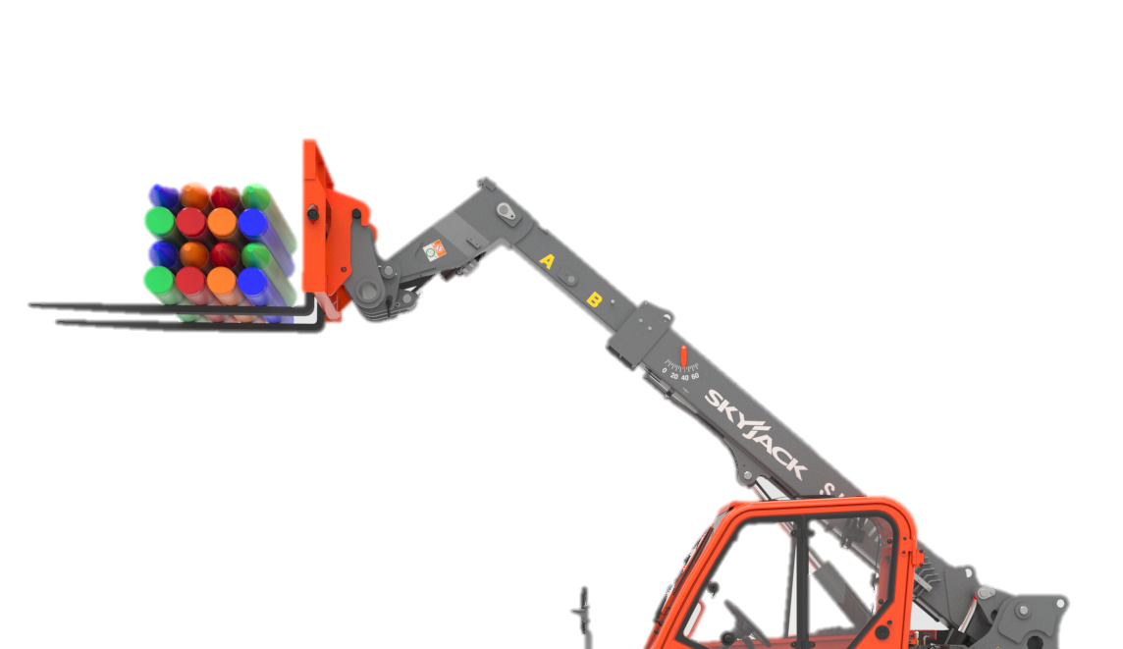
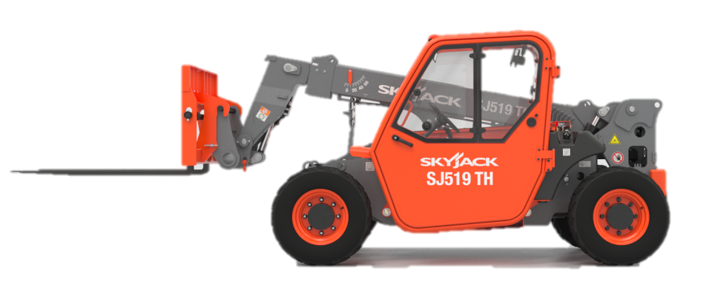

Machine Function Speeds Do Not Change
Drive Speed Select Dial
Available for the SJ519 TH
Allows the operator to reduce drive speed while keeping all function speeds the same.
By allowing low travel speed at high engine RPM, the operator is able to creep forward and reverse while maintaining all function and hydraulic performance required to complete the job.
Reduces Drive Speed

Slide 17
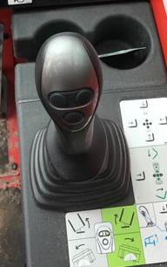
Premium Joystick Option
Superior multi-function capabilities.
  Allows for simultaneous use of boom angle and carriage tilt.

Slide 18
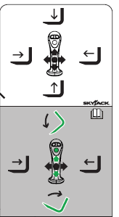
Joystick Controls
Dimensions Imperial Metric
Multifunctional Joystick Directions

Slide 19
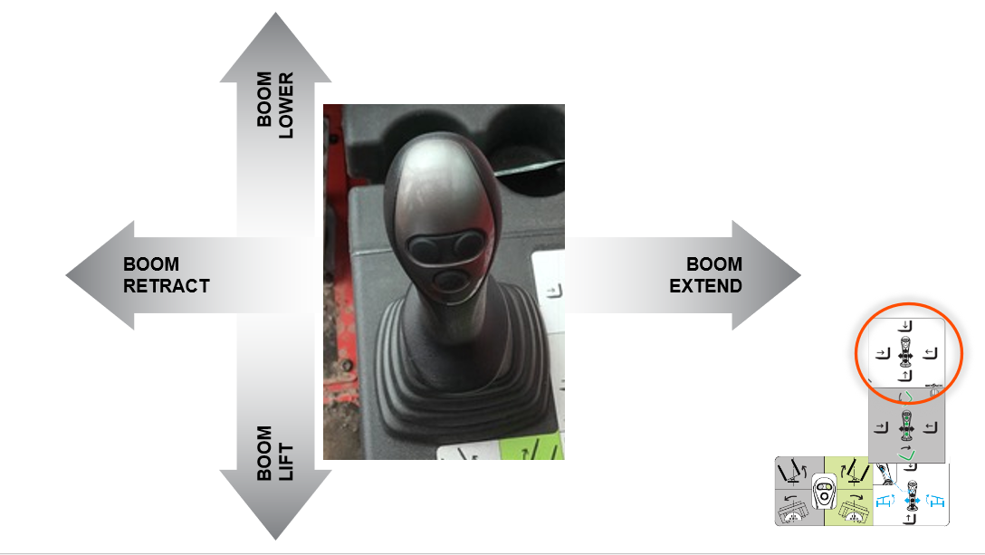
Main Boom
Dimensions Imperial Metric

Slide 20
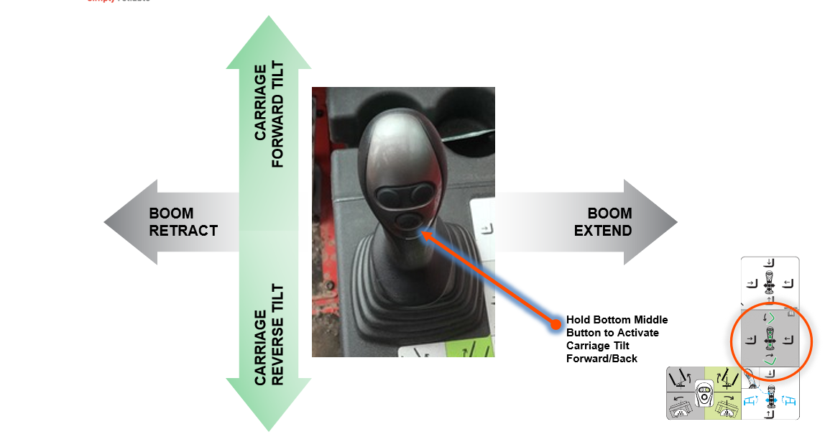
Frame Tilt
Dimensions Imperial Metric

Slide 21
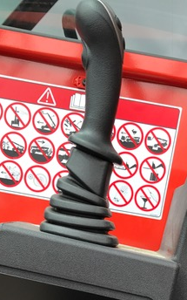
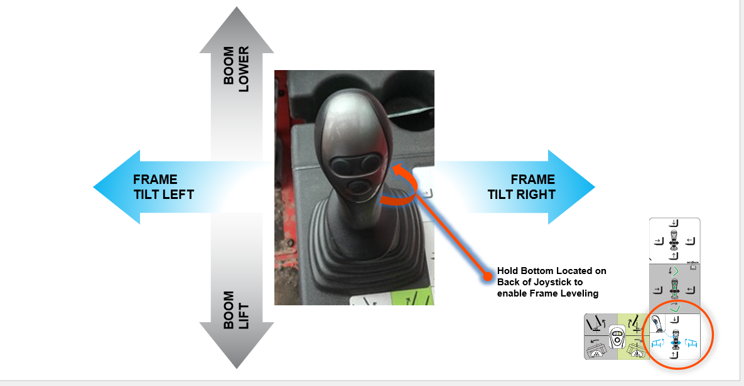
Main Boom
Frame Level Enable Switch
Dimensions Imperial Metric

Slide 22
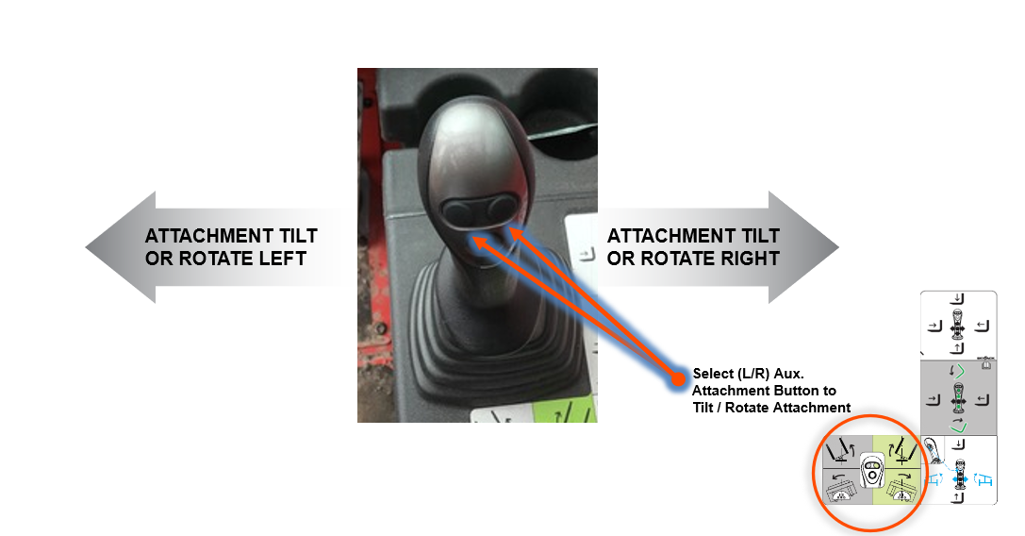
Attachment Functions
Dimensions Imperial Metric

Slide 23
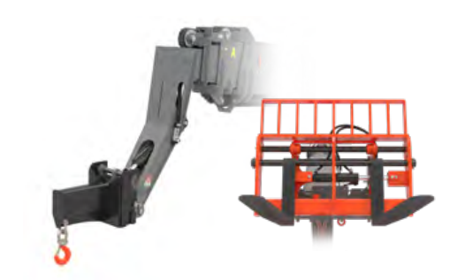
Carriages & Additional Attachments
Dimensions Imperial Metric
Skyjack’s TH Series telehandlers offer a wide variety of carriages, fork options, and additional attachments designed to increase telehandler productivity to help you tackle ever-changing jobsites.

Slide 24
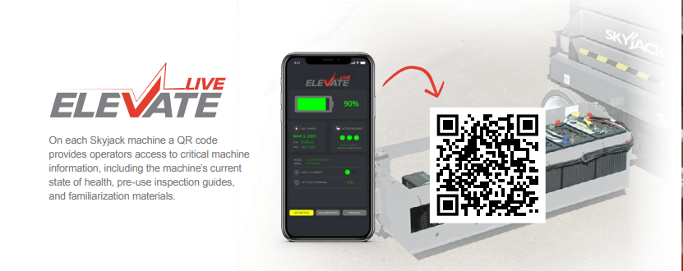
On each Skyjack machine a QR code provides operators access to critical machine information, including the machine’s current state of health, pre-use inspection guides, and familiarization materials.

Slide 25
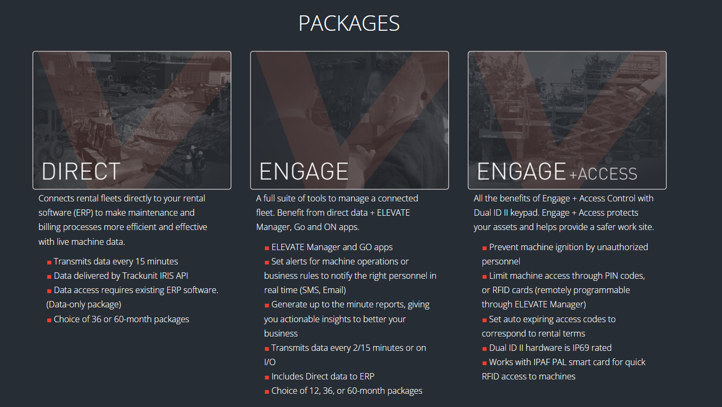
Elevate Telematics

Slide 26
Options
Forks (standard taper, fully tapered, block).
Carriages (standard, side tilt, swing).
Hydraulic carriage connect (SJ519 TH).
Closed cab.
FLEXDRIVE™ drive speed select dial (SJ519 TH).
Tilt steering (SJ519 TH).
Air conditioning.
Premium joystick.
Four wheel fenders.
Road lights.
Boom Lights.
Rotating beacon.

Slide 27
Options
Back up sensor.
Back up camera and sensor.
Block heater.
Cold weather package (Includes cold start engine oil, block heater, battery blanket & hydraulic tank heater).
Service convenience package (Includes remote axle grease points & clean drain oil valve).
Pintle hitch.
White noise alarm.
Tires (solid, non-marking, turf (for SJ519 TH).
Skid steer attachment.
Truss boom.
Bucket.
Partially closed cab.
Fire extinguisher bracket.

Slide 28
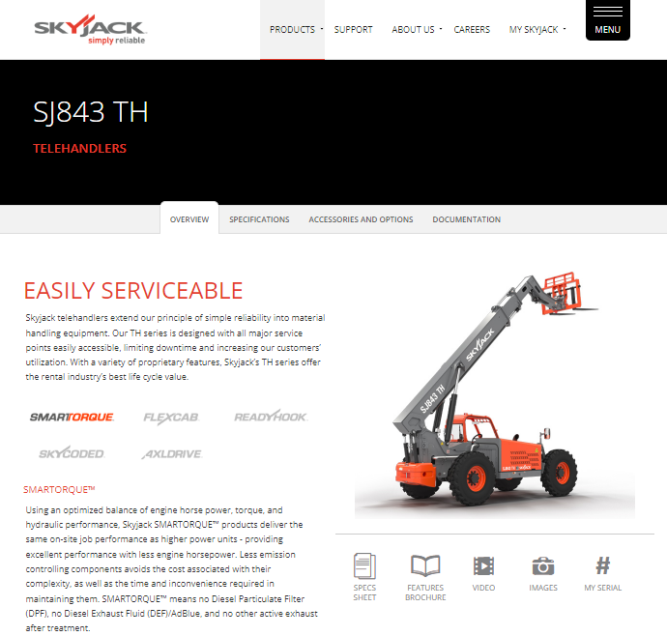
More Information
www.skyjack.com

