Slide 2
Full Size Rough Terrain Scissors Lifts

Slide 3
Skyjack proudly provides companies with quality-engineered, simple and reliable access and material handling equipment globally so they can maximize utilization and their return on investment.

Slide 4
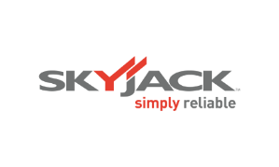
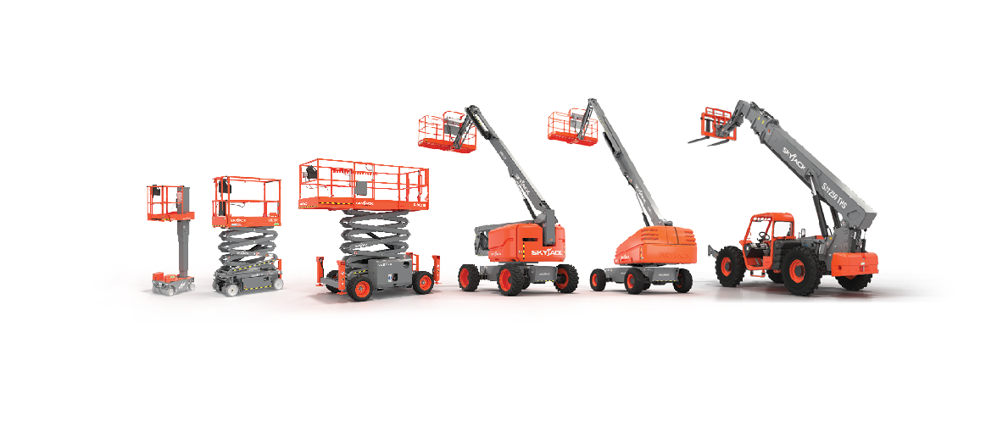
Simple, reliable products

Slide 5
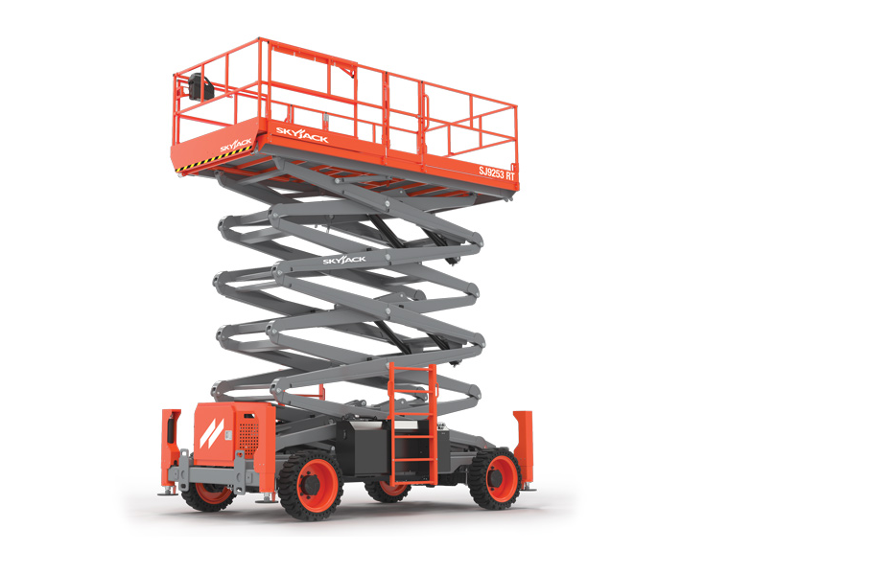

Slide 6
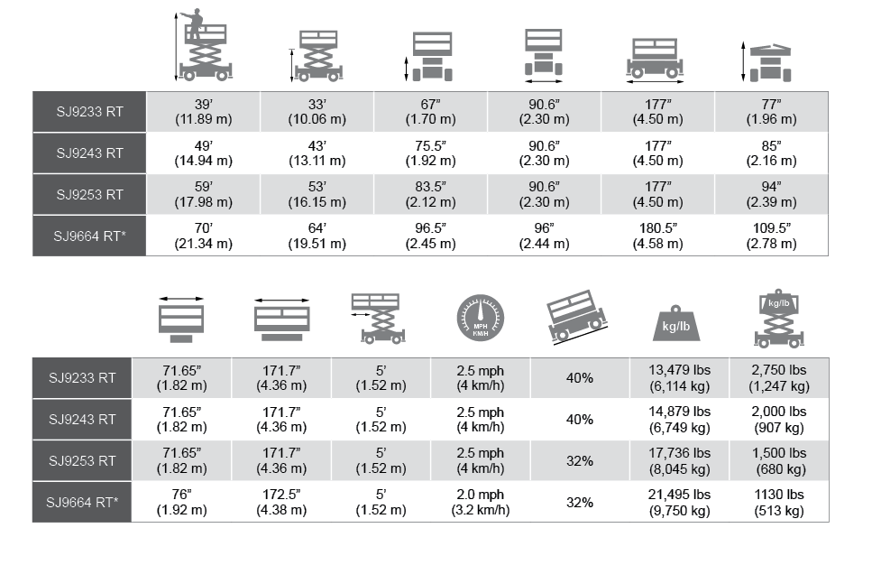

Slide 7
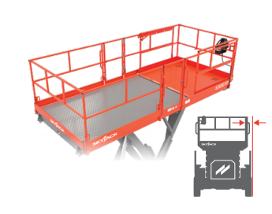
Expansive Workspace
Full Size Rough Terrain range remain the largest work platforms in the market.
Over 6’ wide and 14.5’ long.
Option of single or dual 5’ extension decks.
All steel platform provides a large working space for personnel, tools, and material
class leading clearance between the platform and the base of the machine.
Keeping the gap to 8.5” increases accessiblity.
Complimented by class-leading capacities.

Slide 8
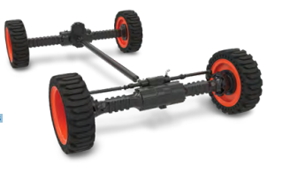
Superior Traction – True Mechanical Four-Wheel Drive
Provides unmatched traction and up to 40% gradeability.
A significant reduction in the number of hydraulic connections, which results in lower maintenance needs and more uptime.

Slide 9
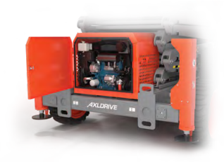
Optimized Balance of Engine Horsepower, Torque and Hydraulic Performance
By adjusting axle gear ratios and maximizing hydraulic output, the models provide excellent performance with less engine horsepower.
An optimized lower horsepower engine not only benefits performance but keeps cost down – both upfront acquisition and maintenance.
Reduced use of emission controlling components avoids the cost & time associated with their complexity.

Slide 10
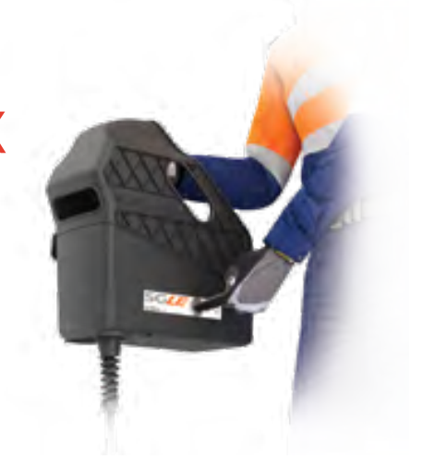
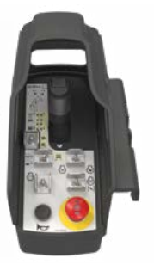
Simple Robust Controls
High strength and impact resistant composite control box with integrated shroud.
Compatible with optional SGLE (Secondary Guarding Lift Enable) system.

Slide 11
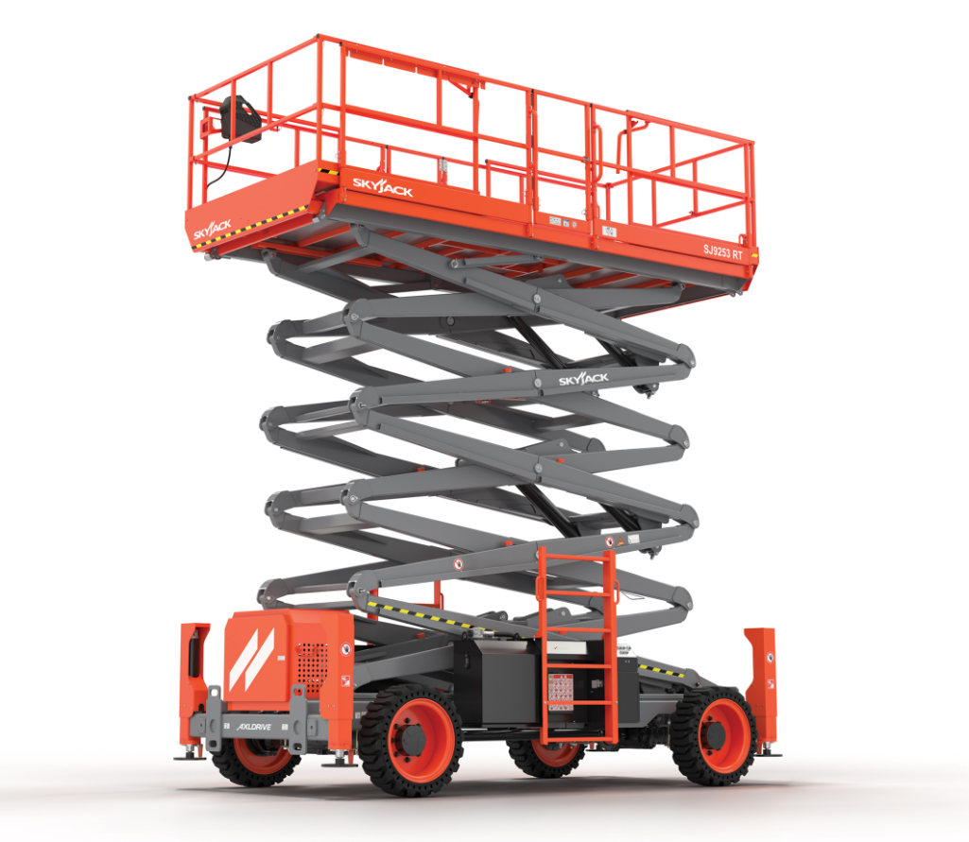
Ease of Maintenance
All routine maintenance items are located on the outboard side of engine and can be accessed without removing the engine cover.
Hydraulic manifolds for lifting, driving, and braking are all located under a protective cover at the rear of the machine.

Slide 12
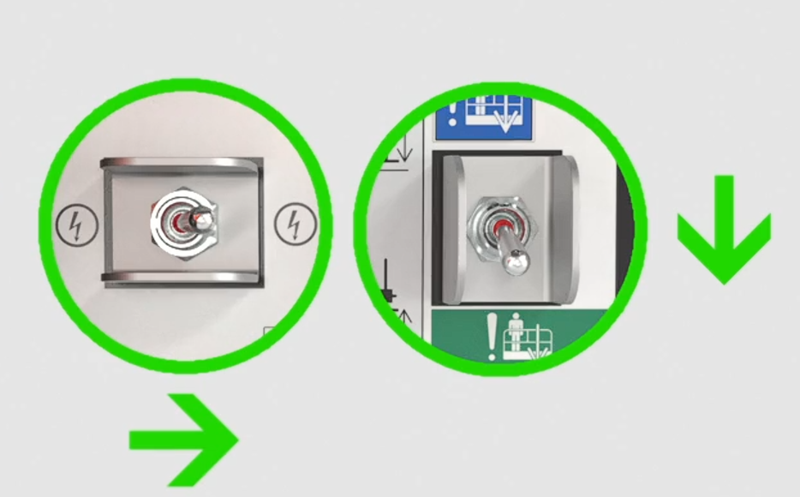
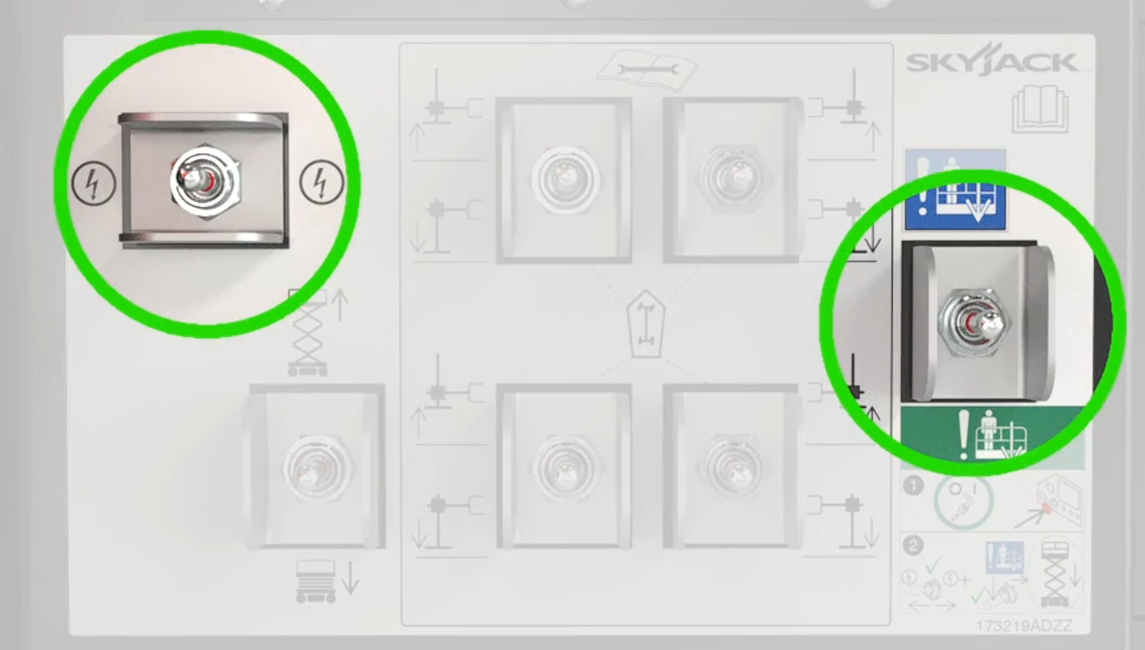
Simple Emergency Lowering
Single location emergency lowering
Toggle switch for enable and toggle switch for emergency lowering function.

Slide 13
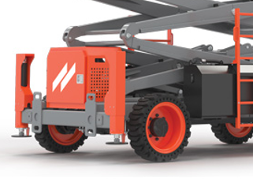
Maintenance Free Solid Tires
Solid rubber tires (non-marking option also available) are standard.
They provide a damage resistant alternative for enhanced protection of terrain and debris found on a typical job site.
A deep rough terrain tread provides optimal traction while also extending the serviceable life of the tires.

Slide 14
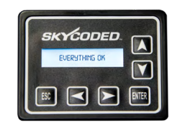
Color Coded and Numbered Wiring
A proven and simplistic control system.
Skyjack’s color coded and numbered wiring system makes our machines the easiest to troubleshoot and repair.
Translates into less maintenance and lower |costs for our customers.
A visual display module at the base control box provides an easy to navigate interface – outputting plain text and easily understood codes.

Slide 15
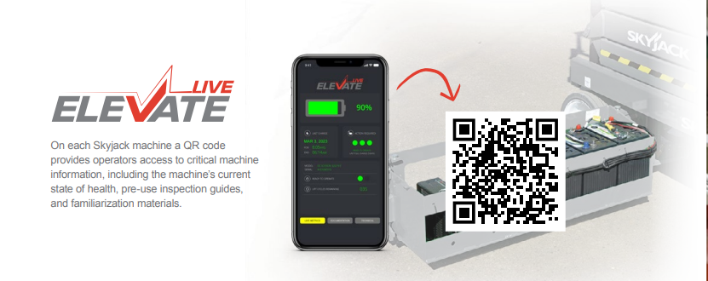
On each Skyjack machine a QR code provides operators access to critical machine information, including the machine’s current state of health, pre-use inspection guides, and familiarization materials.

Slide 16
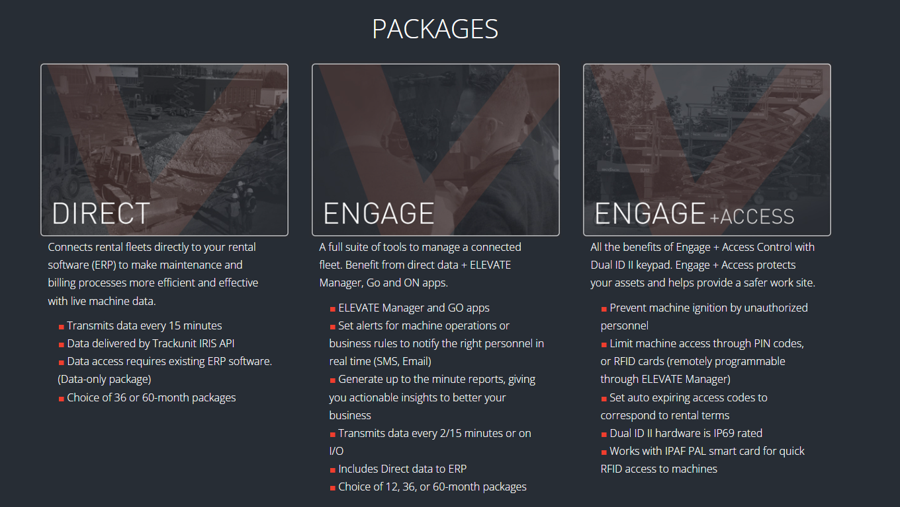
Elevate Telematics

Slide 17
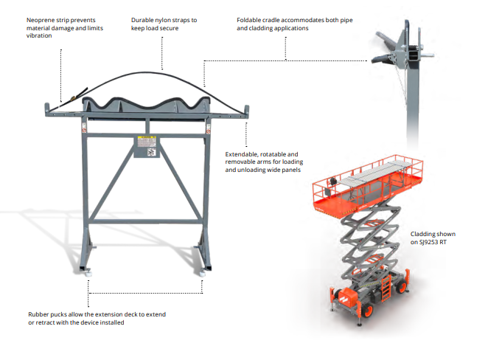
Material Handling Stand.
Secondary Guarding Lift Enable (SGLE).
Heavy Duty Pipe Rack.
Tool Caddy.

Slide 18
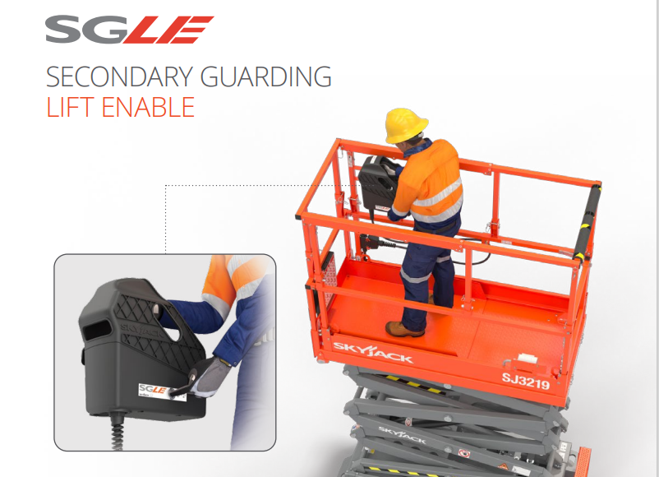
Material Handling Stand.
Secondary Guarding Lift Enable (SGLE).
Heavy Duty Pipe Rack
Tool Caddy.
Industry groups have recently suggested possible circumstances, conditions, and operations that might result in inadvertent contact with obstructions and consequently an entrapment hazard. As a result, a form of secondary guarding is now being requested on scissor lifts and vertical mast lifts by some equipment users.
Robust control box shroud provides additional guarding of controls; reducing the risk of unintended actuation.
Two-handed operation is required to lift, maintaining the operator’s body in an upright position and away from the railings; mitigating the risk of entrapment.
Both joystick and secondary enables must be activated to allow the platform to lift; release of either will stop the function immediately.
A secondary anti-tamper enable button located on the side of the control box.
The secondary enable button is not used for lowering the platform or for driving; those functions are joystick enable only.
Available as a direct factory install or aftermarket accessory.

Slide 19
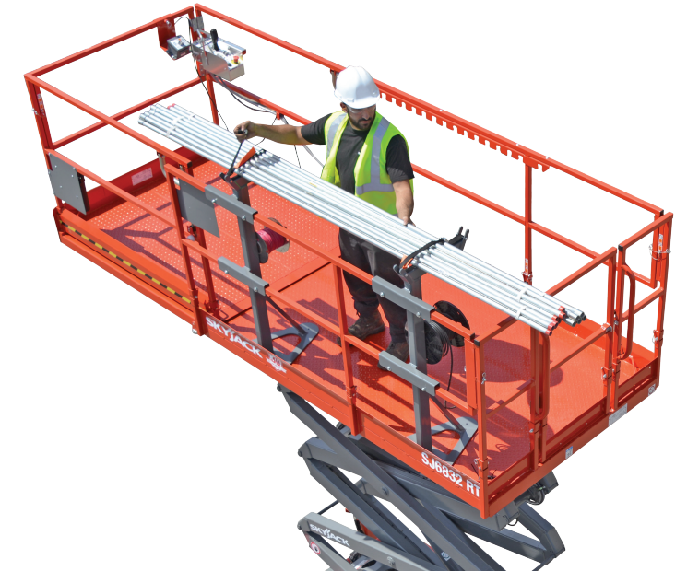
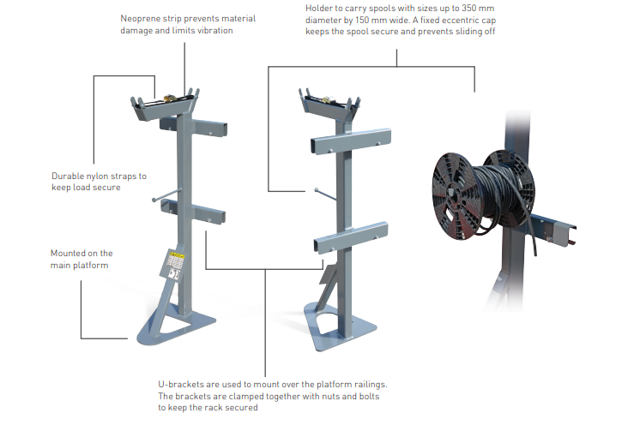
Ideal for HVAC, plumbing and fire sprinkler installation, the heavy duty pipe rack is designed for durability and sturdiness. The pipe rack provides a high capacity with a rated load up to 850 lb (varies by model) and 40 cm diameter pipes, providing a secure, safe and productive solution. The pipe rack is equipped with a spool holder, an add-on feature for electricians, which can carry spools of cable sizes 350 mm diameter by 150 mm wide providing a smooth, quick dispensing of cable
Material Handling Stand.
Secondary Guarding Lift Enable (SGLE).
Heavy Duty Pipe Rack
Tool Caddy.

Slide 20
Options
Dual 5’ (1.52 m) roll-out extension deck.
Auto leveling outriggers.
3.5 kW Belt driven generator.
Welder ready package (Includes 7.5 kW hydraulic generator, hydraulic oil cooler, 3-phase power connection in platform).
Positive air shut-off valve.
Dual fuel engine (except SJ 9664 RT).
Diesel scrubber.
White noise alarm.
Cold weather start kit (Recommended for regions where average monthly low temperatures can reach 14°F / -10°C. Includes hydraulic oil tank heater, battery blanket, coolant or block heater).
Arctic weather package (Recommended for regions where average monthly low temperatures can reach -0.4°F / -18°C Includes cold weather start kit plus 60/40 coolant, arctic engine and gear oil).
Bio oil.
ELEVATE Telematics.
Non-destructive testing.
Non-marking grip lug, solid tires.
Warranty options (3-year or 5-year plans available).

Slide 21
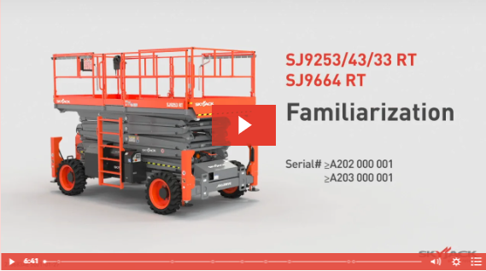
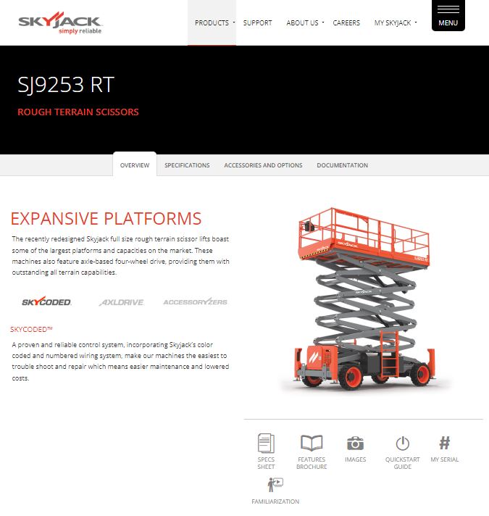
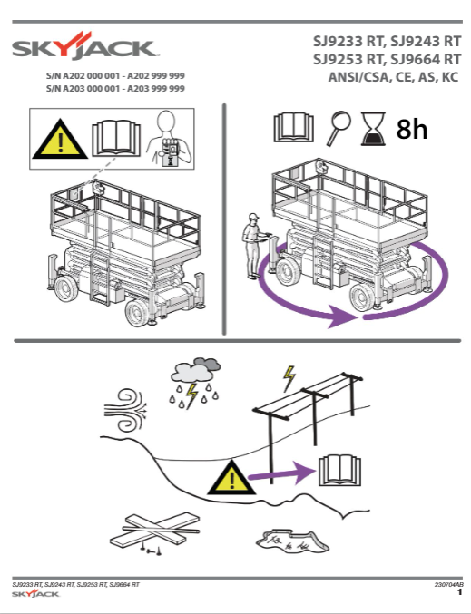
More Information
www.skyjack.com

