Slide 2
Elevate Telematics

Slide 3
Skyjack proudly provides companies with quality-engineered, simple and reliable access and material handling equipment globally so they can maximize utilization and their return on investment.

Slide 4
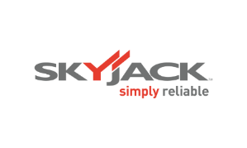
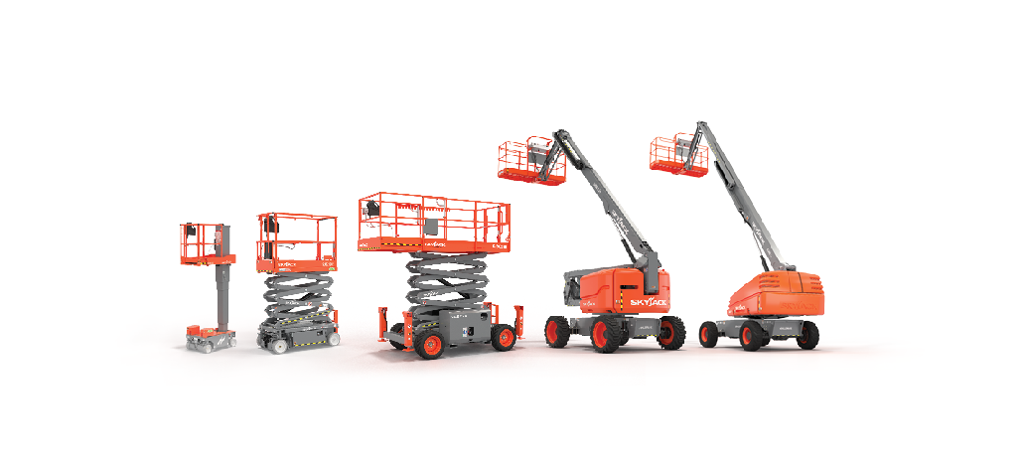
Simple, reliable products

Slide 5
Actionable Insights.
Measurable Benefits.
More than Telematics

Slide 6
Why Telematics
Telematics systems provide three core benefits…
Improved profitability.
Improved safety.
Fleet visibility & utilization.

Slide 7
Why Elevate
Traditional telematics systems have been taken from on-road products which has created barriers to adoption for off road fleets.
Barriers such as monitoring too many and not the right data points, excessive data costs, monthly license fees, and more.
Combining customer feedback and the expertise of our Skyjack product support and engineering teams, we have identified and optimized the most important data for our machines.

Slide 8
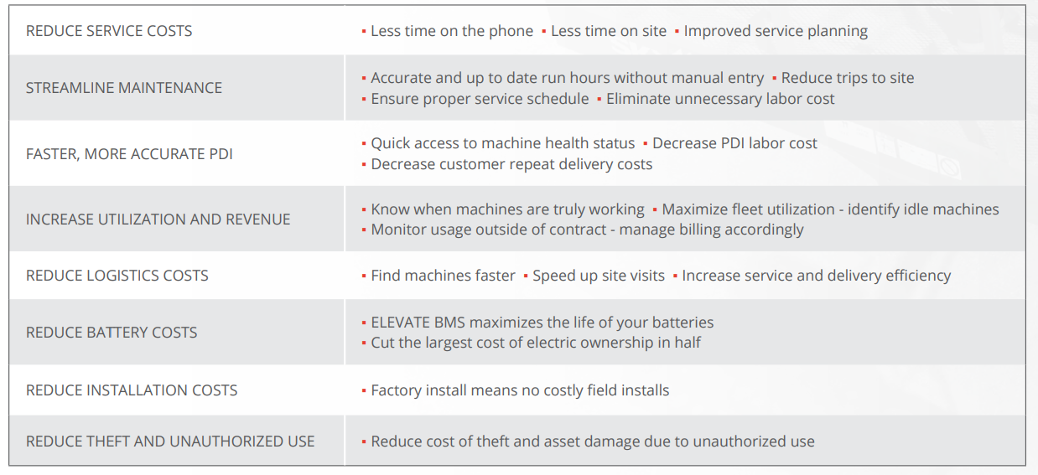
Elevate Telematics Delivers ROI
(Optional)

Slide 9
Reduce Trips to Site
Skyjack’s READY TO OPERATE…
Shorten phone calls, reduce visits to site and reduce cost by remotely identifying operator error. Indicates machine settings:

Slide 10
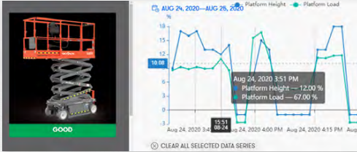
Increase Revenue
TRUE UTILIZATION allows analysis of time elevated, driving, loaded and total run time provides true working time. Unlike other systems that simply look at engine run/pump time, true utilization tells you when your machine was at work, and when it was not.

Slide 11
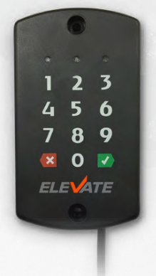
Protect Your Assets
ACCESS CONTROL reduces unauthorized use and provides a safer work site by adding access control to your fleet. The Dual ID II keypad uses PIN code, or an RFID card to control who operates your machines.

Slide 12
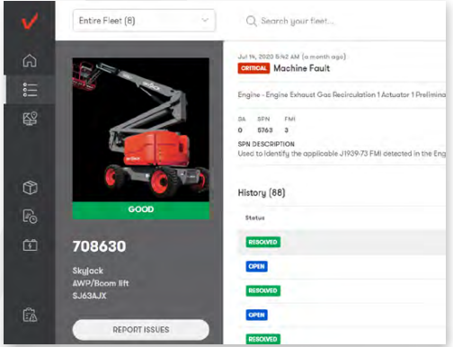
Stop Service Calls Before They Start
CAN DATA AND ALERTS allows you to understand the machine history without needing to be at the machine with specialized tools/software. Providing full fault code access to your service staff at their fingertips means making better decisions for the machine and the customer, better analysis, and reduced cost.

Slide 13
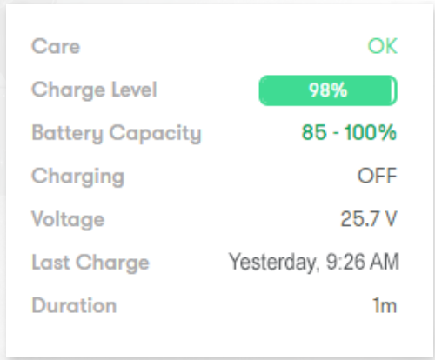
Save Time and Money
DATA-DRIVEN PDI allows referencing of live data and machine history to decrease time and increase precision of PDI checks. Reducing machine replacement/repair on site means higher profitability per asset. Send a machine that you know is ready, and improve customer satisfaction.

Slide 14
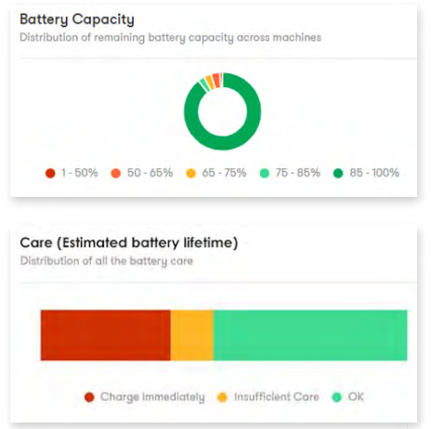
Optional Battery Management System
ELEVATE BMS (Battery Management System) targets the largest cost of ownership on electric scissors. ELEVATE BMS provides the operator with charging advice, and the rental company the ability to manage the cost of battery replacement using accurate and immediate data.

Slide 15
Rental Software Integration
All ELEVATE packages come with access to Trackunit‘s Manager to run reports and see insights for your entire fleet (while benefitting from Skyjack-provided insights and alerts engineered for your Skyjack machines).
Or API connectivity allows you to feed your rental software/ERP system with live data direct from the machine.

Slide 16
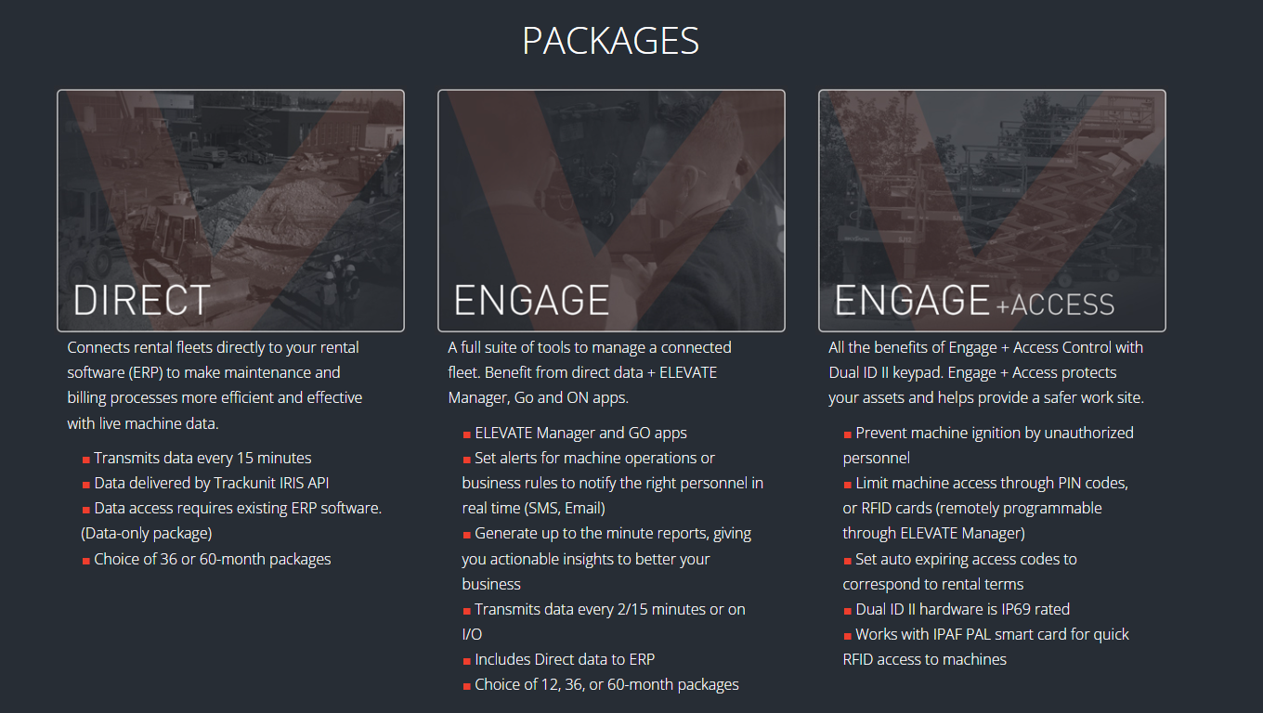

Slide 17
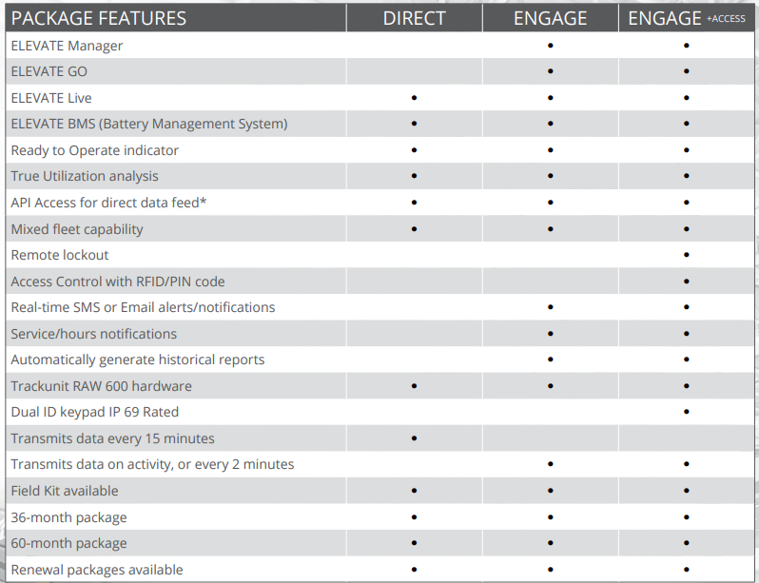
*ERP pairing/API Access may require additional programming resources and advanced knowledge of database management – not included with ELEVATE packages.

Slide 18
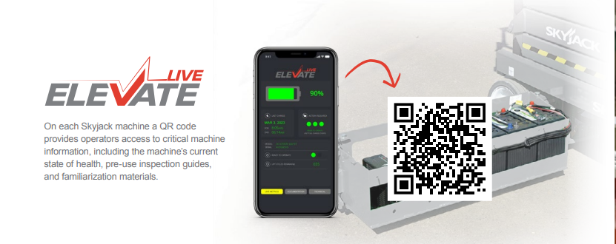
On each Skyjack machine a QR code provides operators access to critical machine information, including the machine’s current state of health, pre-use inspection guides, and familiarization materials.

Slide 19
ELEVATE Live provides operators access to the machine’s current state of health and serial specific resources through a simple QR code.
Electric Machines (with BMS): State of health, simple percentage of battery life, last charge date, and recommended charging action.
Combustion Machines: Engine faults, daily hours, and fuel used.
In addition to live machine data, operators also have access to…
Operator manuals.
Familiarization videos.
Brief visual overviews of the machine.
Serialized machine information, including parts manuals and specification sheets.
Emergency lowering procedures.
Pre-use checklist: visual guides for pre-use inspection.
Quick start guide.

