Slide 1
Electric Drive
Vertical Mast Lifts

Slide 2
Skyjack proudly provides companies with quality-engineered, simple and reliable access and material handling equipment globally so they can maximize utilization and their return on investment.

Slide 3
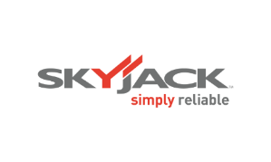
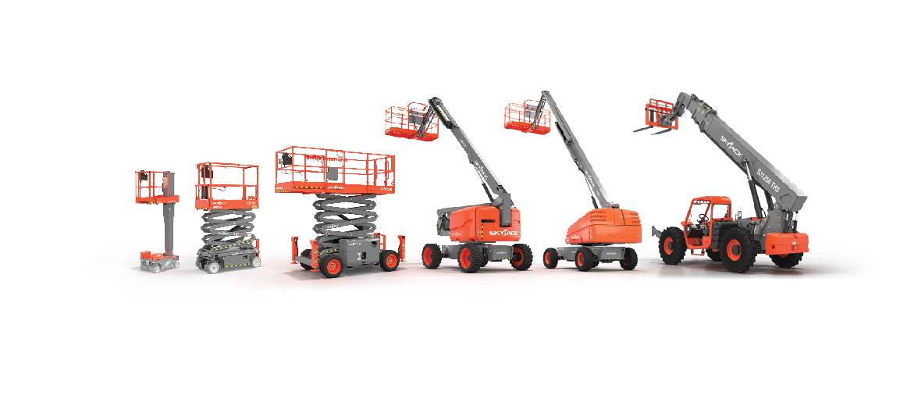
Simple, reliable products

Slide 4
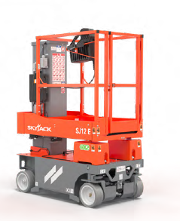
Overview
AC brushless electric drive.
Multi-stage lift cylinders.
Mast in-line with platform height ( SJ12/16E).
Full Unrestricted view - mesh bottom platform design.
Self closing half height gate .
Load sensing included.
Wind rated SJ12E – optional on SJ16/20 E.
Leak containment *Optional.
Traversing 16” (0.41m) extension for up and over reach.
4” (10cm) wide tires.
90°front wheel steering provides zero turning radius.

Slide 5
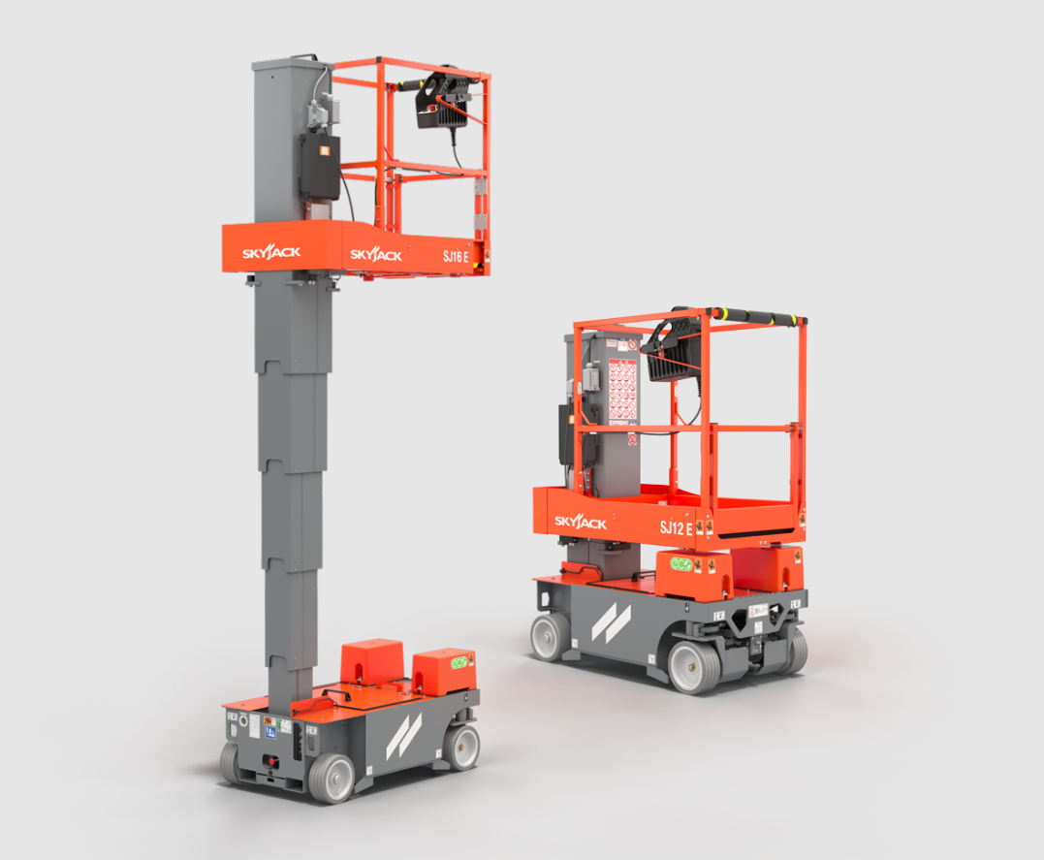
Click on image for video

Slide 6
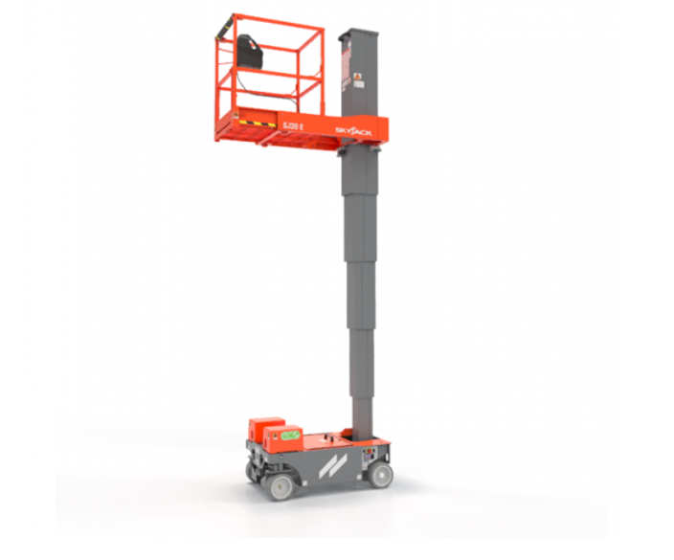
Click on image for video
Click image for video

Slide 7
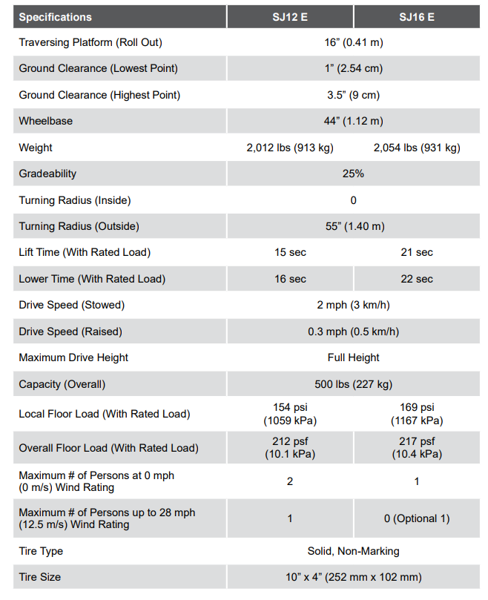
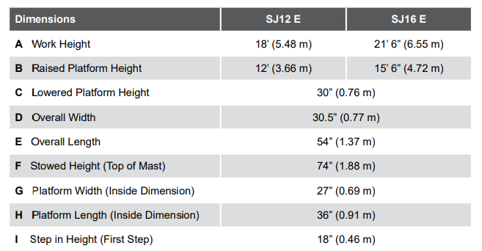
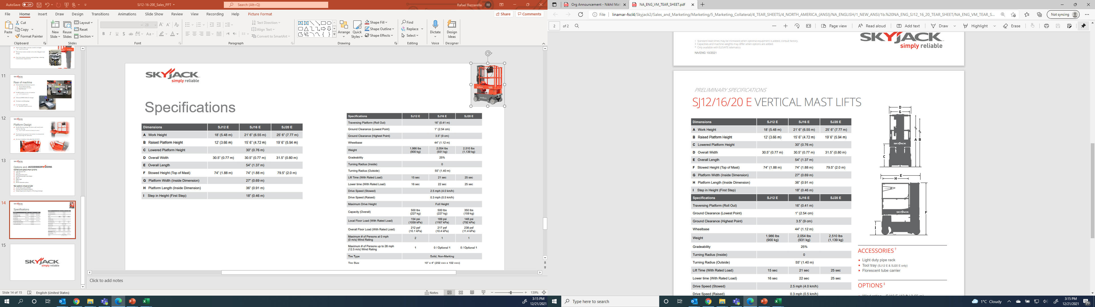
Specification Overview

Slide 8
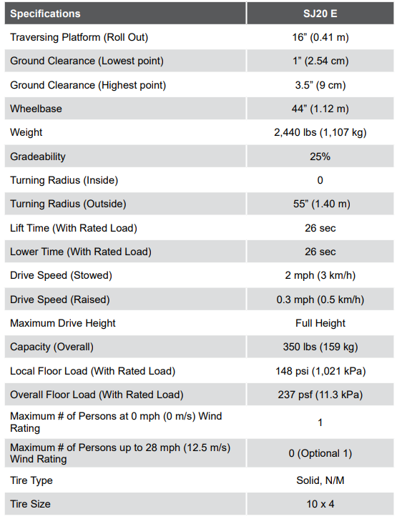
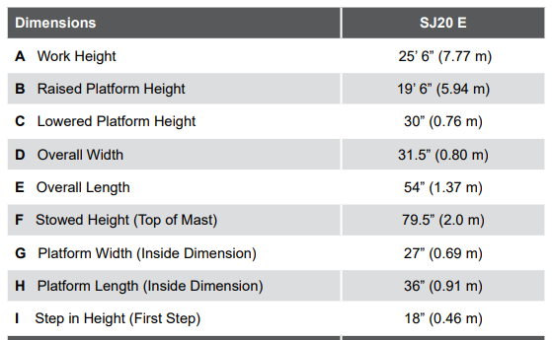
Specification Overview

Slide 9
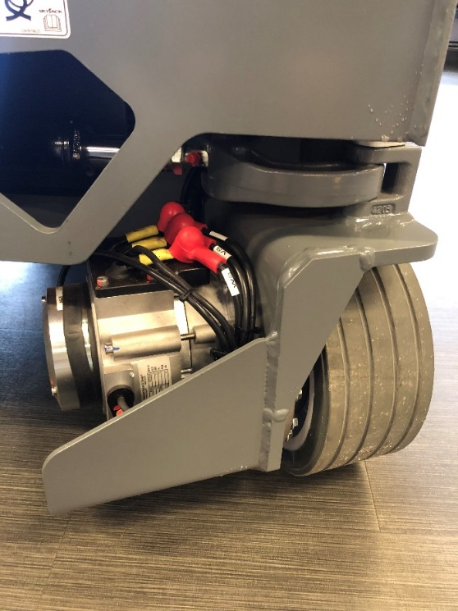
Electric Drive
More Productivity, Performance and Maneuverability
Variable speed brushless front wheel AC electric drive…
  Consistent torque and speed.
  Improves loading/ offloading onto trucks.
  25% gradeability.
  70% less hydraulic connections.
  30% improvement in duty cycle.
Fully proportional drive and lift controls offer superior
drive – more efficiency, controllability & improved torque.
Hydraulic front wheel steering…
  Steering cylinder mounted underneath chassis.
  Zero inside turning radius.

Slide 10
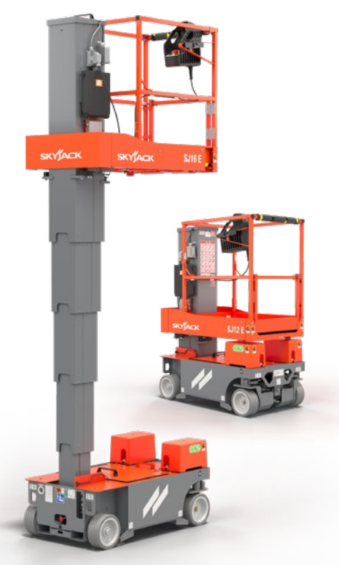
Electric Drive
More Productivity, Performance and Maneuverability
90°front wheel steering provides zero turning radius and excellent
performance and around job site maneuverability.
25% gradeability and consistent torque.
35% improvement in drive efficiency.
Reduced charging and power consumption.
Low GVW and wide non-marking tyres provide low
ground pressures and help protect finished flooring.
Electrically-released brakes, lift/tie down points, makes loading
and transportation safe and easy.
Compact size and low weight allow passage through a standard
doorway and carriage in a passenger elevator.
Simple, maintenance-free, fixed pothole protection system, no
moving parts, allows drive over site debris by improved ground clearance.
Forklift pockets located at the rear with tie down and lift points provided.

Slide 11
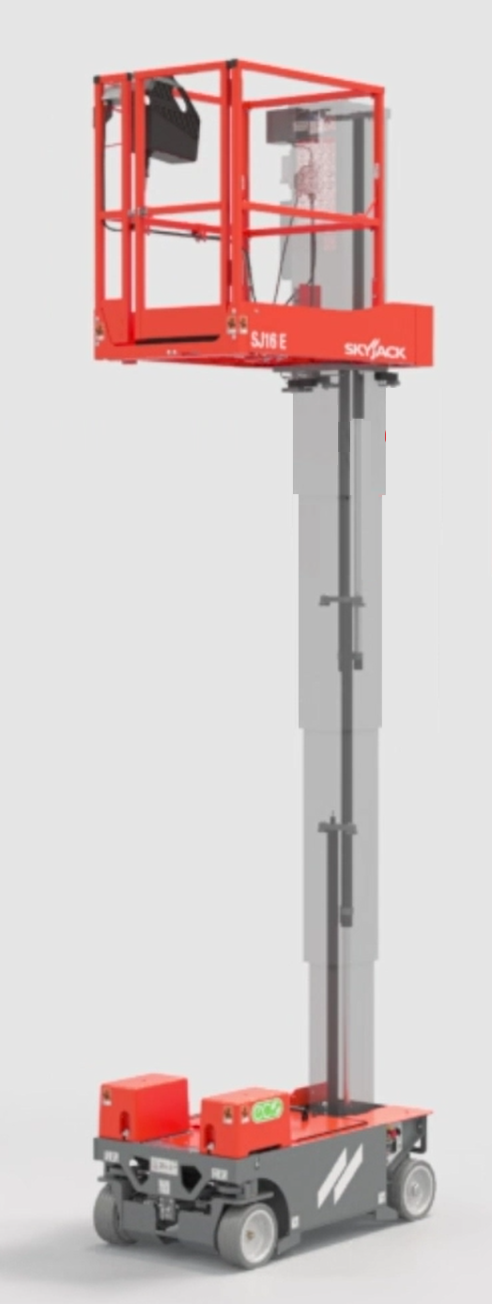
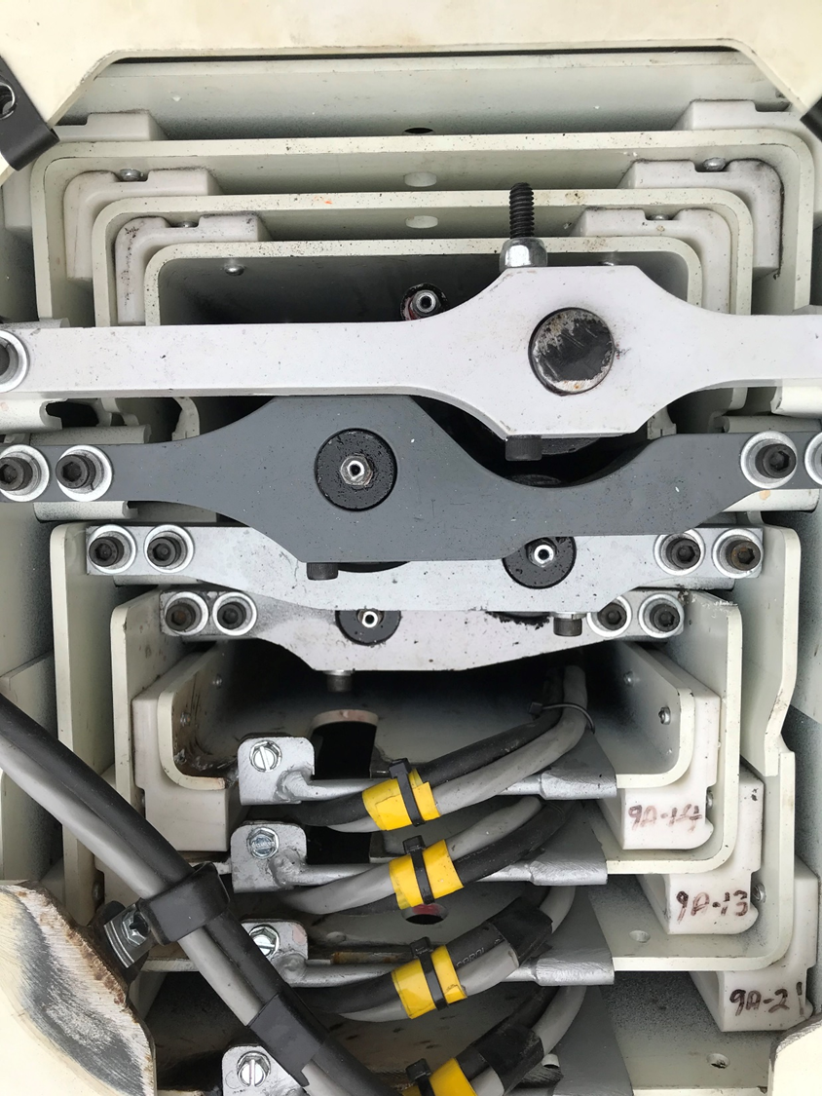
New Mast Design
Free from chains, sheaves, or bushings to reduce maintenance
Multi-stage lifting cylinder eliminates chains, sheaves and bushings….
  SJ12E – 4 section mast with 3 stage lift cylinder
  SJ16E and SJ20E – 5 section mast with 4 stage lift cylinder.
Rigid design allows operator comfort at height through improved mast overlap.
Closed from debris ingress.
Top of mast now in line with platform rails, which benefits overhead working on drop ceilings.

Slide 12
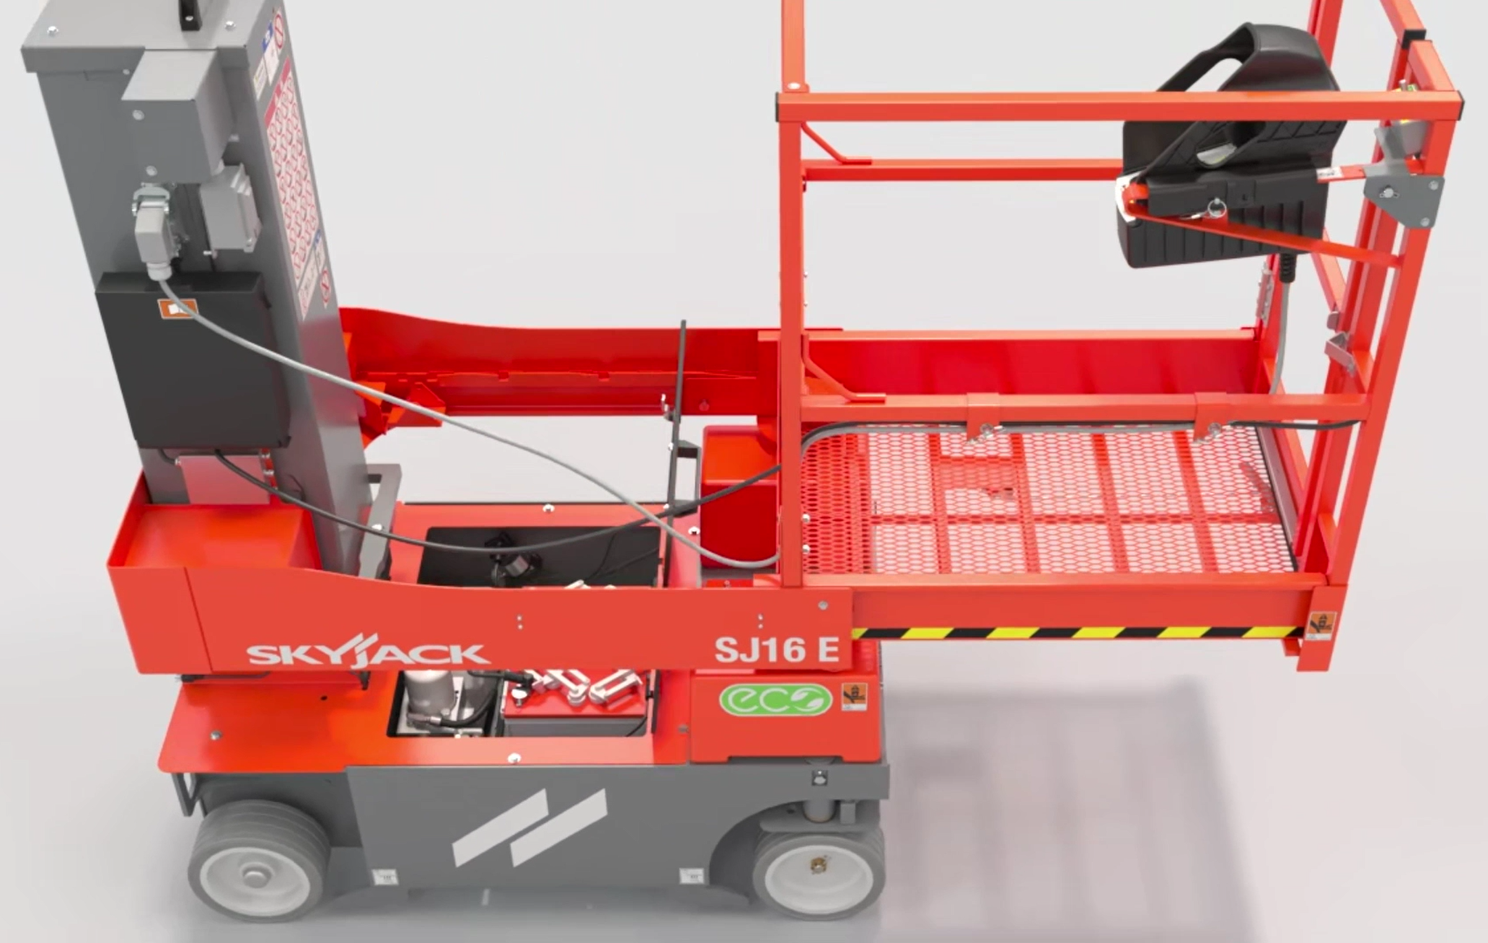
Traversing Platform
More Productivity, Performance and Maneuverability
Robust all steel platform which incorporates
a manually operated traversing deck feature
which provides 16in (41cm) of up-and-over
capability.
Released with a simple to use foot pedal,
which can be locked in various positions.

Slide 13
Traversing Platform
More Productivity, Performance and Maneuverability
Easily replaceable mesh flooring gives operators the freedom to see ground level without looking over the side of the machine.
When moved forward into service position, provides full access to base service hatch.
Self-closing full-height gate.
Power to the platform provides a power source for
tools and eliminates hanging cords.
Lanyard attachment points are provided around
the platform.
Load sensing system.

Slide 14
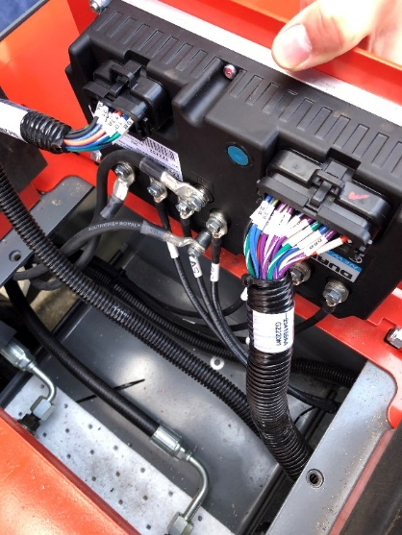
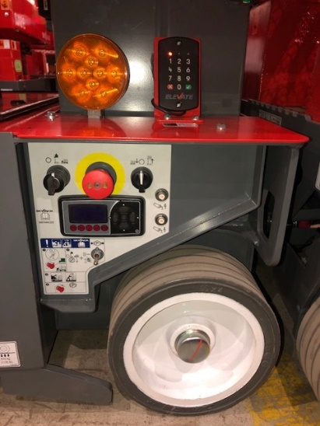
Onboard Diagnostics
Skycoded TM
Skyjack’s standard color-coded and numbered wiring
system. Onboard diagnostics allows operators or service
technicians to see real-time, easy-to understand faults in
plain, simple language readouts. No plug-in calibration
is necessary for day-to-day troubleshooting,
including load sensing information.
Mounted in rear wheel well, offset inside for protection
against debris.
CAN based fully integrated controls with smart charger
provides increased data points (telematics ready).

Slide 15
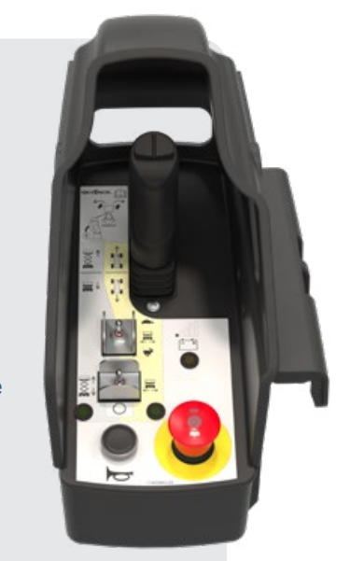
Simple Robust Controls
Removable, high strength, impact resistant upper control box with integrated shroud
Integrated shroud with full proportional joystick safety-enable trigger, thumb steer, selector switches, battery level gauge, horn, and emergency stop .
6ft (1.82m) control cable for ease of walking through entrances or doorways and loading onto trucks.
Interchangeable control box between models (SJ12 E/SJ16 E/SJ20 E).

Slide 16
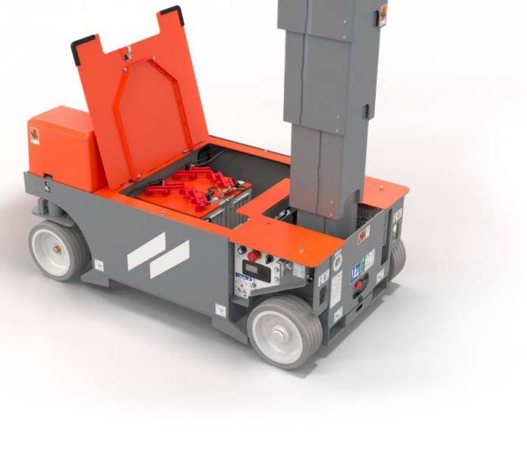
Parts Commonality and Maintenance Accessibility
All components are located inside the base, the “flip up” maintenance hatch provides easy, unrestricted access to all major components
and batteries…
  Flip up access lid for main service components
  Bucher pump/motor combo mounted inside with access
  to all valves and service parts.
  Delta-Q 650W universal smart charger mounted inside
  rear of machine.
  LED lights can be seen from rear of base.
  Main manifold with spin off oil filter for ease of service.
  2 x 12V battery configuration standard…
    4 x 6V as an option (4 x 6V standard for CE and AS).

Slide 17
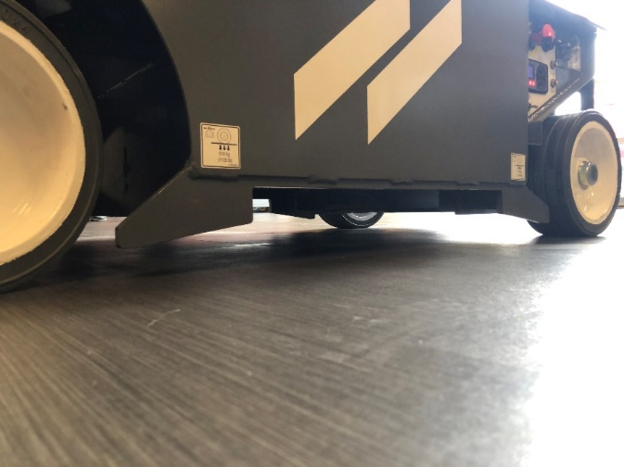
Pothole Protection
Fixed pothole protection system.
Designed to go over cables without issues of “catching up”.
Freedom to forklift from the side like other models.
  Welded plates act as catch system incase of
  slippage when loading/ offloading.
  Lowest clearance is 1" and 3.5“ highest point.

Slide 18
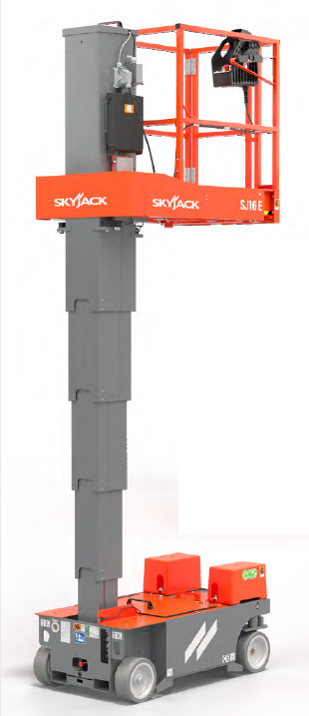
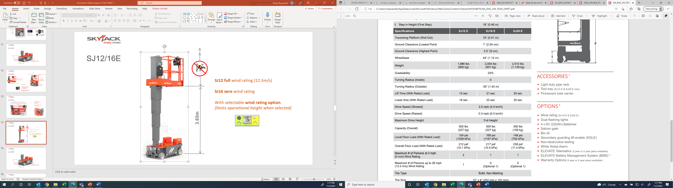

Wind Rating
SJ12 E fully wind rated (12.5m/s).
SJ16E and SJ 20E have a selectable wind rating option
which limits operational height when selected...
  SJ16E (12 ft/3.66m).
  SJ20E (13 ft/3.96m).
SJ16E - 12’ - 3.65 m
SJ20E – 13’ - 3.96 m

Slide 19
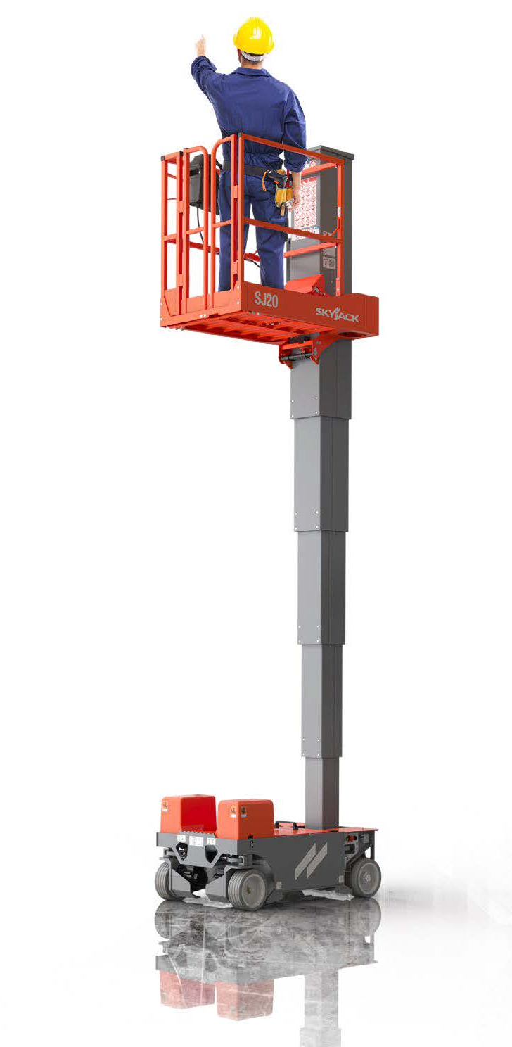
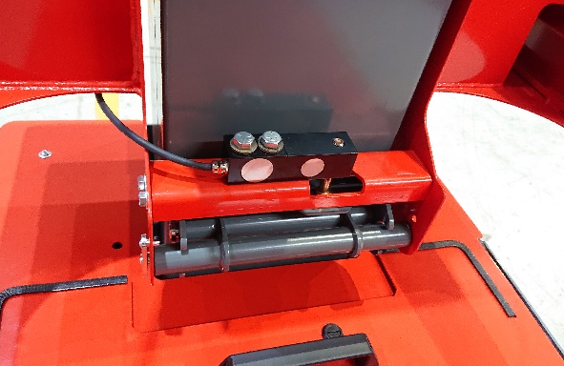
Load Sensing
Standard Dual Load cell..
  Two different load cells beneath platform.
  Wire feeds into junction box then main controller.

Slide 20
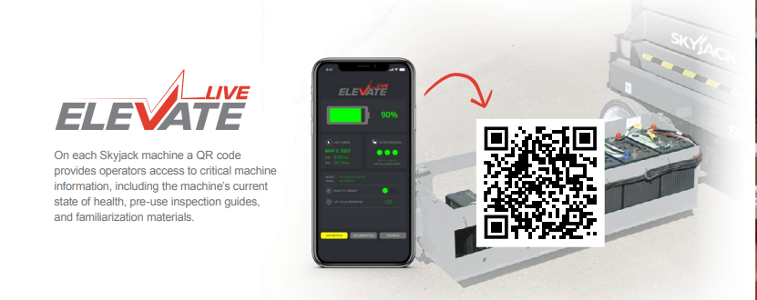

Slide 21
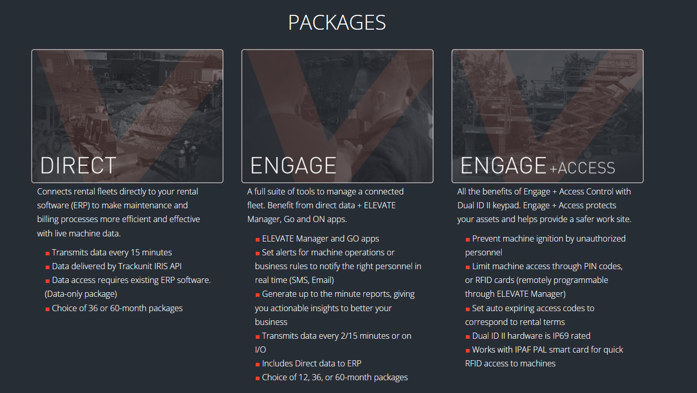
Elevate Telematics

Slide 22

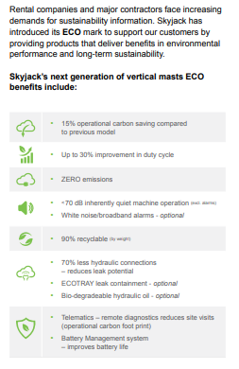
Remove battery management system

Slide 23
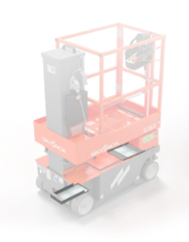


ECOtray leak containment.
Secondary Guarding Lift Enable (SGLE).
Light duty pipe rack.
Fluorescent Tube Carrier.
Tool tray.
ECOTRAY has been designed with essential machine functionality in mind. It prevents potential leaks from hydraulic systems dripping onto floors and other internal components
Protects against entire hydraulic system and steering cylinders.
Capable of containing ALL machine oil by volume
Avoids cumbersome diaper attachment.
Prioritizes machine functionality.
Factory fit or field install option.
Installed in less than 10 minutes, absorbent pads changed in seconds.

Slide 24
Options
Wind rating…
  SJ16 E (12 ft / 3.65 m).
  SJ20 E (13 ft / 3.96 m).
Dual flashing lights
4 x 6V (220Ah) batteries
White noise alarm.
Saloon gate.
Bio oil .
Non-destructive testing.
Perimeter lights.
ELEVATE Telematics and ELEVATE Battery Management System (BMS) .
Warranty Options (3 year or 5 year plans available).
EcoTray Leak Containment System.

Slide 25
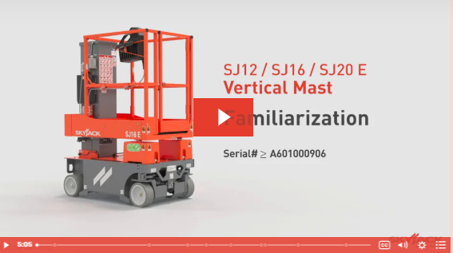
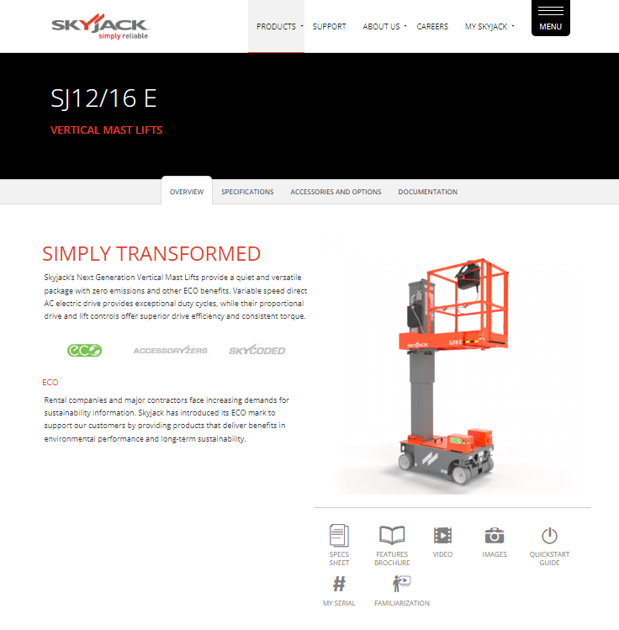
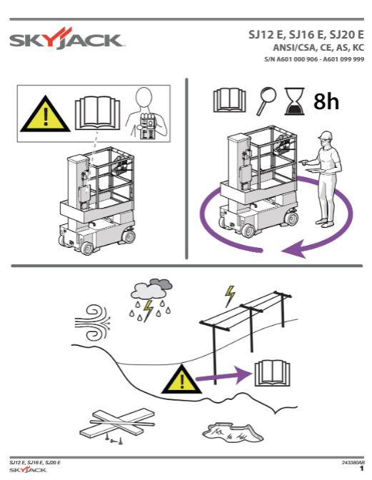
More Information
www.skyjack.com

