Slide 2
Compact Rough Terrain Scissors Lifts

Slide 3
Skyjack proudly provides companies with quality-engineered, simple and reliable access and material handling equipment globally so they can maximize utilization and their return on investment.

Slide 4
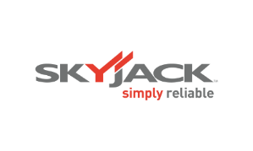
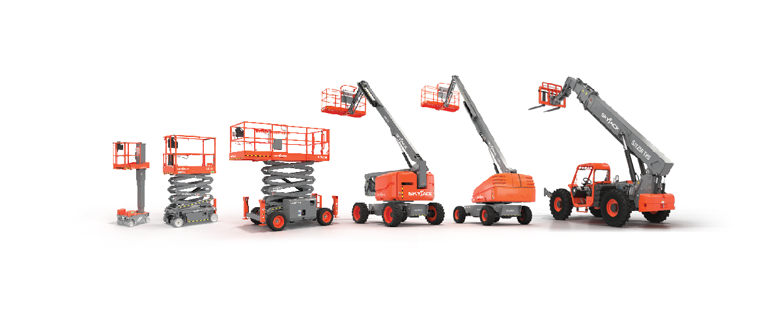
Simple, reliable products

Slide 5
COMPACT ROUGH TERRAIN SCISSOR LIFTS
Skyjack’s compact rough terrain scissors offer large working area, impressive platform capacities.|
Unequaled rough terrain performance and optional self-leveling outriggers making it an ideal choice for a wide range of construction, maintenance, and industrial applications.

Slide 6
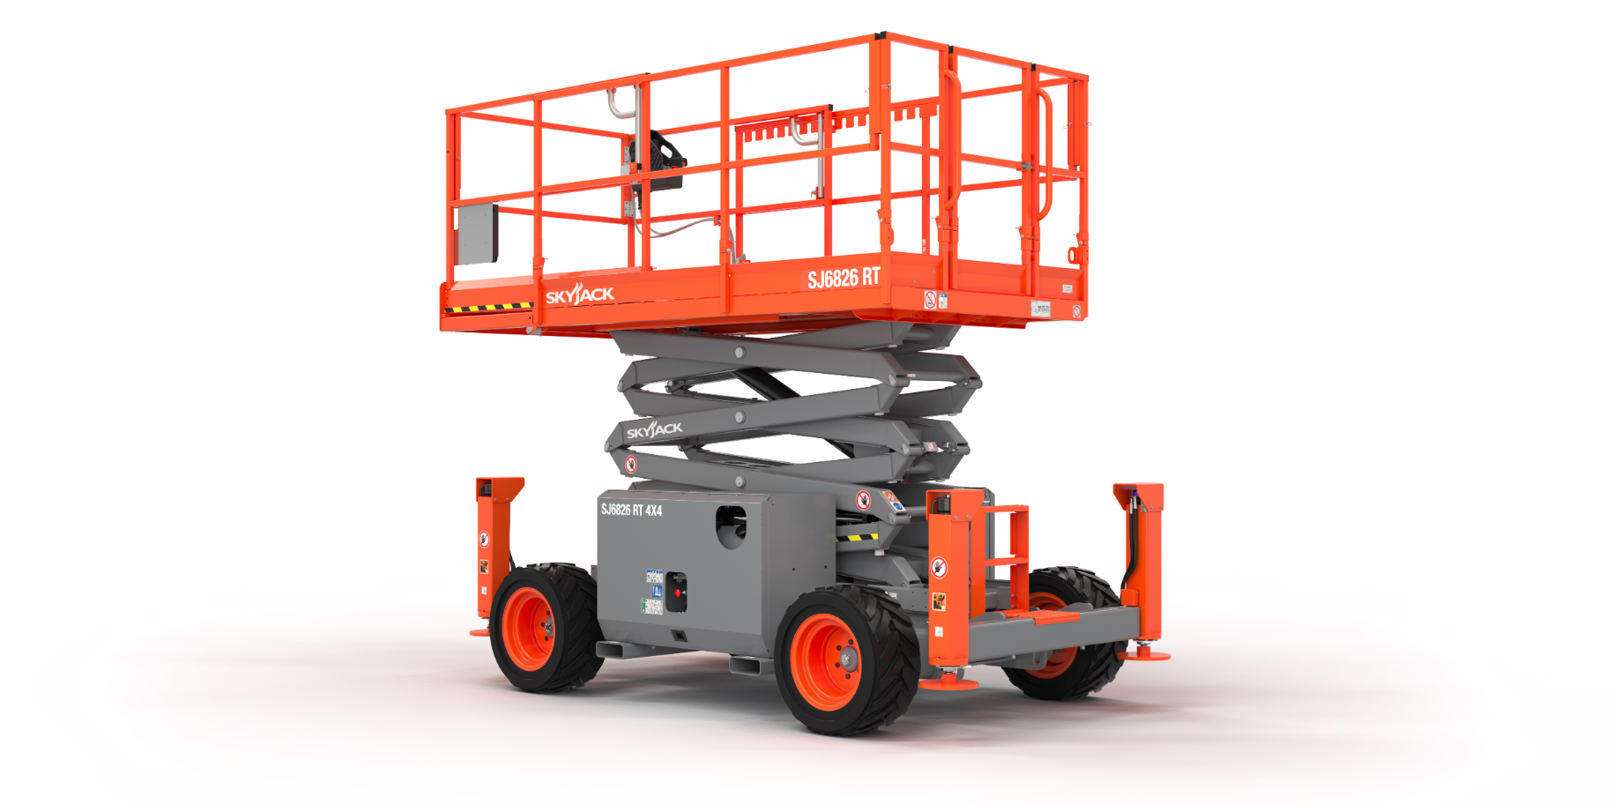

Slide 8
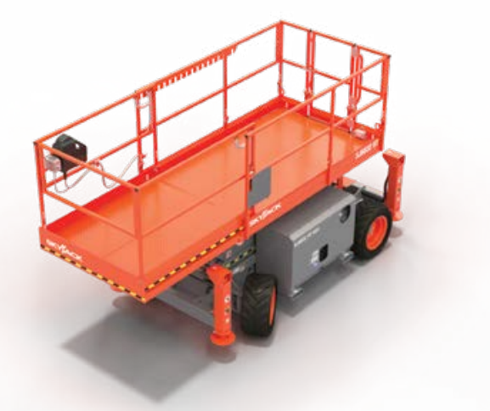
Large Work Area
Sturdy all steel design incorporates a manually operated 5’ (1.52 m) roll out extension deck which increases work area and provides up-and-over capability.
Permanent anti-slip checker plate floors.
Self-closing full gate and steps provide easy entry into the platform.
110V AC Outlet on platform with GFI provides a power source for tools and eliminates hanging cords.

Slide 9
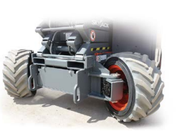
Superior Traction and Maneuverability
Crossover symmetrical 4-wheel drive system, which provides the best possible positive traction, even with one wheel off the ground.
Small 60” (1.52 m) inside turn radius offers excellent job site maneuverability.
Diesel or Dual fuel engines available.
Standard foam-filled low profile grip lug tires (non-marking tires are available).

Slide 10
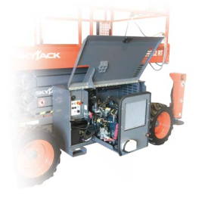
Maintenance and Accessibility
All components are located inside individual swing-up steel cabinets which provide protection but allow easily accessibility to engine, tanks, and all major components.
Pull-out engine tray designed for serviceability & easy access for maintenance.
Tilt-out hydraulic manifold and opening electrical panel.

Slide 11
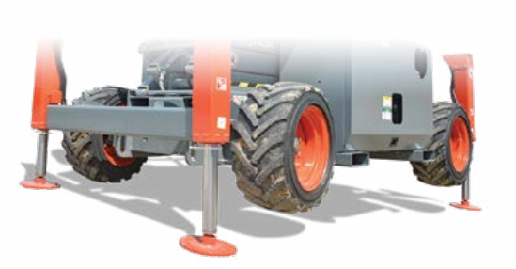
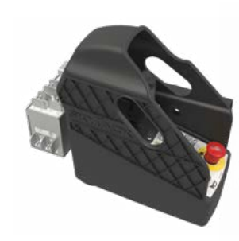
Self Leveling Outriggers
Independent/auto-leveling outriggers level the machine out when on uneven terrain and allows users to work in a variety of different job site conditions. Optional on both models.
Separate outrigger control box incorporates enable switch and level indicator light.

Slide 12
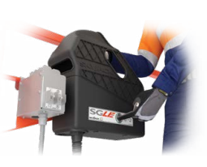
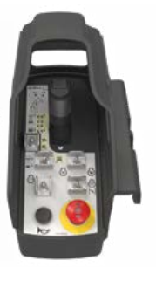
Simple Robust Controls
High strength and impact resistant composite construction.
Fully protected proportional joystick with a safety enable trigger, thumb steer, engine start, engine speed, high/low torque selector switches, horn and emergency stop.
Incorporates Shroud to protect against in advertent operation.
Accurate load sensing system limits normal movement of the platform, when the full rated load is reached or exceeded.
Compatible with optional SGLE (Secondary Guarding Lift Enable) system.
A lockable battery disconnect is located at the base controls, which increases security and can prevent un-authorised use.

Slide 13
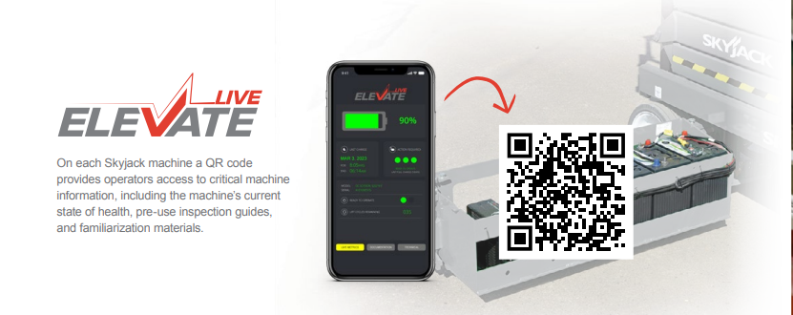
On each Skyjack machine a QR code provides operators access to critical machine information, including the machine’s current state of health, pre-use inspection guides, and familiarization materials.

Slide 14
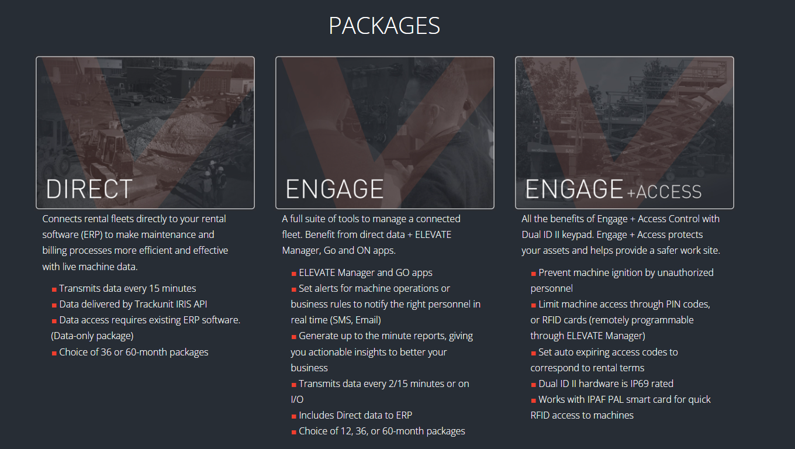
Elevate Telematics

Slide 15
Secondary Guarding Lift Enable (SGLE).
Heavy Duty Pipe Rack.
Tool Caddy.
Telematics.

Slide 16
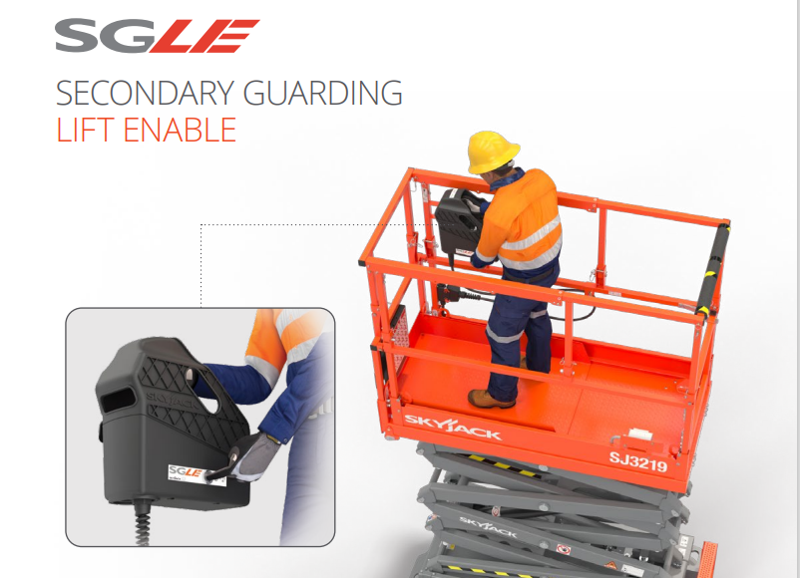
Secondary Guarding Lift Enable (SGLE).
Heavy Duty Pipe Rack.
Tool Caddy.
Telematics.
Industry groups have recently suggested possible circumstances, conditions, and operations that might result in inadvertent contact with obstructions and consequently an entrapment hazard. As a result, a form of secondary guarding is now being requested on scissor lifts and vertical mast lifts by some equipment users.
Robust control box shroud provides additional guarding of controls; reducing the risk of unintended actuation.
Two-handed operation is required to lift, maintaining the operator’s body in an upright position and away from the railings; mitigating the risk of entrapment.
Both joystick and secondary enables must be activated to allow the platform to lift; release of either will stop the function immediately.
A secondary anti-tamper enable button located on the side of the control box.
The secondary enable button is not used for lowering the platform or for driving; those functions are joystick enable only.
Available as a direct factory install or aftermarket accessory.

Slide 17
Secondary Guarding Lift Enable (SGLE).
Heavy Duty Pipe Rack.
Tool Caddy.
Telematics.

Slide 18
Options
Heavy duty pipe rack.
Independent / auto leveling outriggers.
Flashing light.
3.5 kW Hydraulic generator.
Cold weather start package (Includes hydraulic oil tank heater, battery blanket, coolant or block heater).
Positive air shut-off valve.
Bio oil.
Non-destructive testing.
Secondary Guarding Lift Enable (SGLE).
Non-marking grip lug foam-filled tires.
White noise alarm.
Diesel scrubber.
ELEVATE telematics (3-year or 5-year plans available).
Warranty options (3-year or 5-year plans available).

Slide 19
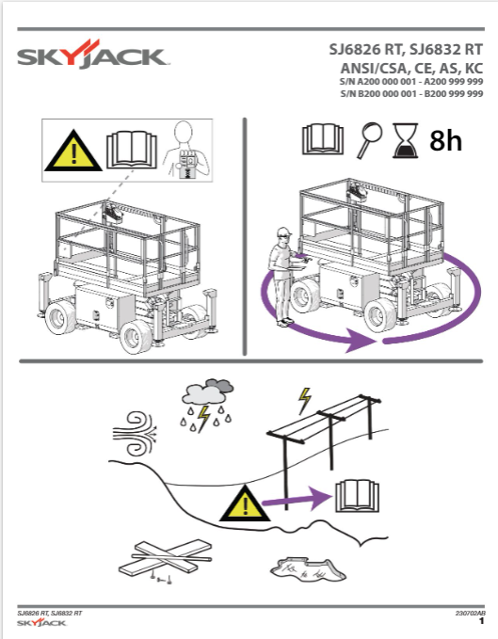
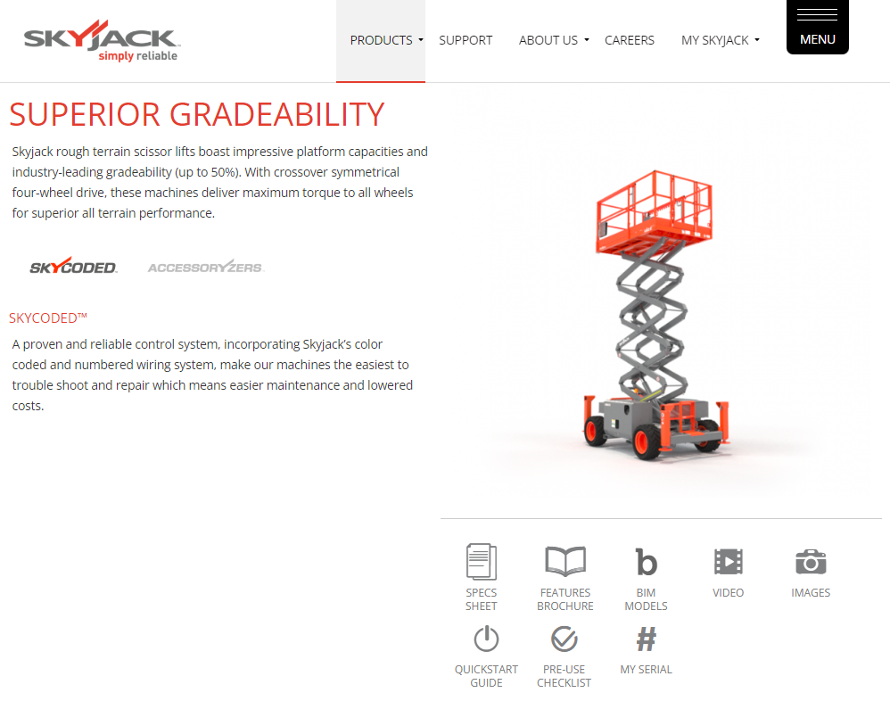
More Information
www.skyjack.com

