Slide 1
Articulating Booms

Slide 2
Skyjack proudly provides companies with quality-engineered, simple and reliable access and material handling equipment globally so they can maximize utilization and their return on investment.

Slide 3
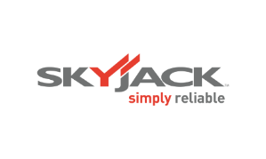
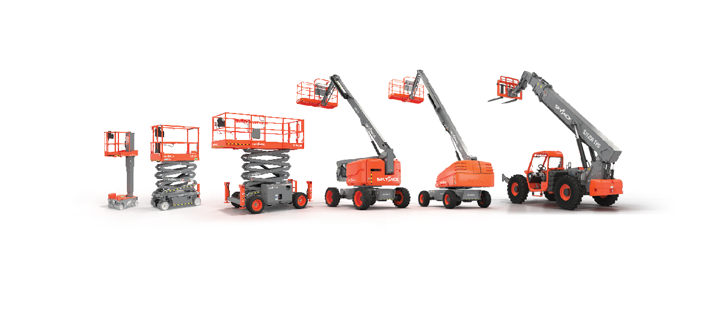
Simple, reliable products

Slide 4
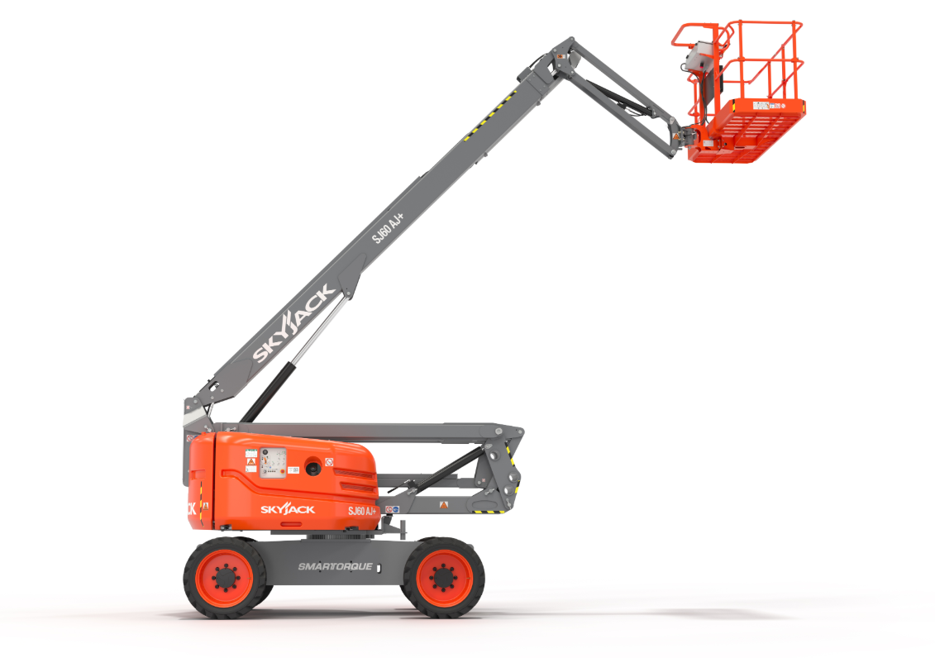
Click image for video

Slide 5
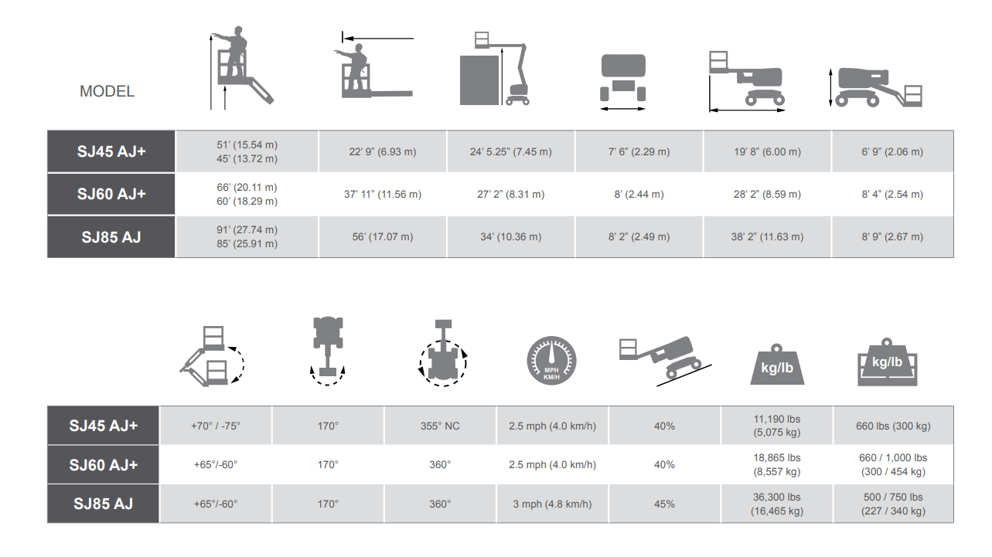

Slide 6
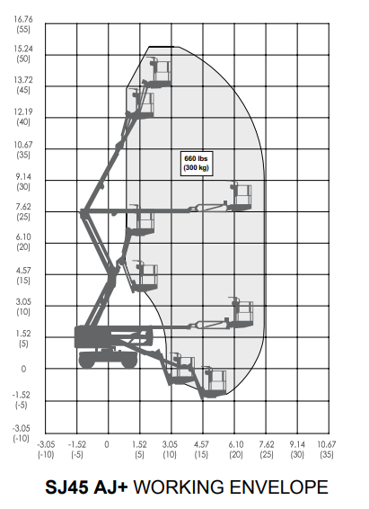

Slide 7
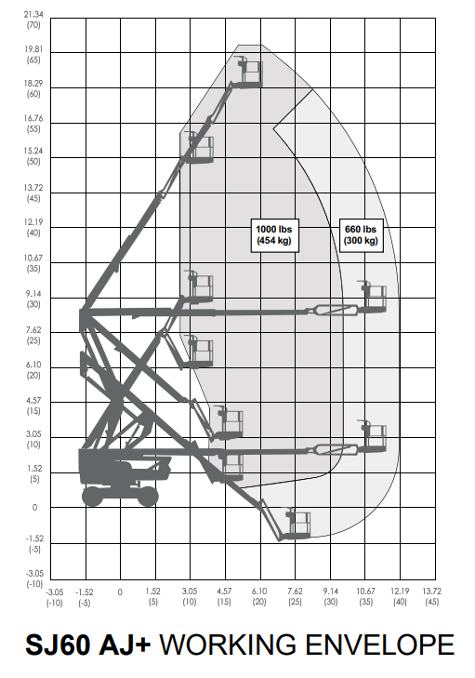
Dual Zone

Slide 8
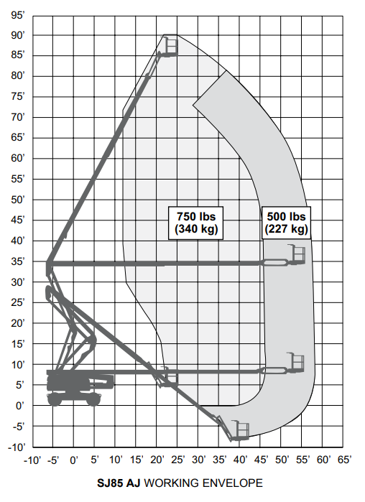
Dual Zone

Slide 9
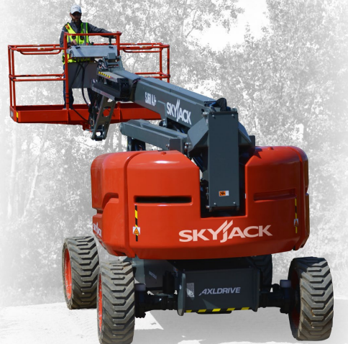
Let’s Talk Torque
An optimized balance of engine horsepower, torque, and hydraulic performance, delivers the same on-site job performance as higher-powered units - providing excellent performance with less engine horsepower.
Less emission controlling components avoids the cost associated with their complexity, as well as the time and inconvenience required in maintaining them.- powered to meet true job site performance expectation.

Slide 10
Let’s Talk Torque
Simple, straightforward service and maintenance of engines.
Avoidance of expensive emission controlling sensors.
Reduced calls to customers who have a machine down ultimately due to failed emission controlling components.
No need to monitor operators to ensure they are treating emission modules correctly.
Reduced risk of costly emission controlling component replacements or in some cases engine replacements.
Smaller engines require less fuel.

Slide 11
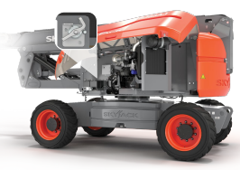
Ease of Maintenance
Designed with Ease of Maintenance in Mind
All Skyjack articulating booms are designed with ease of maintenance and service in mind.
Key components are easily accessible and all wiring is colour coded and numbered to minimise downtime.
Strategic placement of hydraulic and other components for optimum hose routing.
Lockable battery disconnect that fully disables operation.

Slide 12
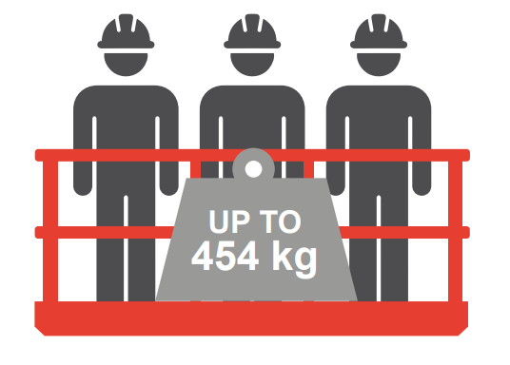
Platform Capacities
Capacities up to 1,000 lbs (454kg) and 3 People in the Platform
Increases productivity.
Higher capacities allow for fewer trips and more efficient use of time and resources.
Integrated with load sensing.
Lights on control box indicate zone…
based on weight and position.

Slide 13
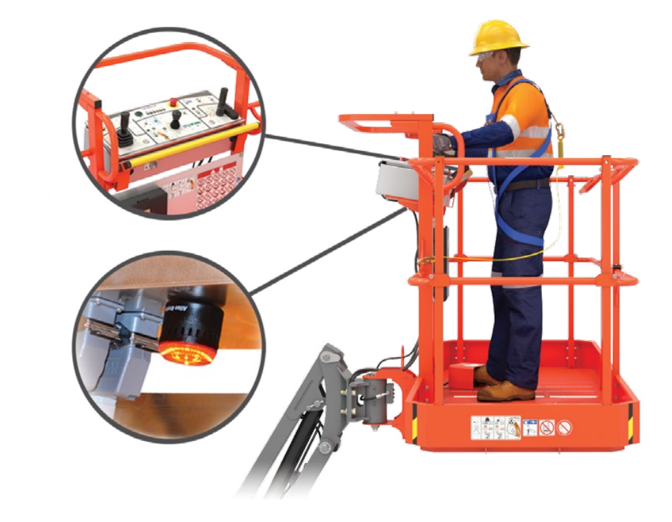
Secondary Guarding (Electrical) System Standard
Skyjack’s SGE system is intended to prevent sustained involuntary operation.
When pushed, the sensor bar instantly stops all functions and initiates an audible siren and high-intensity flashing beacon.

Slide 14
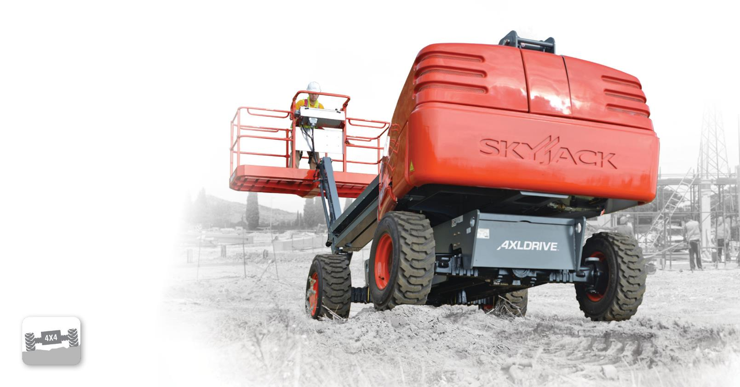
Update images and model names
True axle-based four-wheel drive gives positive traction and excellent rough ground terrainability.
Available on all engine-powered booms,
full-size RT scissors, and telehandlers

Slide 15
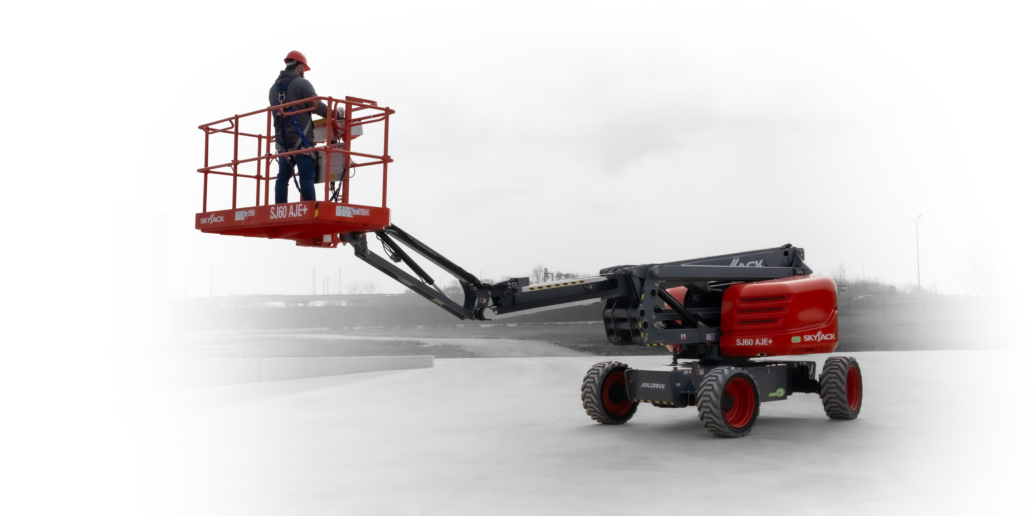
Keeps boom drive controls in the orientation of the boom regardless of position of the turret over chassis.
^{On all booms}

Slide 16
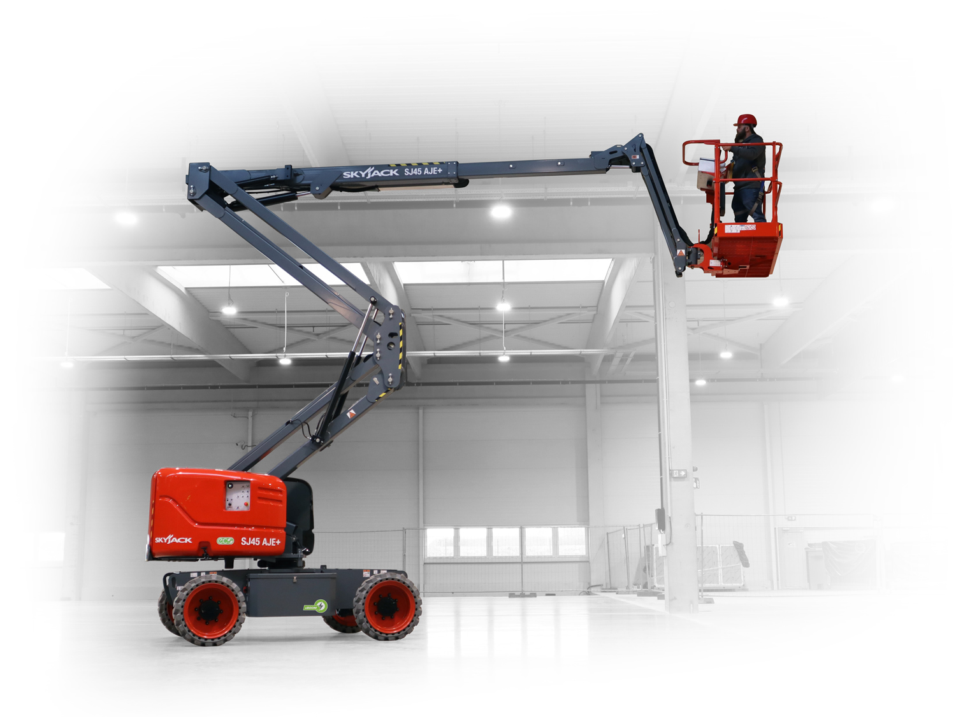
Ensures that the riser and main pivot point connecting the fly boom to the riser travel in a straight vertical line.
^{On all Articulated Booms}

Slide 17
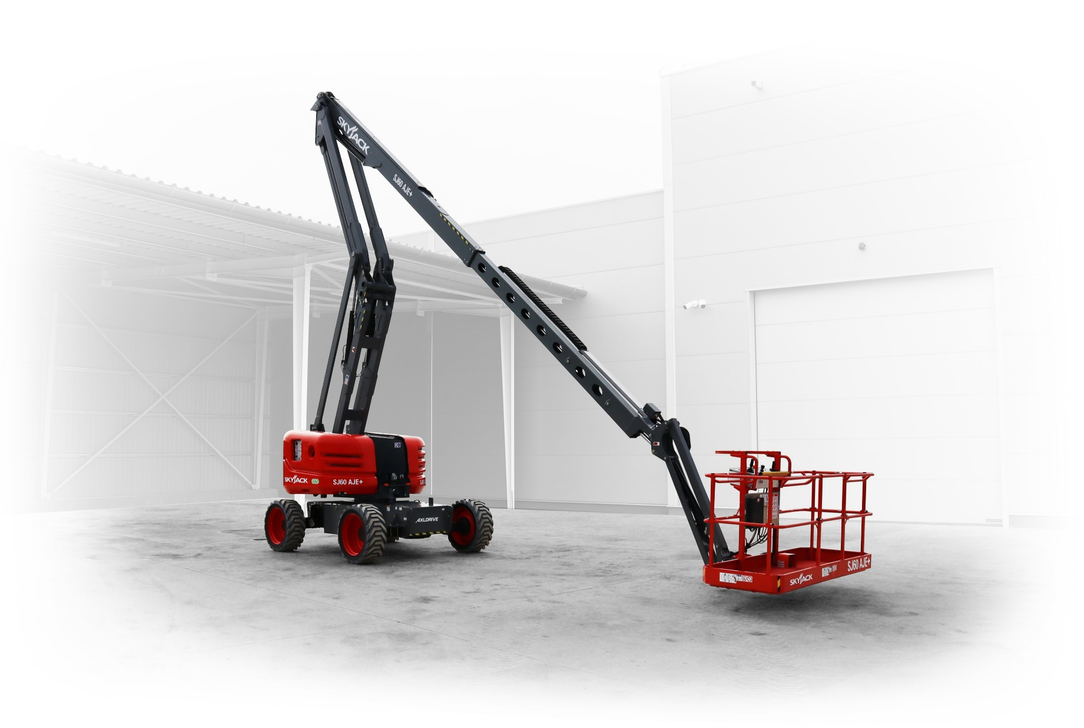
Cycles between max height and ground level quickly by engaging only the boom raise/lower function.
Available on SJ60 AJ and SJ85 AJ models

Slide 18
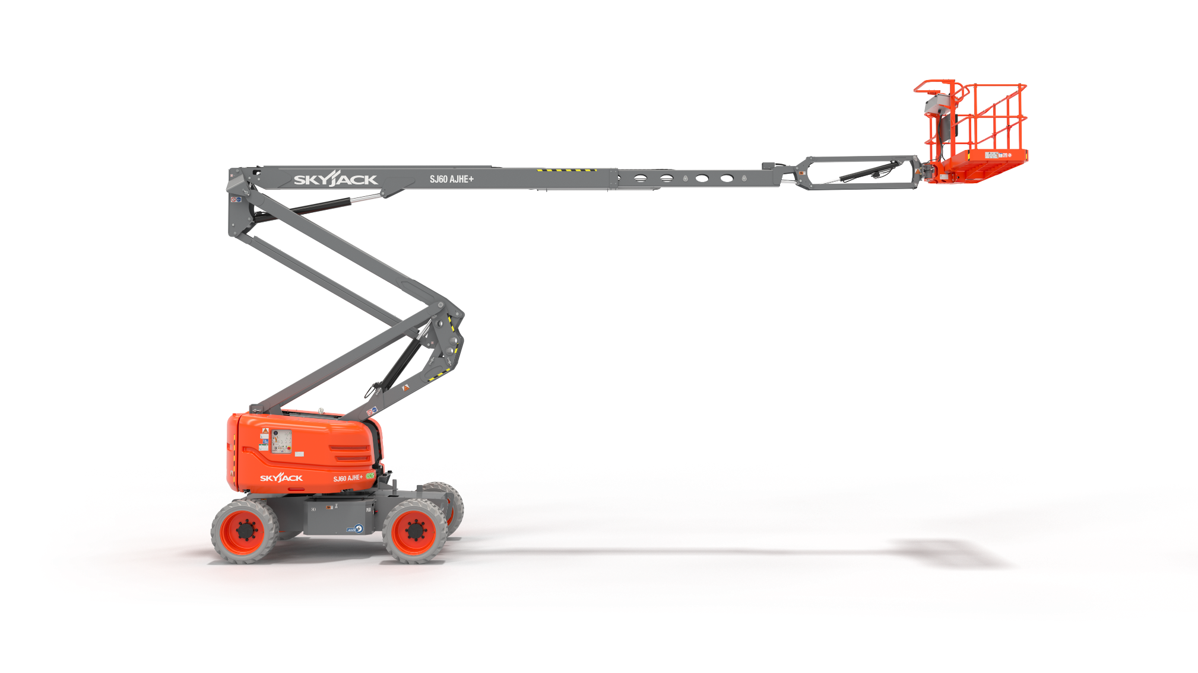
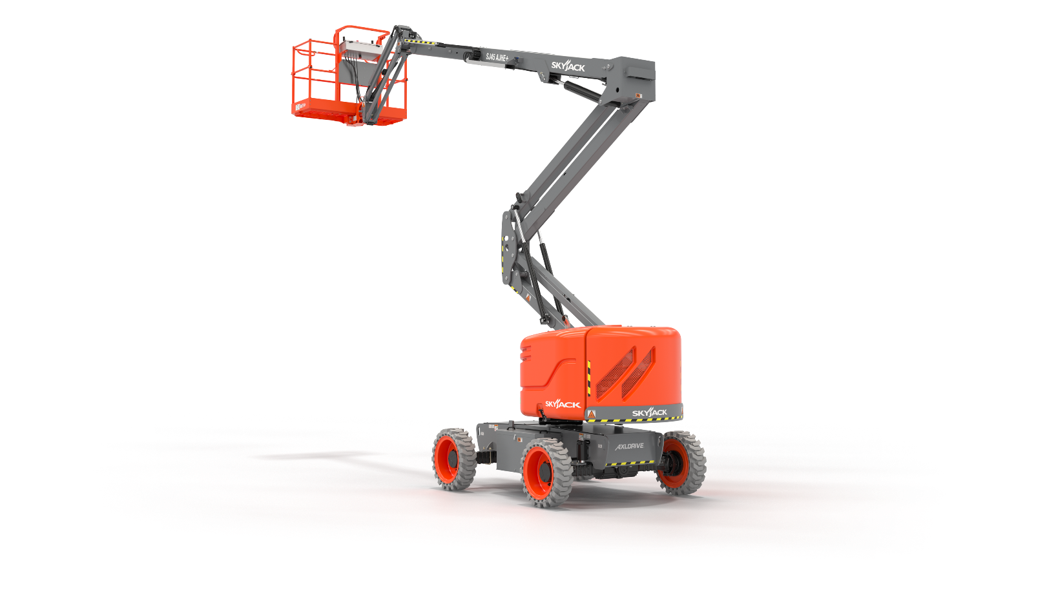

Slide 19
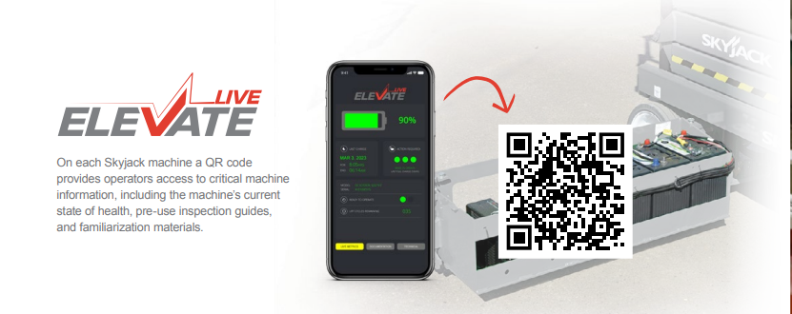
On each Skyjack machine a QR code provides operators access to critical machine information, including the machine’s current state of health, pre-use inspection guides, and familiarization materials.

Slide 20
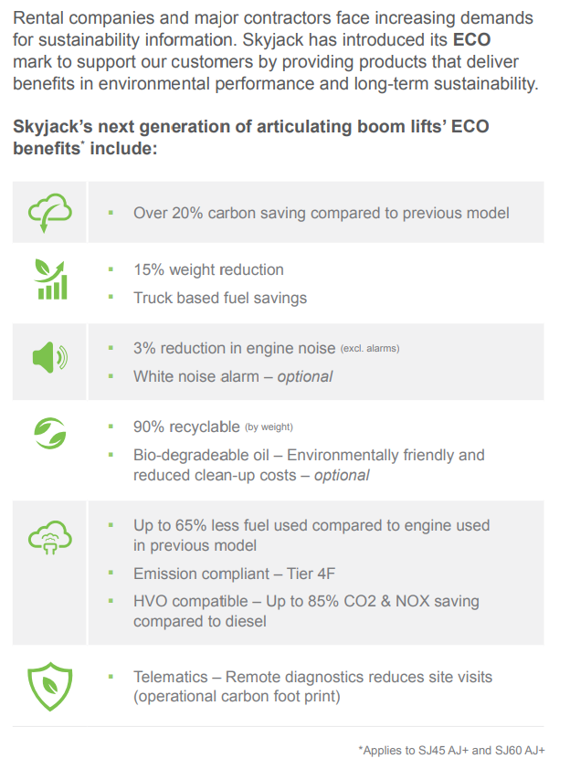

Slide 21
HVO
Helping Rental to go Carbon Neutral
HVO has been shown to reduce greenhouse gas emissions, compared to standard diesel and can help with carbon footprint reduction strategies.
When using HVO shorter maintenance intervals may be required, including replacing fuel filters and system cleaning. Since the density of EN15940 is less than EN590 diesel, when using HVO a reduction in performance may be experienced.

Slide 22
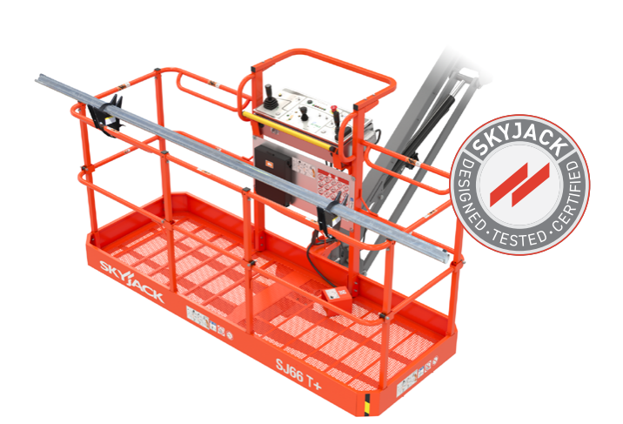
Pipe Rack
Glazer Kit
Tool Caddy

Slide 23
Options
Dual fuel engine.
Flashing light.
30 x 60” Platform.
Auxiliary top rail.
3.5 kW generator.
Welder ready package (Includes 7.5 kW generator, 3-phase power connection in platform, and welder mount)
Cold weather start kit (Recommended for regions where average monthly low temperatures can reach 14°F / -10°C (Includes cold start engine oil, battery blanket, and hydraulic tank heater).

Slide 24
Options
Arctic weather package (Recommended for regions where average monthly low temperatures can reach -0.4F / -18°C (Includes arctic engine oil, battery blanket, hydraulic tank heater, block heater, arctic hydraulic oil, and arctic gear oil in the axles and swing drive. Glow plugs, arctic hydraulic hoses (all), arctic platform rotator and oversized foot switch cover are also included (standard equipment).
Control box cover.
Diesel scrubber for sub 25hp engine.
Positive air shut-off valve (diesel only).
Bio oil.
Non-destructive testing.
Grip lug non-marking tires.
ELEVATE telematics.
White noise alarm
Turf tires (SJ45AJ+ & SJ60AJ+).
Platform Mesh.
Extended Warranty.

Slide 25
Click image for video

Slide 26
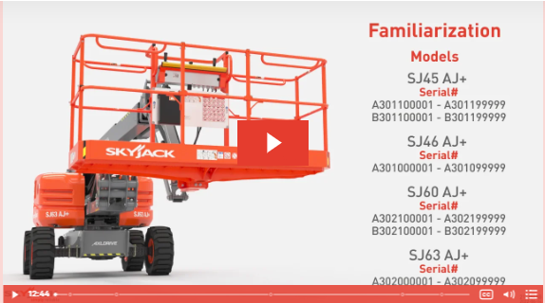
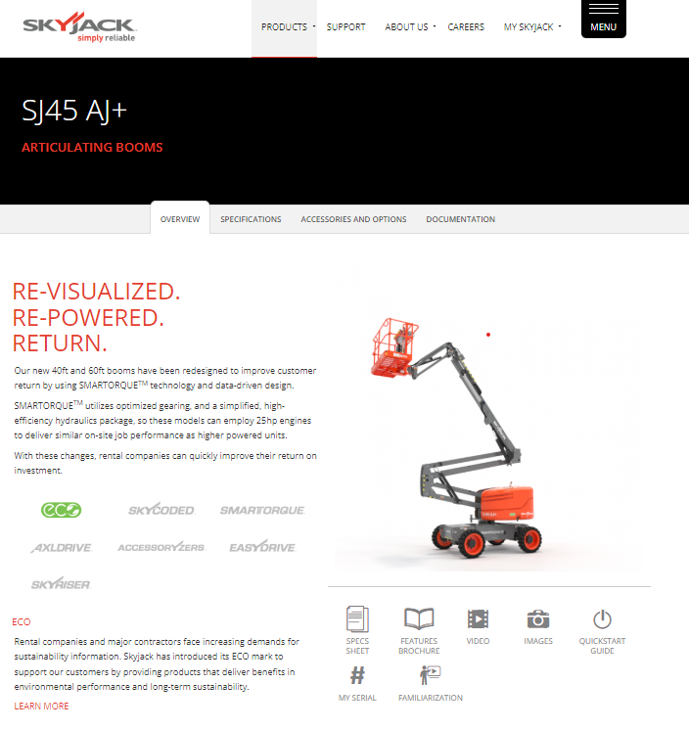
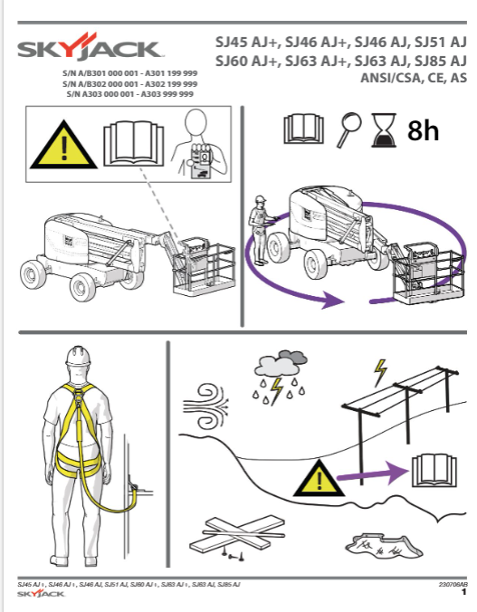
More Information
www.skyjack.com

