Slide 2
Articulating Electric Booms SJ30 ARJE

Slide 3
Skyjack proudly provides companies with quality-engineered, simple and reliable access and material handling equipment globally so they can maximize utilization and their return on investment.

Slide 4
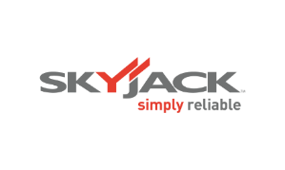
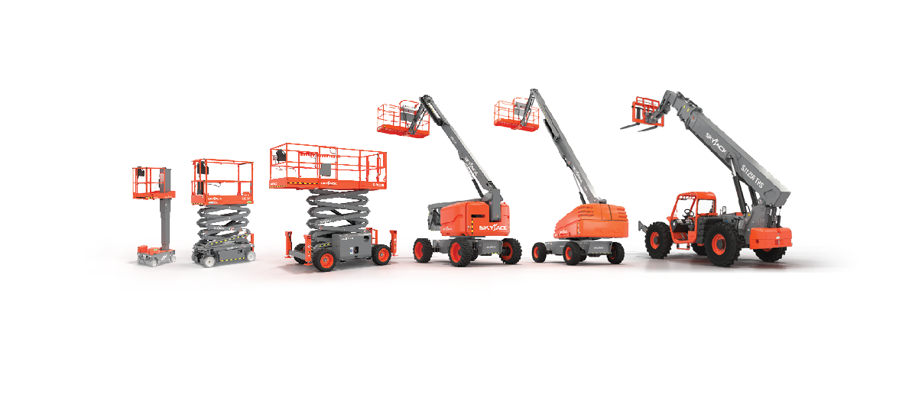
Simple, reliable products

Slide 5
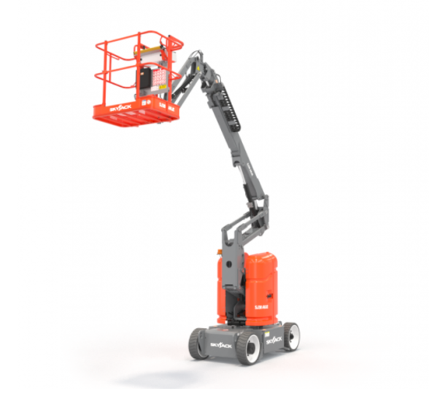

Slide 6
MORE THAN
JUST REACH
Along with offering competitive reach specifications, Skyjack’s SJ30 ARJE features exceptional drive and duty cycle performance.
Increased duty cycles maximize the amount of work possible from a fully charged machine.
Outstanding drive performance means loading trailers for transport is significantly improved.

Slide 7
MORE THAN
JUST REACH
A direct electric AC drive features two wheel motors operating in parallel to maximize gradeability and efficiency, while speed sensing traction control reduces loss of traction and tyre scrubbing.
Combining a machine weight of 5,675 kg with appropriately sized batteries, a variable speed system pump, and the utilization of gravity for riser lowering, further aids machine efficiency

Slide 8
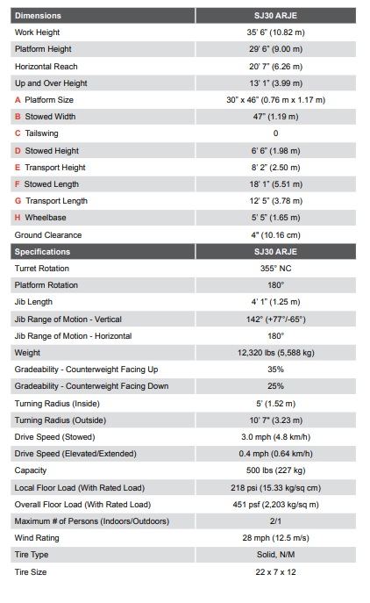
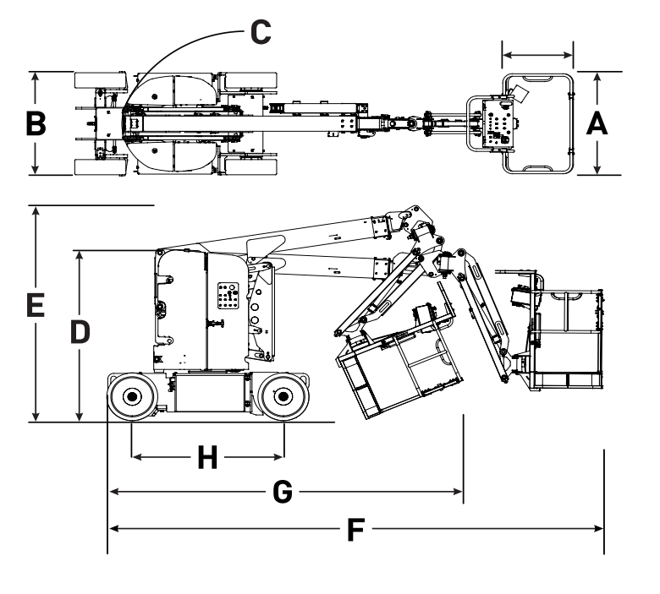

Slide 9
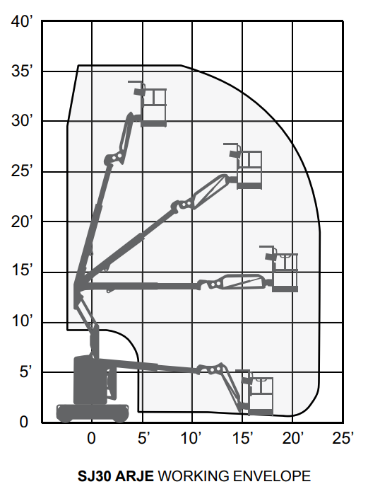

Slide 10
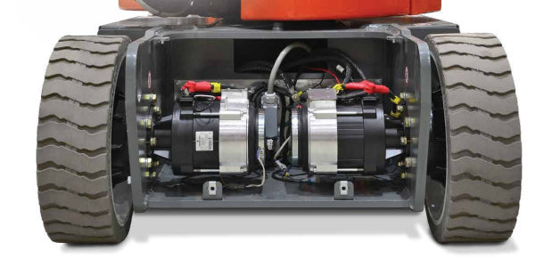
Simply Reliable
Outstanding drive performance means loading trailers for transport is significantly improved.
All components are protected whether it be from water ingress or falling debris so you know the SJ30 ARJE is fit for typical rental applications.
An optimised hydraulic system provides multi function capability for riser, boom, jib and platform rotation functions which promotes improved productivity.
Exceptional efficiency via a variable speed system pump, reduced weight, optimized battery selection and the utilization of gravity for riser lowering.

Slide 11
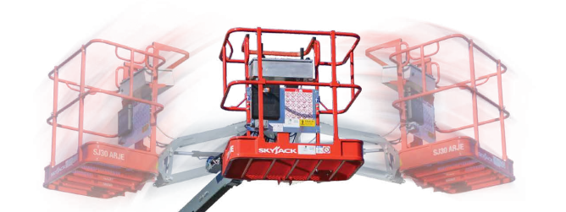
Rotating Jib
The SJ30 ARJE (Articulating Rotating Jib Electric Boom) offers a working height of 11 m, and horizontal outreach of 6.25 m. Ideal for warehouse, manufacturing and industrial settings that require up and over clearance in tight, confined spaces, the SJ30 ARJE has a width of 1.19 m and up and over clearance of 4 m.

Slide 12
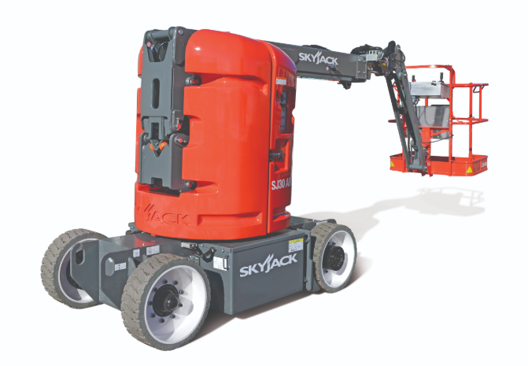
Skyjack SJ30ARJE
Direct AC electric drive.
Variable speed electric wheel motors.
35% gradeability.
Dual spring applied, electromagnetically released brakes.
Regenerative braking.
Speed and angle sensing traction control.
Direction sensing drive and steer controls.
True vertical rise.
28 mph (12.5 m/s) wind rating.
DC Powered emergency lowering.
Secondary guarding (electrical).

Slide 13
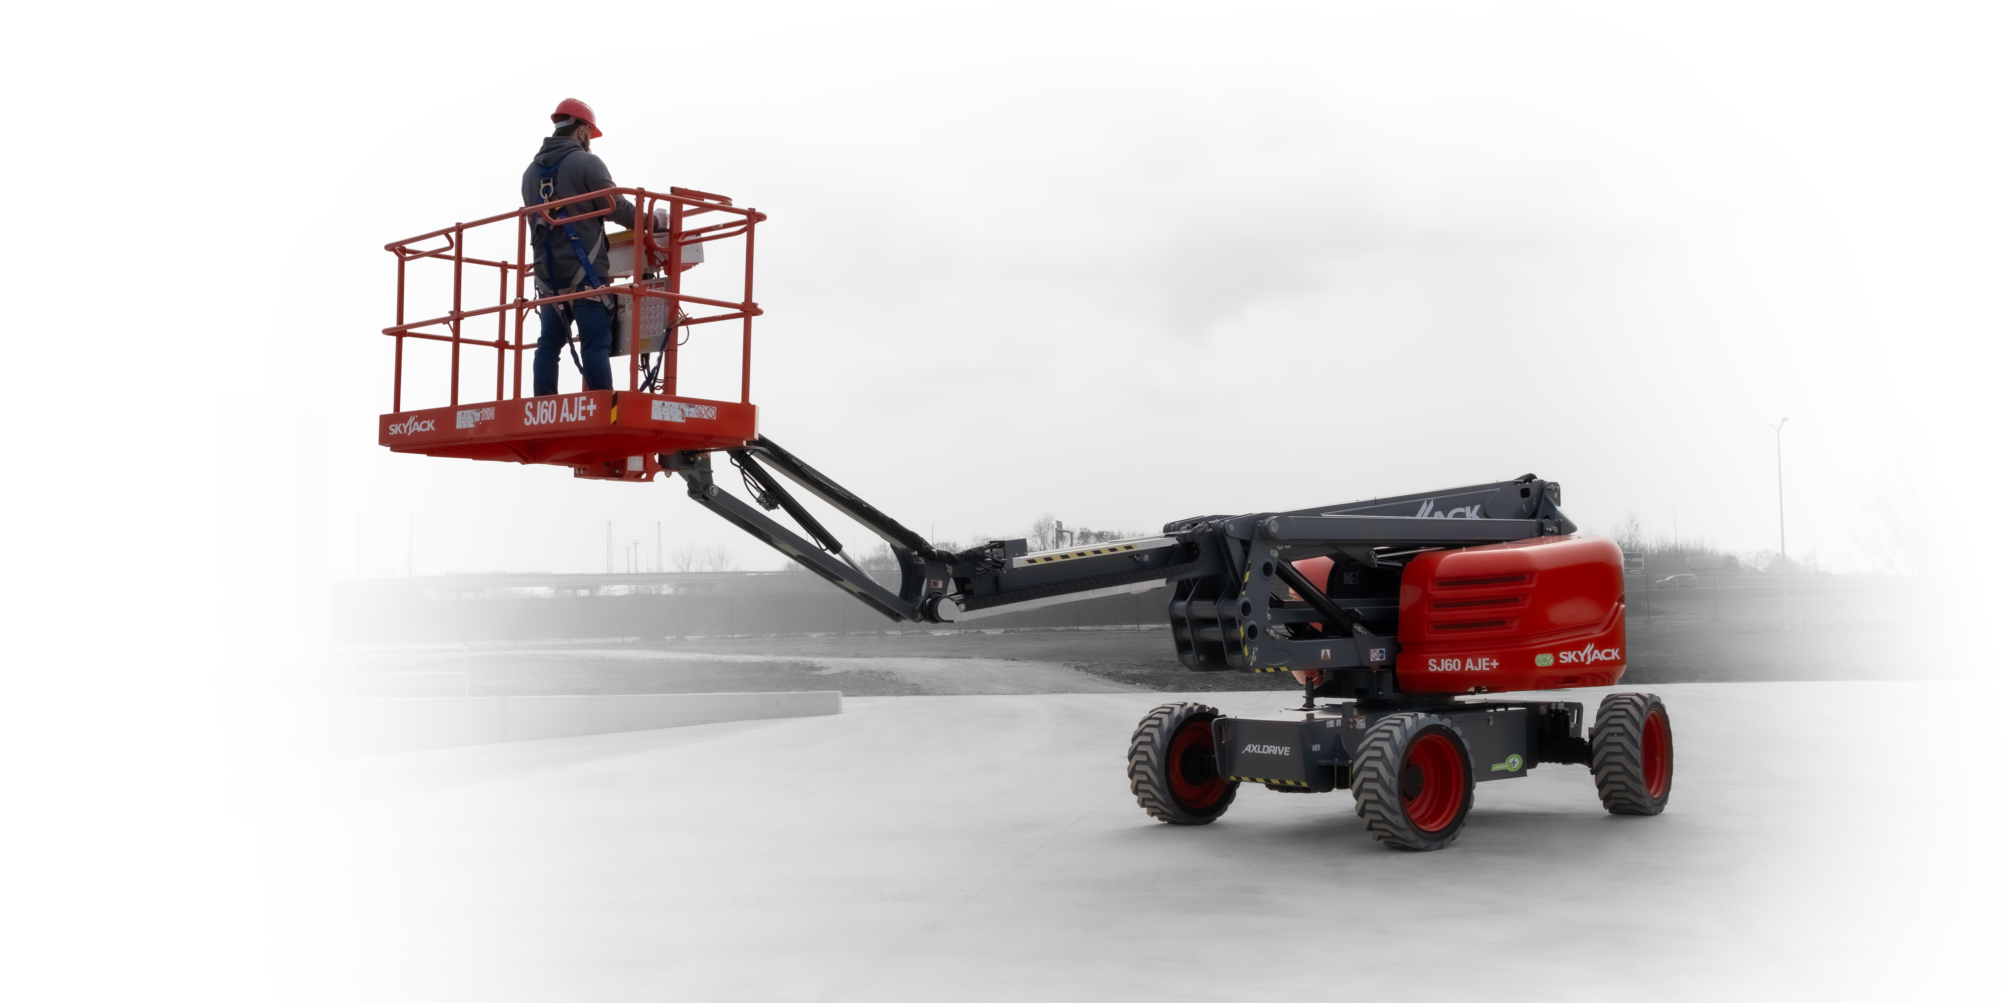
Keeps boom drive controls in the orientation of the boom regardless of position of the turret over chassis.
^{On all booms}

Slide 14
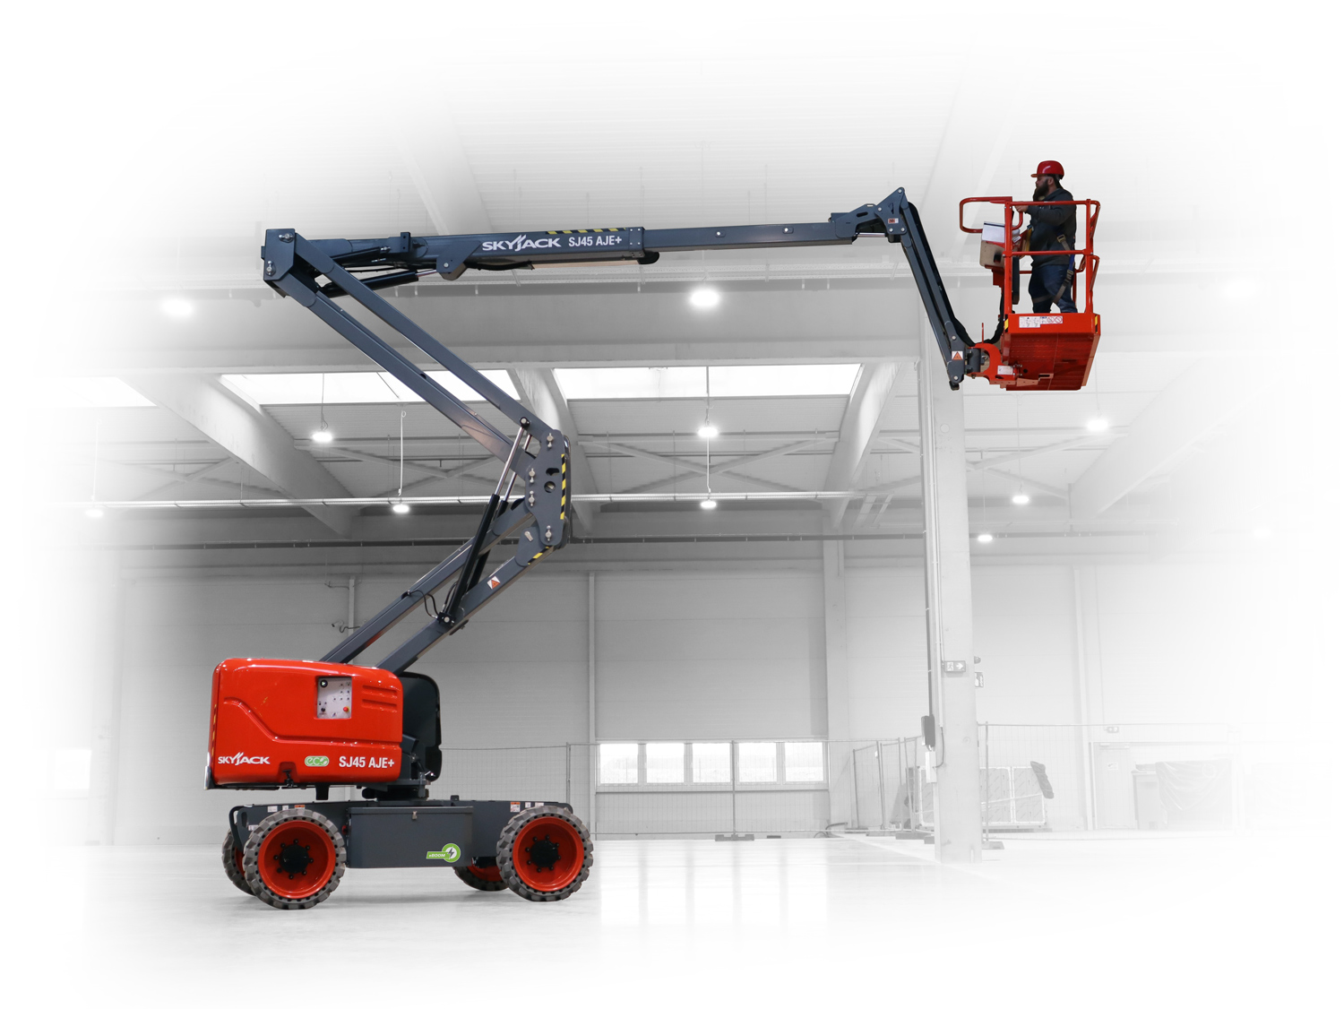
Ensures that the riser and main pivot point connecting the fly boom to the riser travel in a straight vertical line.
^{On all Articulated Booms}

Slide 15
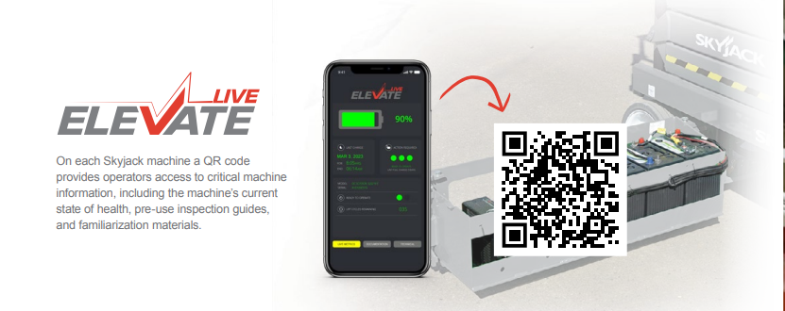
On each Skyjack machine a QR code provides operators access to critical machine information, including the machine’s current state of health, pre-use inspection guides, and familiarization materials.

Slide 16
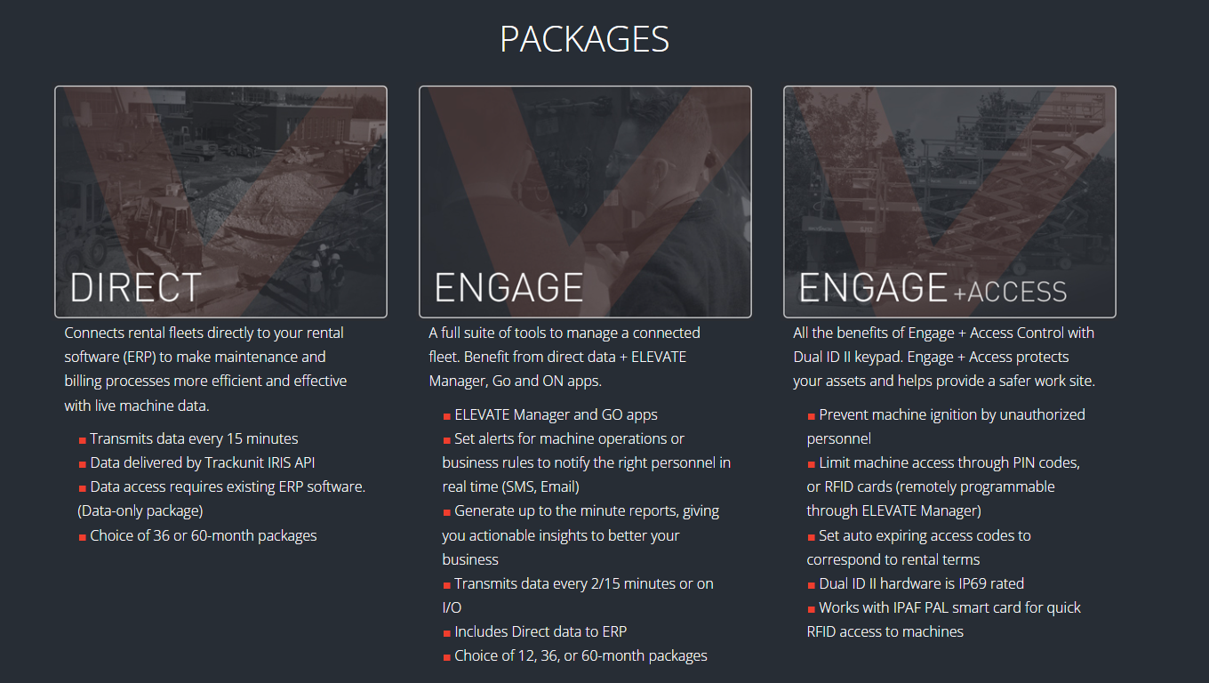
Elevate Telematics

Slide 17
Pipe Rack.
Tool Caddy.

Slide 18
Options
Flashing light.
Airline to platform.
Control box cover.
Rear spring hinged entry gate.
Bio oil.
Non-destructive Testing
Telematics.

Slide 19
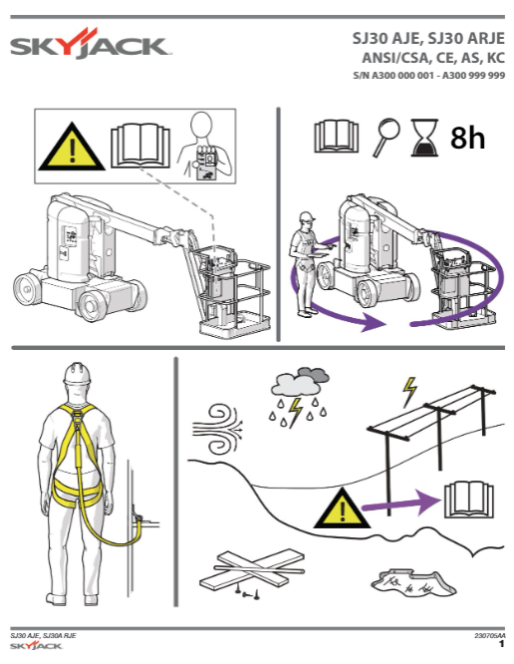
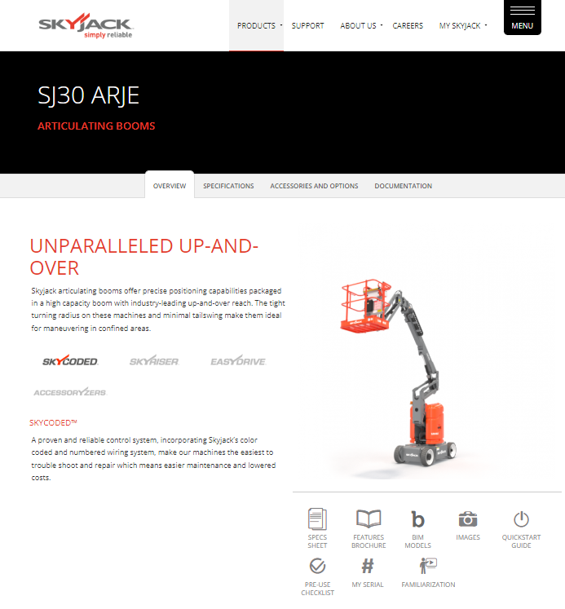
More Information
www.skyjack.com

